Slide 1

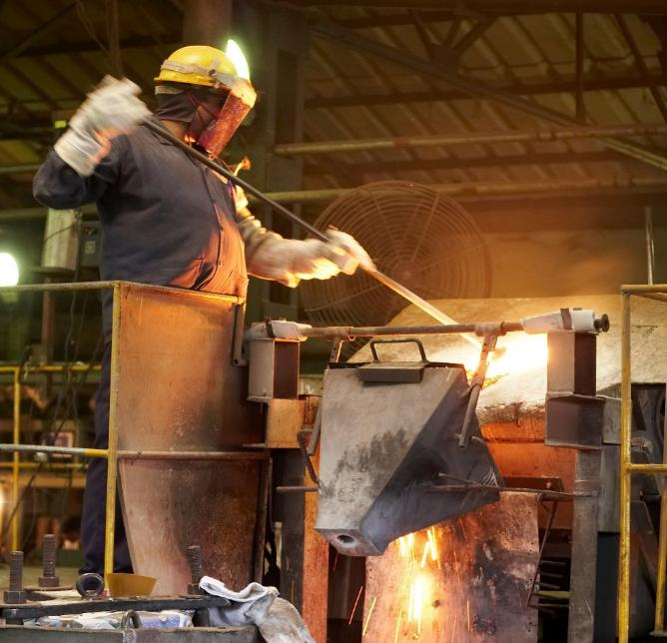
PERMANENT
MAGNETS
LIMITED
Trust. Reliability. Quality.
Information in this presentation is confidential

Slide 2
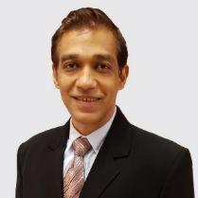
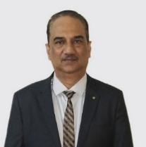
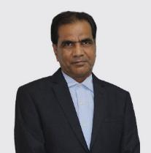
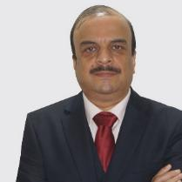
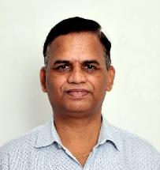
THE TEAM
Why are we the ones to solve the problem? - Team with diverse strengths
Sharad Taparia
Prabhakar Kamath
Sukhmal Jain
Girish Mahajan
Hemant Kore
Managing Director
President,
Shunt Division, Copper and Brass Parts, Magnets and Magnetic Assembly CT Division Gas Meter Parts
Sr. Vice President, Finance
Vice President, Development, New Products, Software, Systems, Metallurgy
Vice President, Alloy & Magnets

Slide 3




THE BUSINESS LEADERS
Allen D'Cunha
Ajit Vanjare
Manish Kale
Paresh Rathod
General Manager
CT Business
Deputy General Manager
Business
Deputy General Manager
Business
Deputy General Manager
Business

Slide 4

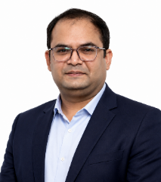

THE BUSINESS LEADERS
Shashin Rajput
Raghav Garg
Ganesh Garad
Deputy General Manager
Relay
Deputy General Manager
Shunt
Sr.Manager-Assemblies
TMPL

Slide 5

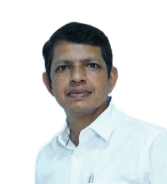
OTHER KEY PERSONNEL
Swapnil Khochare
Sunil Verma
Deputy General Manager
Quantum Magnetics
Deputy General Manager
Operations

Slide 6








PERMANENT MAGNETS LTD
Public Limited Company
Established in 1960
5+1 Locations
Listed on Bombay Stock Exchange
180+ Staff
400+ Workers
75+ Engineers
$24 Million+ revenue

Slide 7
MILESTONES
1960
PML Established: Alnico Magnet Production
2000
Magnetic Assemblies Export
2007
Shunt Division Starts: Copper Manganin Shunt Assemblies
2017
CT Division Starts: Nano Crystalline And Amorphous Components
2022
Expansion of stamping facility
2024
Inhouse Manufacturing of wound cut cores
2026
NdFeB Magnet processing starts
1983
Know How Agreement: Sumitomo Special Metals Japan
2005
Hiperm Division Starts: Soft Magnetic Parts
2016
Zamak Die Casting Process Starts
2018
Plastic Molding Process Starts
2023
Nano Ribbon Casting
Vacuum Induction
Melting
2026
Relay Division: Manufacturing of Latching relays for energy meter
2027
NdFeB Magnet inhouse manufacturing

Slide 8










CAPABILITIES
Casting
1
6
Winding
Heat treatment
2
7
Assembly
Stamping
3
8
Die casting
Plastic Molding
4
9
Metallurgy
Brazing
5
10
Riveting

Slide 9


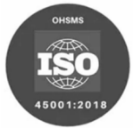


QUALITY CERTIFICATES
ISO 14001:2015
ISO 9001:2015
ISO 45001:2018
Environment
Quality System
Occupational
Health & Safety
IATF 16949:2016
AS 9100: 2016
Automotive
Aerospace

Slide 10
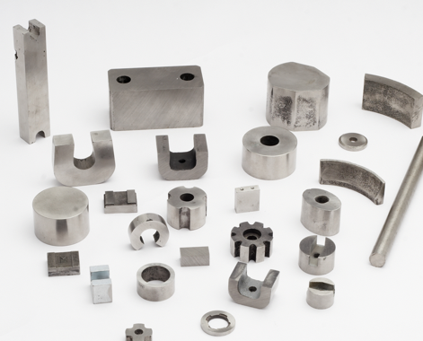
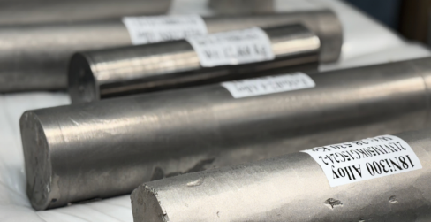
CASTING
Process
Induction melting, vacuum induction melting (VIM)
Precision casting + controlled refining
Key Capabilities
Alnico magnet manufacturing (full range of grades)
Superalloys (Ni, Co, Fe-based)
Custom alloy development
Infrastructure
Furnace capacity: 5 kg - 600 kg
Nano ribbon casting + advanced pyrometry
In-house spectrometer & testing
Key Advantages
High purity & low impurity levels
Flexible batch sizes
Strong metallurgy expertise + 60+ years experience

Slide 11
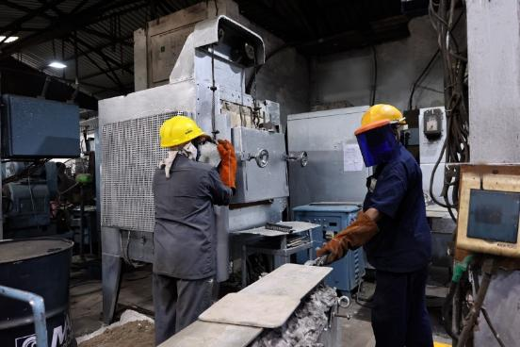
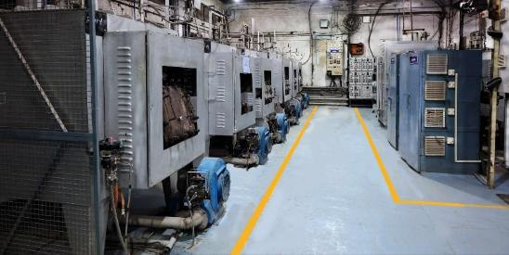
HEAT TREATMENT
Facilities
Types of Annealing
20 advanced furnaces with atmosphere control
Precision temperature control (PID systems)
Class 2–5 furnaces with high accuracy
Full data logging & traceability
In-house magnetic testing & cleaning facilities
Dry Hydrogen Annealing: Controlled heating, soaking, cooling in Hydrogen/Nitrogen atmosphere
Vacuum Annealing: Oxygen-free processing for contamination-free, uniform results
Materials Expertise
Ni-Fe, Co-Fe, Silicon Steel
Amorphous & Nano-crystalline alloys
Bi-metal and special alloys

Slide 12
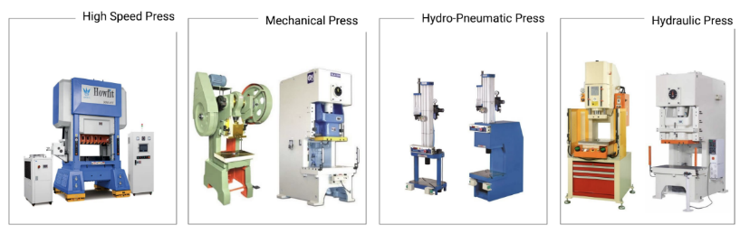
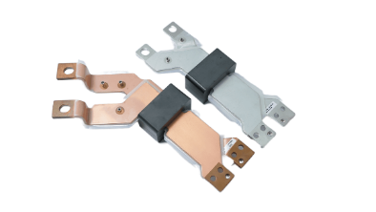
STAMPING
Process
Materials
Copper, Aluminum, SiFe, NiFe, Steel
High-speed metal stamping with integrated tooling
Stage, progressive, compound & auto-stacking dies
Output
Laminated Flux concentrators, Heatsinks, shunts, busbars, deep-drawn parts
Key Capabilities
Press range: 1T–160T
High-speed production with tight tolerances
Auto-stack technology (50+ components/min)
Facilities
Mechanical, hydraulic, hydro-pneumatic presses
Multi-slide machines + in-house tooling

Slide 13
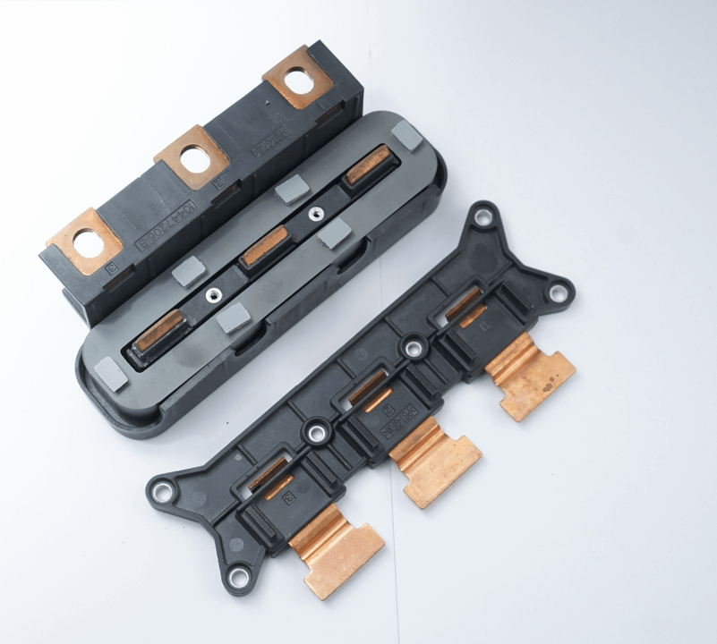
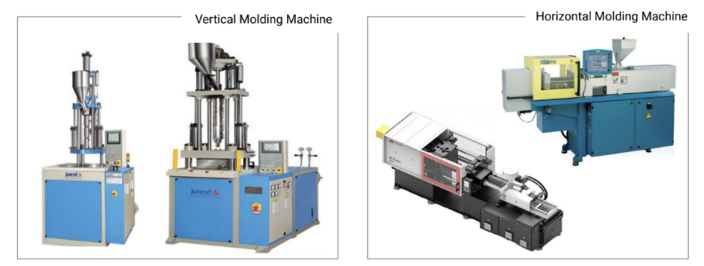
PLASTIC MOLDING
Process
Capacity
Precision plastic overmolding on metal components
Vertical & horizontal injection molding
Machines: 45T–110T
Component size: up to 120 × 120 × 30 mm
Key Capabilities
Strength
Enhances durability, functionality & aesthetics
Wide range of engineering plastics (PPS, PBT, Nylon, etc.)
Design + tooling + molding under one roof
Strong design collaboration & material selection support

Slide 14
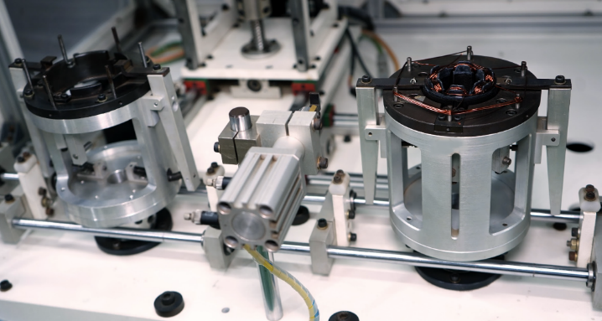
WINDING
Applications
Key Benefits
Process
BLDC motors, axial flux motors
Transformers & sensors
Improved energy efficiency
Increased component lifespan
Coil winding for electrical components
Types
Concentrated (needle)
Distributed
Toroidal
Linear

Slide 15
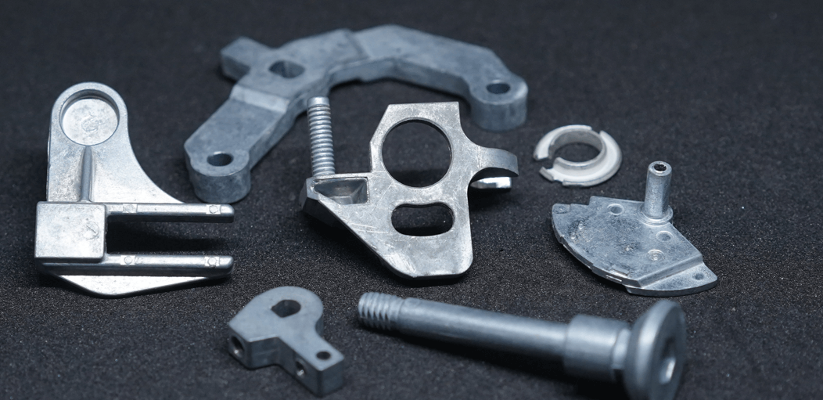
DIE CASTING
Process
Applications / Output
Multi-slide die casting (2–4 slides) using Zamak alloys
Net-shape manufacturing with minimal secondary operations
Intricate, small precision components
Tight tolerances with smooth surface finish
Facilities
Key Capabilities
In-house machines (8T–25T)
Compact tooling for improved accuracy
Capability: up to 50×50×50 mm, 40g components
High precision: ±0.001" (0.025 mm)
High-speed production: up to 14 shots/min
Reduced material waste & cost

Slide 16
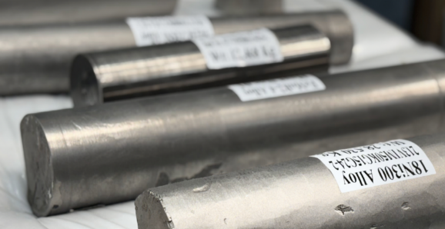
METALLURGY
Core Capability
Testing & Analysis
End-to-end metallurgical expertise in magnetic materials
Magnetic testing (hysteresis, permeability)
Chemical, microstructure & mechanical analysis
Materials
Strength
Soft & hard magnetic alloys
Ferrous & non-ferrous alloys
Strong R&D + process control + quality assurance
Key Processes
Alloy design & development
Melting, casting, heat treatment
Machining & surface treatment

Slide 17
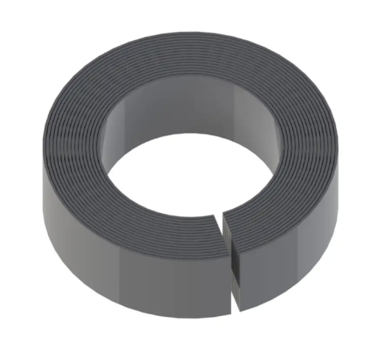
TOROIDAL & WOUND CUT CORES
Overview
Toroidal & rectangular cut cores made from Ni-Fe & Si-Fe soft magnetic alloys
Designed for high-accuracy current sensing & flux concentration
Optimized through controlled hydrogen annealing for superior magnetic performance
Key Features
High permeability & low core loss
Excellent linearity & very low hysteresis
Varnish-coated for mechanical stability & insulation
Standard strip thickness: 0.1 mm & 0.23 mm
Custom dimensions available

Slide 18
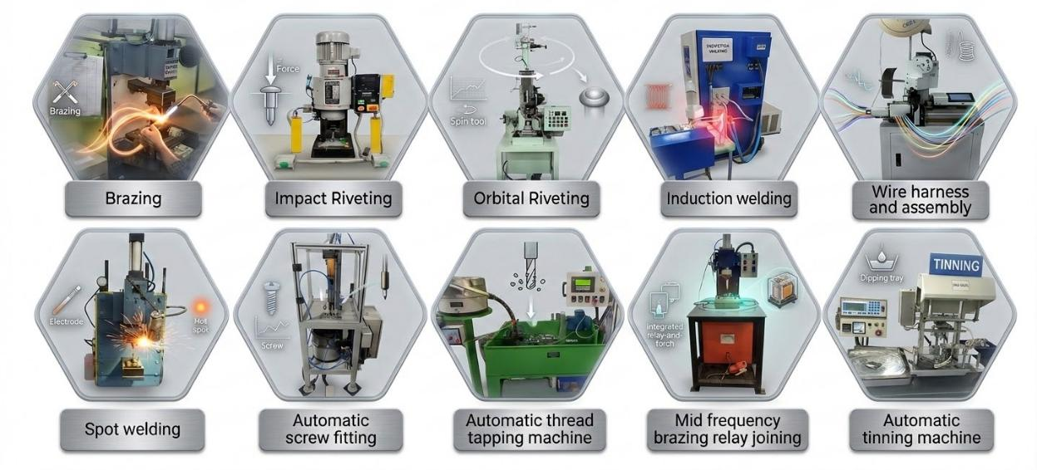
ADVANCED PRECISION MANUFACTURING

Slide 19
ASSEMBLY
Process
Key Capabilities
End-to-end assembly of electromechanical systems
Focus on current sensors & integrated systems
Automated assembly lines
Robotic pick & place + automated potting
Complete system integration
Quality
Advantages
Rigorous electrical, functional & environmental testing
Reduced lead time (one-roof manufacturing + assembly)
Improved quality control & cost efficiency

Slide 20
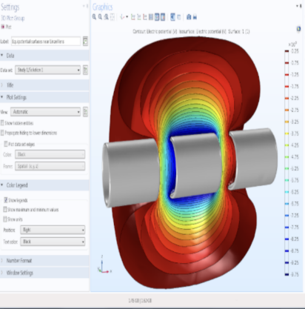
DESIGNING
Core Capability
Team
Product design leveraging magnetics & metallurgy expertise
20–30 experienced designers
Tools & Technology
Simulation: COMSOL, SolidWorks, Fusion 360
CAD/Drafting: SolidWorks, ProgeCAD
Electronics: Altium, Eagle
Key Strengths
Optimized performance + cost-to-quality ratio
Compliance with industry standards

Slide 21
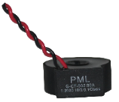

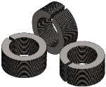
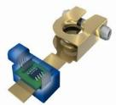
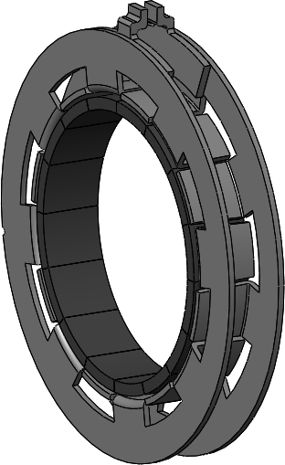
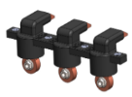

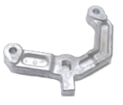
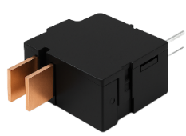
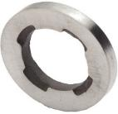
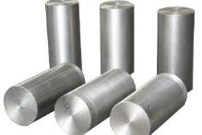
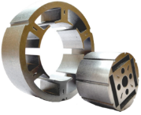
PRODUCTS
NiFe, Silicon Steel Core, Shields,
Flux Concentrators
Insert Molded parts
Copper Manganin Shunts and Assemblies
Nano Crystalline
Amorphous,
Current Transformers
And Cores
Torque Sensor
Metal stamped parts
Magnets
Zamak Alloy Castings
Special Alloys
Latching Relays
Stator Rotor

Slide 22
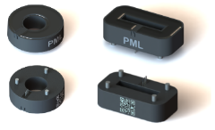

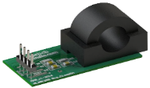

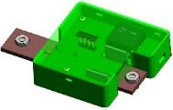
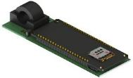
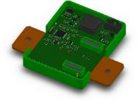

CURRENT AND VOLTAGE
SENSING MODULES
Hall Based Current Sensor
Hall Shunt Module
Shield Assembly
Clamp-on
CAN Enabled
IOT
Smart Battery Clamp
Battery Monitoring System

Slide 23
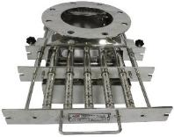
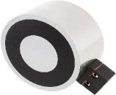
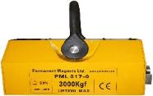
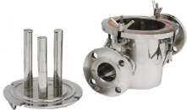
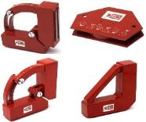
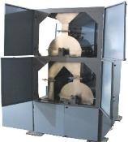
MAGNETIC ASSEMBLIES
Magnetic Grill
Mini Electromagnet
Magnetic Lifter
Magnetic Filter
Welding Clamp
Magnetic Drum Separator

Slide 24
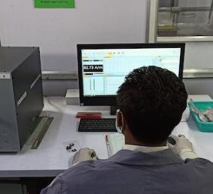
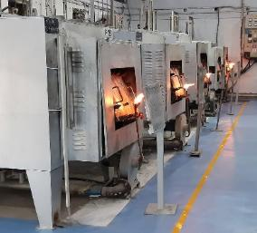
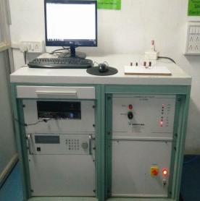
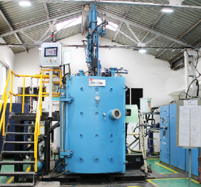
SERVICES
Designing & Prototyping
Annealing Services with Temperature mapping
(TUS, SAT) as per AMS 2750 E
Magnetic Checking
Melting services by VIM

Slide 25
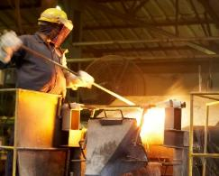
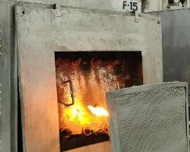






EQUIPMENT & FACILITIES
Induction Air Melting and Casting
High Temp Hydrogen Heat Treatment
High Speed Punching Press
Multi Slide Die
Casting
Toroidal Core Winding Machine
Dr. Boy Plastic Molding Machine
Vertical Injection Molding Machine
Ultrasonic Plastic Welding Machine

Slide 26







EQUIPMENT & FACILITIES
Nano Amorphous Ribbon
Casting
Vacuum Induction Melting and Casting
Metallic Molds
Optical Microscope
Vacuum Annealing
3D scanner - GOM SCAN -1
Wire Cut Machine
26

Slide 27






TESTING EQUIPMENT
AEC Q200
Spectrometer
VMM
Keyence Camera System
for Automatic Inspection
Loop Plotter
Koerzimat

Slide 28

OVERALL REVENUE GROWTH OVERVIEW
(FY 2020-29)
Expansion of Magnet Division
Expansion of Alloy, and Relay Division

Slide 29

COUNTRY WISE SALES

Slide 30

APPLICATION WISE SALE for the year 2025

Slide 31





























CUSTOMERS
Automotive
Non -Automotive
Aerospace

Slide 32
 |  | Reach us at: sales@pmlindia.com or www.pmlindia.com

