Slide 1

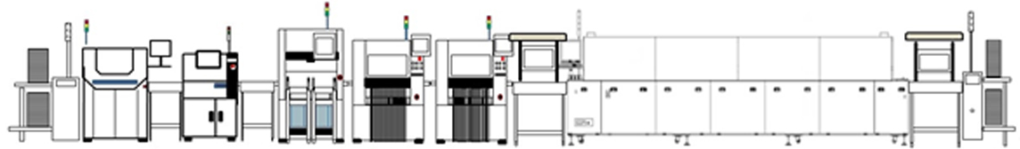

Intelizest
SUPPLY CHAIN REDEFINED

Slide 2



Driving the Entire Supply Chain
Sub Contractors
Dealers
What we DO!
Consumer
Logistics provider
Warehouses
Suppliers
OEM Manufacturer

Slide 3

















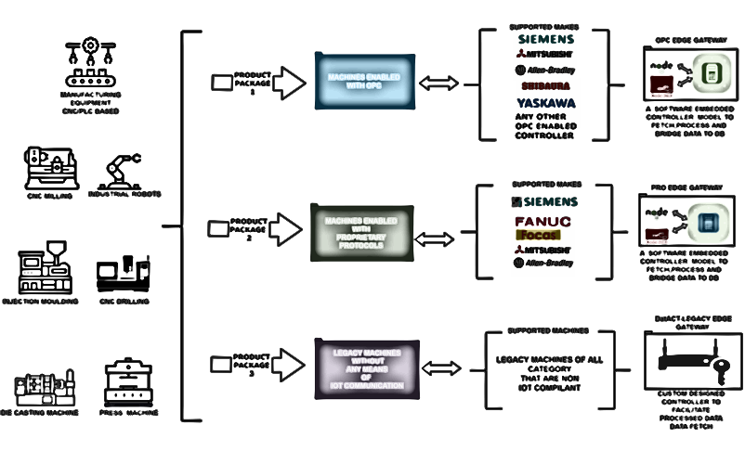

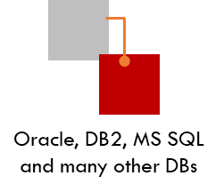


Iz Suite – Product Portfolio
Supplier
Manufacturer
Logistics
Logistics
Customer
Purchase Order (Supplier)
Goods Issue
Logistics
Warehouse (Goods Receipt)
Goods Issue to Manufacturer
Goods Issue
FG to Warehouse
Logistics
Goods Receipt (Customer)
Warehouse
Goods In
Warehouse
Goods Out
Data Visualization Application with meaningful and readily available reports covering the entire supply chain
Algorithmic decisions
Supports universal communication protocol where software – software and machine – software inter-operability has become essential
We have pre-defined communication protocols to connect with any machines or application in a short span improving the implementation efficiency
Integrated Solutions covering the entire business process
Quick to roll out with integrations
Backend Applications and Machines systems (On Premise) with necessary security firewall in place.
Machines

Slide 4

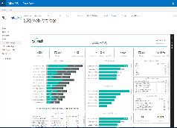
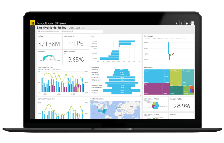

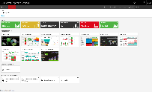
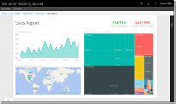







EMS – Track, Trace and Control
Only complete package in the market for fast growing EMS industry vertical with a ready to deploy version connecting with all machine model/makes ensuring seamless data connectivity.
Turbozest – Analytical application with advanced AI algorithms to provide real time insights, alerts and recommendations
Analytical Layer
Zestfloor (MES) - Supports the complete journey of Bare PCB to PCBA to Box Build. Preconfigured features include, Solder Paste Management, FAI, Sample run, Mounter Feeder programs, Interlocking based on previous stages and interlocking of conveyors.
With the ability to interface with all Machines, Test beds and ODM software we ensure the complete process traceability till the very end.
Map against every stage, serial number to BT to IMEI is available.
SMT
ASSEMBLY
PACKAGING
Zestlink – Influencing the API(LED) Connectivity
EMS
iBWMS (Warehouse Management Solution) supports the material intake. Key for Traceability is to give identity to all materials inward. Equipped with the latest technologies to support automation OCR is integrated to capture the details of inward and enable QR code printing. Also supports IQC, OQC and Put away/ Picking strategies.
WMS also supports post package (FG) products and dispatch against Sale orders.
Distributor
Rekochain (P2P) Omni-channel platform to support the procurement of all type of components. This platform is available in two models, first one being one Buyer to many suppliers on collaborative model where the supplier onboarding is at the discretion of Buyer (EMS companies).
Second one is an Omni channel platform where many EMS companies and Suppliers of all kind available making it an effective market place.
Comp Manufacturer
Comp Manufacturer

Slide 5





















MES on Industrial 5.0
Sharing Technology for a better future with automation where required, banking on the strength of Human resources making the Human to Machine collaboration a circular economy and a shared vision of leveraging technology for a better future.
Zestfloor works on the model of converging the OT and IT systems and Digital twins with the highest security compliance ensuring the safety and integrity of critical infrastructure and business operations.
Human Centric Approach – Our Products has always evolved with the intention of keeping human resources. We have consciously developed solution to support the automation process where needed thereby the gaps can be addressed without any impact to the human resource or blending the technology to the needs of the business processes.
1
Sustainable or Sustainability is also an important factor where companies want to focus and invest on applications which can help automate and take care of removing manual and paper driven processes. In addition, our applications has the Machine learning algorithms which supports in optimizing resource efficiency and minimizing waste.
2
3
Resilience – Refers to the need of the hour applications which can support strategic value chains, adaptable production volume/ capacity and flexible business processes.

Slide 6
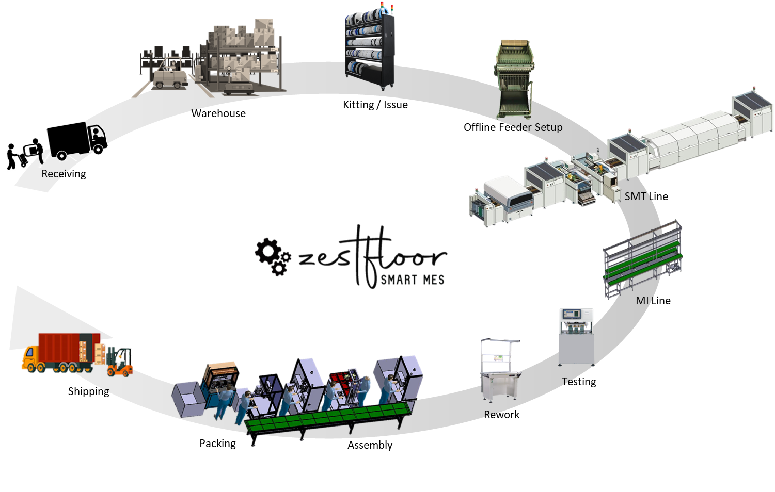
Leading EMS companies use Zestfloor for their entire journey from Material inward to Dispatch
Market Leader in Track, Trace &Control and Connectivity solutions for EMS Industries.
Zestfloor is built on Industrial 5.0 framework with automation and interlocking enabled with the support of latest technologies.
Warehouse Management
Shopfloor Management
Track, Trace & Control
Quality Management

Slide 7





Warehouse Management
Simple Warehouse Configuration starting from,
Warehouse Layout (Virtual Plotting)
Storage Sections
Storage positioning
Storage Types
Strategies at Storage Bins.
Master Data Setup
Handling Equipment
Vehicles
Inward
Operations
Outward
Goods Receipt Optimization
Gate Entry/Out Pass Management
Dock Management
Inward modules with OCR AI for supplier labels
Unique number generation & label printing
QR/Bar Code can be generated capturing batch/serial Management/shelf-life/Expiry dates
Batch Management and Serial numbers
Receive by Alternate UoM
Internal Quality Check (IQC)
Direct Receipt from Production – FG and Excess Material Returns
Inline rejection returns
Auto Bin Determination based on Put-away strategy
Integration with other systems (ERP)
Auto Put-away and Picker Assignment
Kit to stock, BoM Management
Returnable gate pass
Inward adjustment, Store return
Bin to Bin transfer, Internal/external warehouse transfers
Scrap/Waste Handling, Expiry Item Transfer
Material availability report for production & dispatch
Seamless tracking at Product/Carton and Pallet/ Rack level.
Inventory management
Processing forms
Stock audit (perpetual/annual) - On-demand stock taking, Inventory cycle count, Stock consolidation
Visibility into Warehouse operations and Queue
Necessary alerts and notification to stake holders
Material request
Auto Bin Determination based on Picking strategy - (FIFO/FMFO/FEFO/MTO)
Consolidation of Picking / Pick Slip
Issuance, FG receipt, consumption
Picking, Staging / Verification & Packing
Kit to Production Order
Pick by Cart, Production Supply (JIT)
Delivery Management & Consolidation
FG dispatch process
Carton packing, palletization
Packaging specifications
Packing Slips & Documents
TMS module with driver app & route optimization
Shipment tracking – Last Mile Delivery
Enhanced Labour management
Notes:
iBWMS uses Virtual plotting of the warehouse – Digital blueprint of the entire warehouse is mapped and the physical characteristics are captured, like bins rows, aisles and rack, doors.
All the movement of goods in the warehouse, are digitally captured in the system. This will give transactional visibility.
80 to 90% of the standard operations are covered. We have grouped various processes and functionality into 3 modules Inward, Operations and Outward
Inward
Covers goods receipt optimization of the goods receipt process - iBWMS integration is done with Client’s ERP system
With the help of machine learning algorithm running in the background, based on the parameters set, the system identifies the storage bins/racks where the item needs to be placed at
This will also help the operators put the items in the right bins (they would get an update on the mobile app on where the item need be binned)
Once the items are placed, the binning activity is updated using the mobile app which in turn will get updated in this system.
We also cover dock and yard management.
Operations
Covers activities inside the warehouse, like bin to bin transfer, internal warehouse transfer between multiple warehouses.
Managing the goods, based on batch or serial number,
Cycle Count Activities
Batch Management, Packaging specifications
Stock reconciliation, Inventory Management
Activities required to be performed will be delivered to the operators in the form of notification on a daily or weekly basis.
Outward
Delivery management is handled – bin determination for picking
Handle picking, packing, staging, kit to order
Goods Issue and outward automation through IoT devices
Route determination and optimization
Cross docking can be done according to customers or zones or spaces are on delivery date.
The system can also do a good issue based on the container size like whether it's going to be a 20 feet, or 40 feet container.
This system has a level of intelligence built in when an item is bought into the warehouse. Automatic bin determination is done based on various parameters where this item needs to be placed based on the nature of the product. If it needs to be placed in room temperature or in cold storage, or is it a hazardous product. Is it a fast moving or slow moving product. fast moving products are kept closer to the aisle, or within the reach, slow moving products are kept on the highest shelves, various parameters are confirmed before allocating storage for an item. This system does not stop with identifying the storage bins alone but also assigning a handling unit, Like a trolley, or a forklift. So this will allocate a individual or a handling unit for the put away activity. There are two native mobile apps, one for the warehouse operator, and other for drivers. If a person is being assigned a notification would be triggered in his mobile app, where they need to go for that activity and what Handling Unit would they need for this activity. This is where bridging of operations to the system takes place.
On confirming the placing of the goods in the bins in the mobile app. The system is directly updated with the updated inventory.

Slide 8
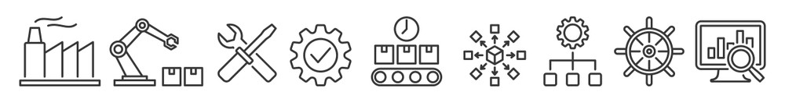


Pre SMT & SMT Line
MI / Assembly Line
Packaging Line
Inventory tracking of Components at each stage of Issue
Kitting Control (follows the FIFO/ FEFO strategy) - WMS integration for material issue validation
Setup Verification, Validation and Process control
FAI to all quality parameters with approvals.
Material issue check before loading
Solder paste Management with alerts & multi-job transfer
Feeder & mounter program data accuracy
Tool Management - Stencil, squeegee tracking
MSD Control
Integration Protocols with all Machine Makes including ICT, RF, Routers and other Machines.
Machine ↔ Application ↔ Machine - SMT validations: PCBA baking, IC programming, solder paste exposure, PCB cleaning & laser etching (inline/offline)
Conveyor stop via PLC
X-Ray counter
Routing with approval workflows.
Multiple routings per model
WIP Inventory tracking at each stage giving real time inventory.
Integrated with MI/ AI line to support the process through PTH and WSM machines for tracking including wave pallet count & tracking.
MI, PTH interlock with SMT completion
Integration with ODM/ OEM machines/ systems to get the throughput for seamless interlock at every process
Functional testing machine integrations (BT, RF, ATE/ATS) - extract data from Bluetooth testing machines, IMEI, MAC, SN verification
Functional testing interlocks
Housing & label printing
Label Setup
Dynamic label generation using PRN/Bartender
Labels for SFG, FG, housing, cartons, bins
FG packing label prints
Adaptable to customer-specific label type
Weighing machine integration
Weight checks at all applicable stations
Customer serial number mapping & traceability
Mono, carton/bin, and pallet packing
Integrate with Label printers and scanners.
Generation of labels against GB/ Carton/ Pallets and movement to Warehouse (Dispatch) against Delivery.

Slide 9
Work Order Management
BoM, PCBA, Firmware & Routing Management
Quality Module
Configurable work order types: Standard, Dismantle, RMA, Others
Serial Number ID generation & upload against Work Order
Work Order-specific BoM pulled from ERP
Aging forecasting, line-wise tracking
Manual close, Cancel, Hold features
Order swapping
Operation/job order-based scanning
Serial number comparison across stations
Line change during production for running job orders
Standard BoM with alternate items, sub-assembly station mapping, and workflow approvals
Routing by Standard / Platform / Model with approval workflows.
Multiple routings per model
Quality order with specific routing
RMA process with dynamic routings
Detailed Quality module to capture the testing (100% sampling or Random sampling with respect to time or quantity) is supported.
Quality check sheets with approval flows
Inline/process rejections with ERP postings
Dismantle process with reset part, RM, scrap approvals
Sampling rules by operation, model, WO, time
Random sampling, X-ray, LQC, FQC, OQC, EOLA & PDI
Hold/release setup
Dust, temperature & humidity updates
Status control panel for quality holds/releases
Rework Module
Retest count for ICT, FCT
Rework count for all testing stages
TRC visual inspection & operator assignment
Material replacement requests
Rework & rejection traceability
Serial number reset & unbind option
Serial Number Management
Serial Number Generation (internal/external)
Serial Number rule (ID/Track ID) for PCBA & FG
Carton, pallet, shipment & packing rules
MAC ID & IMEI generation
Customer serial number mapping & traceability

Slide 10
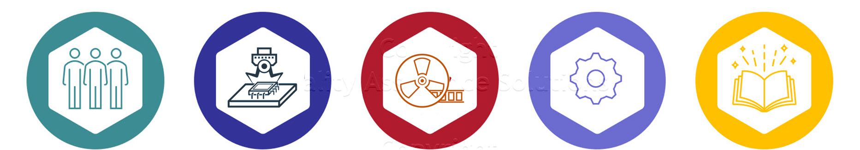
Traceability
Material
Manpower
Material Tracking with
  Unique ID, Part Number
  Supplier, Lot & Date Codes
  MSD Information
Method / Procedure
Operator Name/ID
Each Operation’s Start & End Date/Time
  Product & Work Order
  Line Details
  Machine / Workstation ID
Machine
Tools & Consumables
All process records directly from machines
Trace from material info (e.g., lot code, reel ID) to find units produced
Tools used on machines
Specific tools
Life Cycle Management – No. of Strokes
Cleaning Process

Slide 11





Complete Automation
Interlocking at every possible stage right from SMT to Assembly eliminating the possibility of defect boards to move down the line. Use of PLC automation to STOP the conveyor in case of anomaly either in materials, machines or processes.
OCR enablement supports and makes life easier where the majority of companies have challenges since none of ERPs or any application captures critical data like MPN, Mfg. date and LOT number. It also saves $$ by avoid buying Machines.
Interlock
OCR
Ability to integrate all Model and Make of Machines in SMT, Assembly and Testing Lines. We also provide the option of having all done in our application saving you the cost of licenses but still provide all the features expected.
Machine Data
Complete automation of traceability end to end including WIP tracking and Handling nit where the SMT or boards that are completed with processes are stocked.
Process and Part traceability Automation.
Traceability

Slide 12





















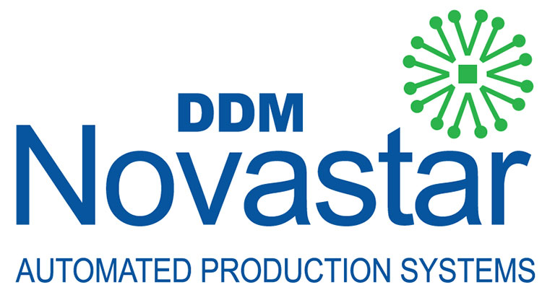





















Influencing the API(led) Connectivity
Zestlink Machine Connectors
Experience Protocol Agnostic Connectors
(Purpose-built APIs for SMT Machines, Assembly Testing Machines (Client/ OEM/ ODM), Bluetooth Machines Others)
API Framework
Process
(Orchestration, Composable APIs)
Zestlink Application connector
System
(Legacy Modernization, Connectivity to SaaS Apps, Web Services & Restful APIs)
Client IT Systems

Slide 13
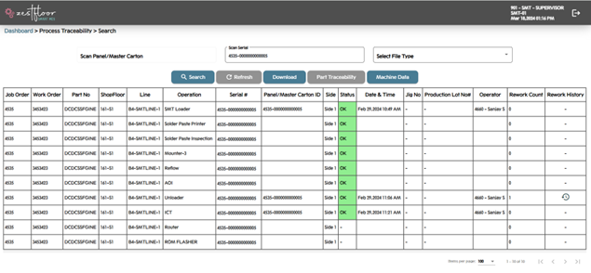

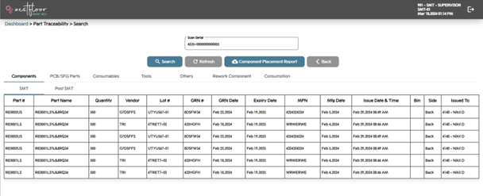

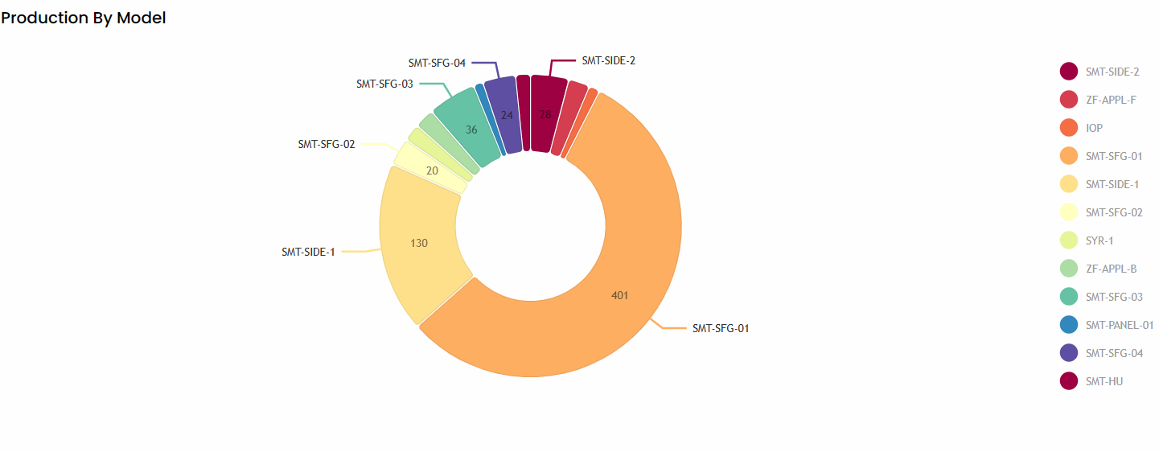
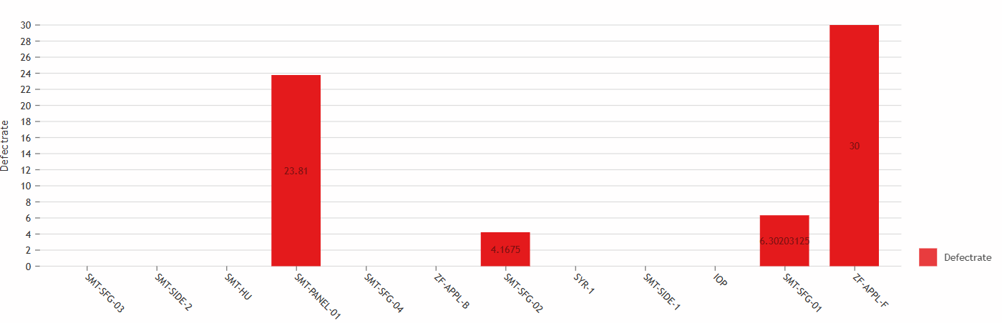
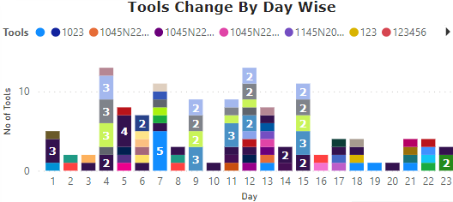
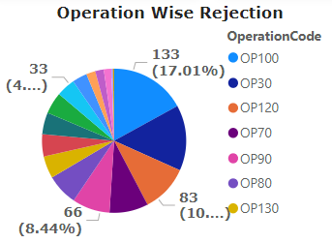
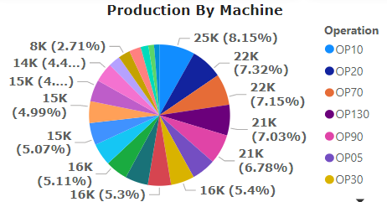
Analytical Insights
Part Traceability
Process Traceability
Production by Model
Defect by Model

Slide 14


































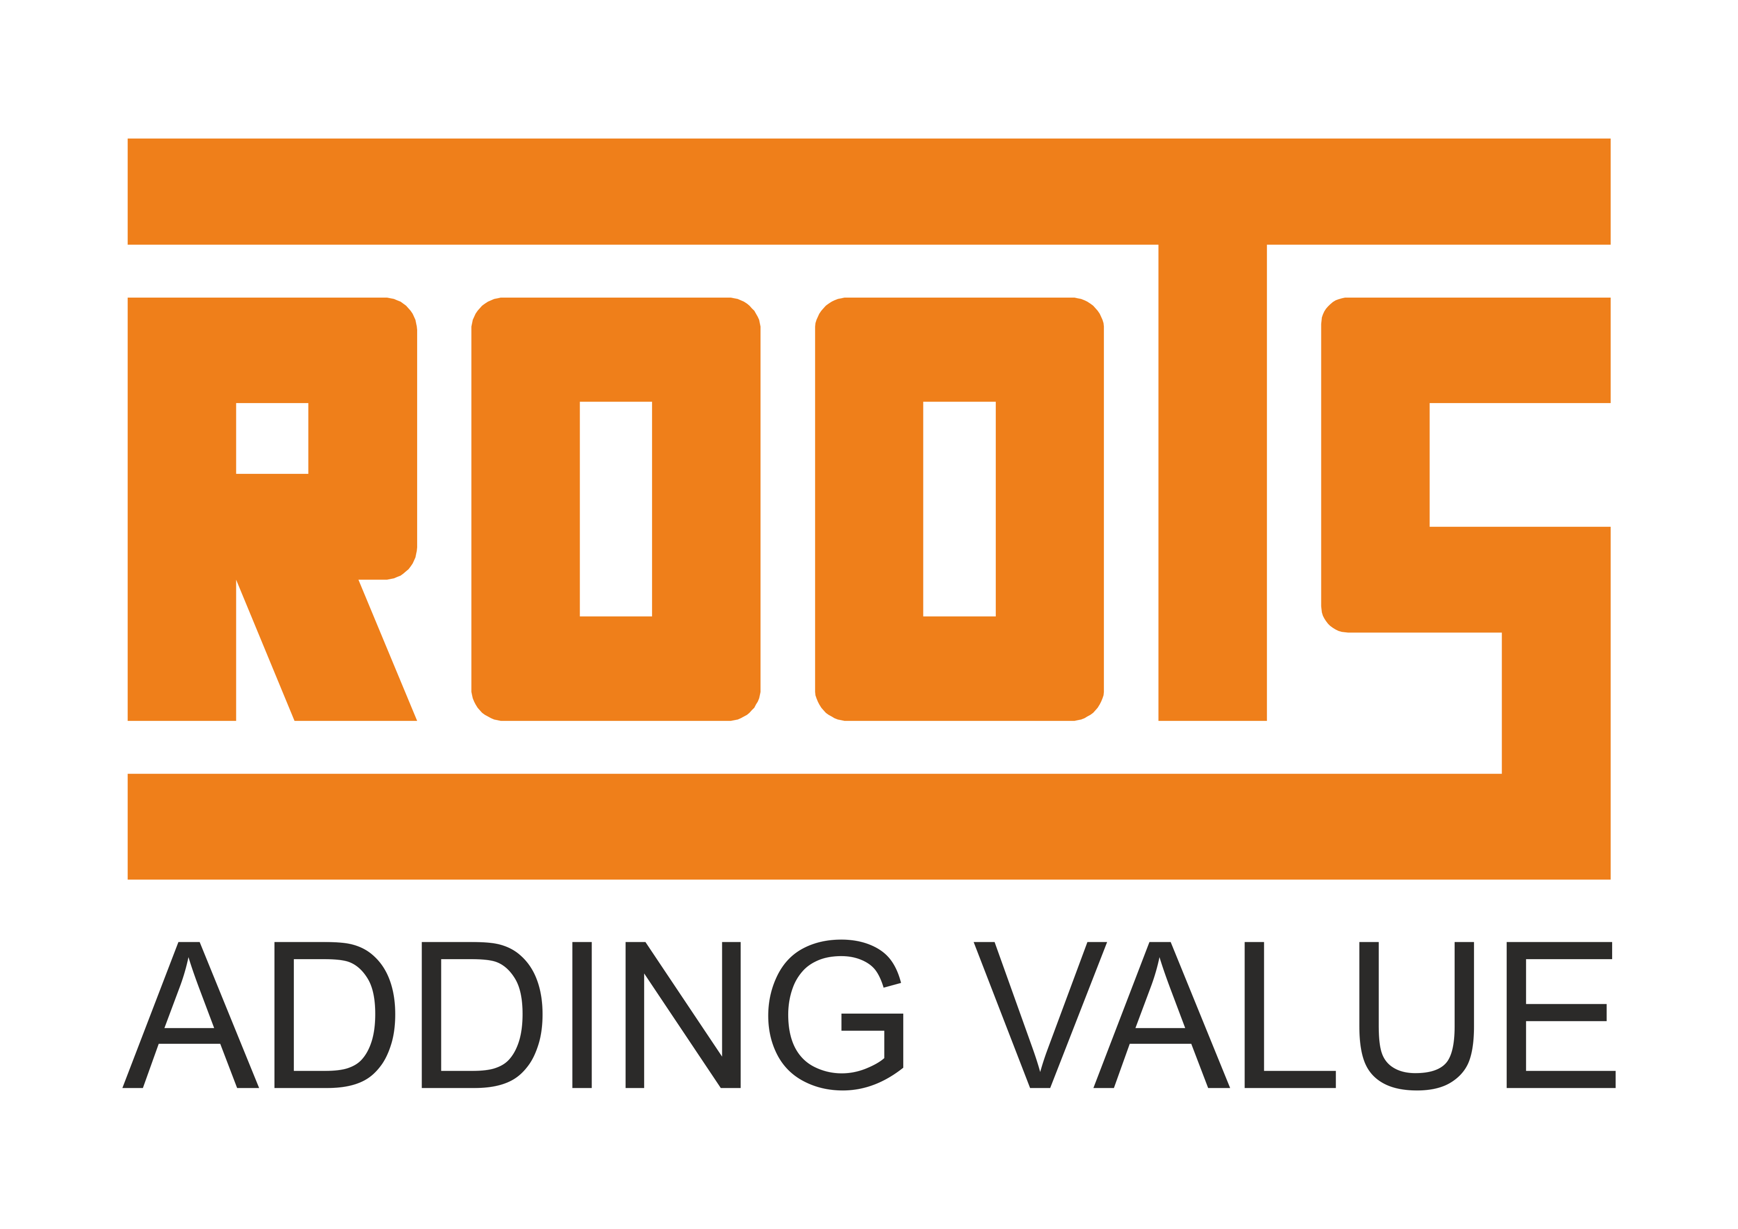















Key Customer Engagements – 2022-2026
Sasaa
Ventures

Slide 15






www.intelizest.com
sales@intelizest.com
in.linkedin.com/company/intelizest
twitter.com/Inteli_zest

