Slide 1




Corporate Presentation
Since 2004

Slide 2






About Us
Approvals from Indian
Navy
Army (Defence)
- Railway
Global Certifications
150+
Patents
2 Awarded
6 in Pipeline
12 Plants with 650,000
Sq. Ft Working Area
Associates
4000+
Staff
400+
Exporting to
15+
Countries

Slide 3
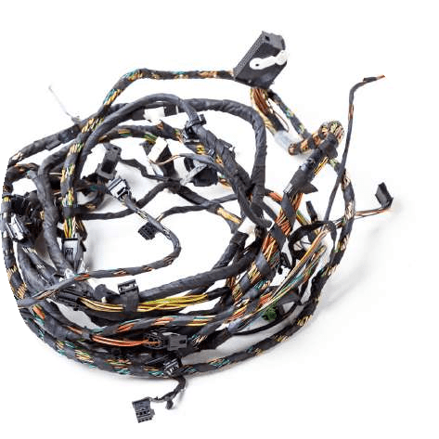
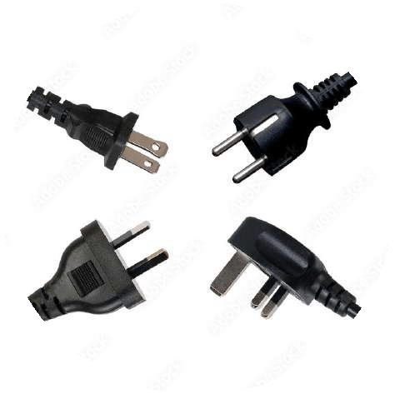
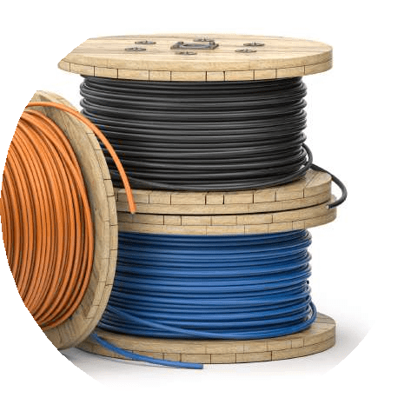
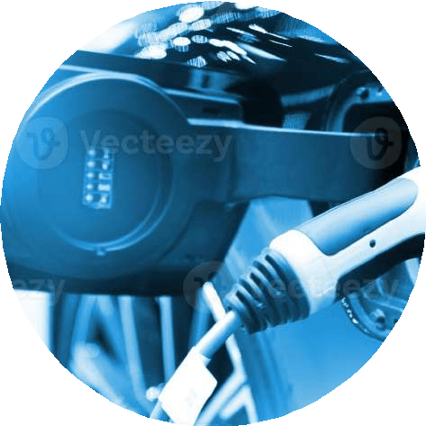
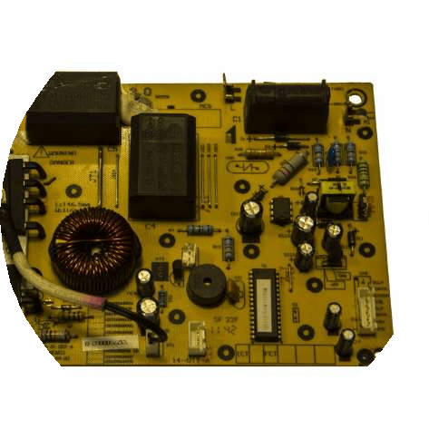
Product Verticals
Wire Harness
Power Cords
Specialized Wire & Cable
EV
Solutions
Electronics Products

Slide 4


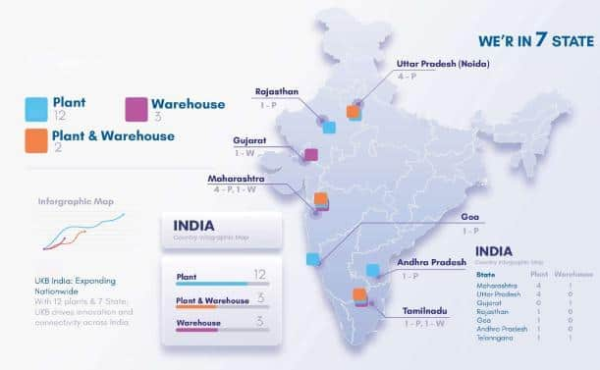











Manufacturing Locations
U.P. - 250k sq ft 4 Plants
TN - 35k sq ft 1 plant
Rajasthan - 450k sq ft 1 Plant
Goa - 25k sq ft 1 Plant
Maharashtra - 300k sq ft 4 Plants
Andhra - 30k sq ft 1 Plant
All locations fully integrated by
All Locations are 100% ROHS And REACH Compliant

Slide 5
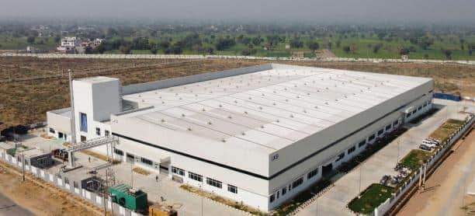
Wire & Cable Facilities
Manufacturing Plants
Rajasthan Plant (Neemrana)
Dedicated Plant for Specialized Wires & Cables
Unit with Electron Beam Machine (E-Beam) 3.0 MeV and 1.5 MeV
Complete Setup of all Wire & Cable Machines
Current Shop Floor Area – 150K Sq Ft
Under Construction – 300K Sq Ft (ETC Apr 25)
Total Wire & Cable Manufacturing Units in India (3 Units)
Neemrana – 1 Manufacturing Units
Noida – 1 Manufacturing Units
Pune – 1 Manufacturing Units
Rajasthan Plant (Neemrana)

Slide 6
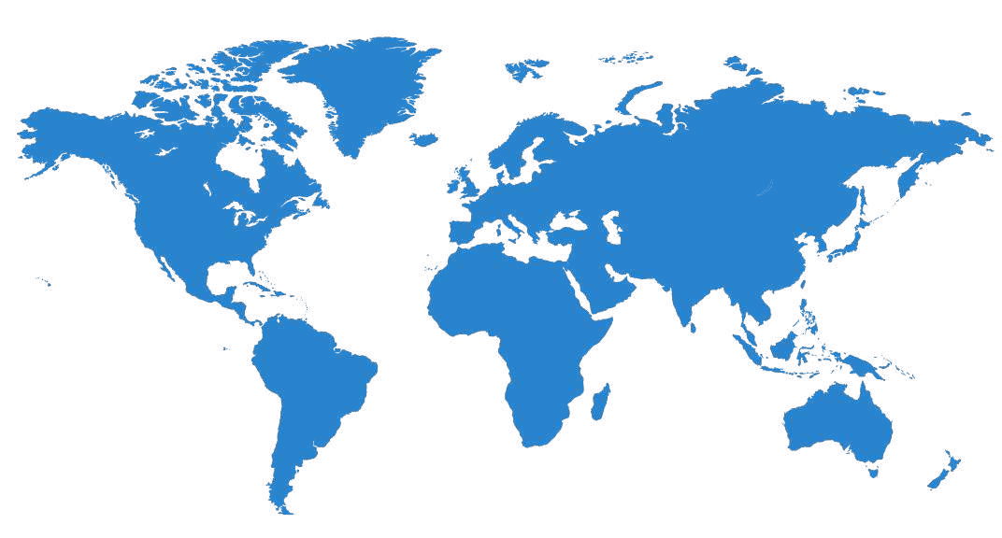

Global Footprint
Asia Pacific
SOUTH KOREA
THAILAND
MALAYSIA
CHINA
HONGKONG
VIETNAM
BANGLADESH
North America
USA
MEXICO
Middle East
TURKEY
ROMANIA
Europe
SPAIN
POLAND
SLOVENIA
GERMANY
AUSTRIA
ITALY

Slide 7


















Clientele

Slide 8











Product Global Certifications
Asta Mark, UK
UL Recognized Components, US & Canada
PSE Mark, Japan
TUV Mark, Europe
VDE Mark, Europe
ISI Mark, India
UL Mark, US & Canada
Spring Mark, Singapore
SASO Mark, UAE
GCC Mark Gulf Countries
NSW Mark, Australia

Slide 9
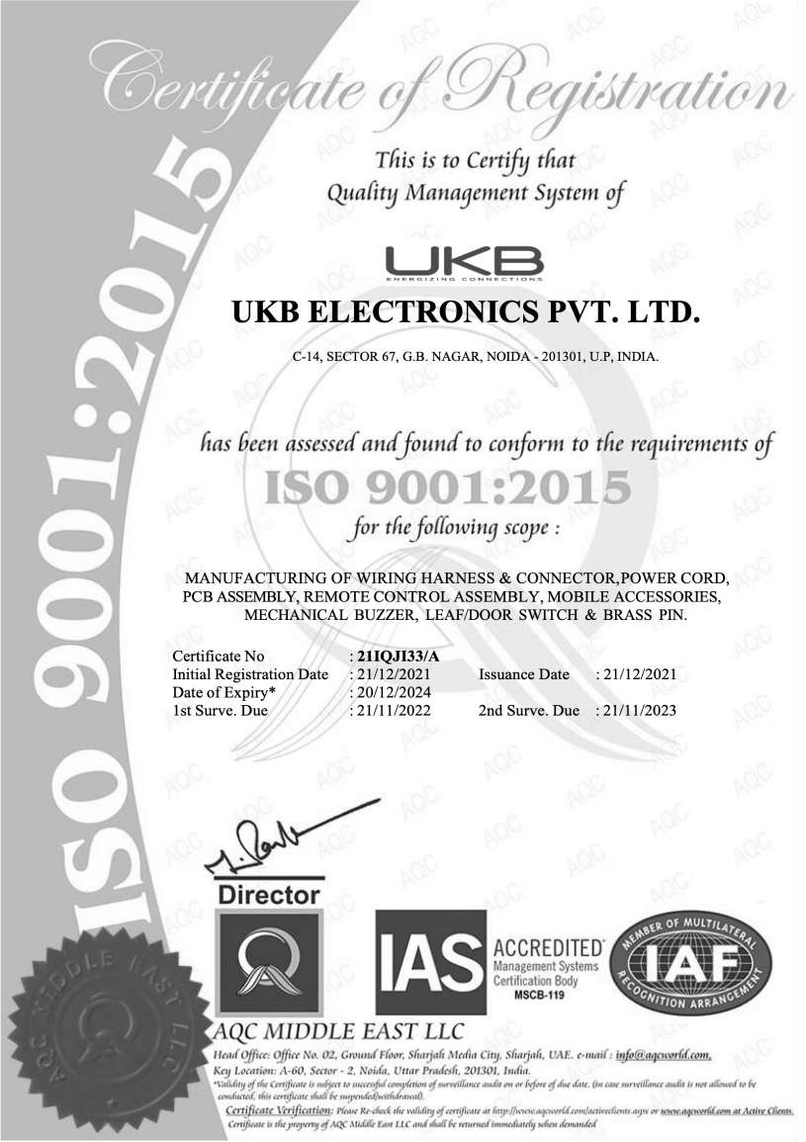
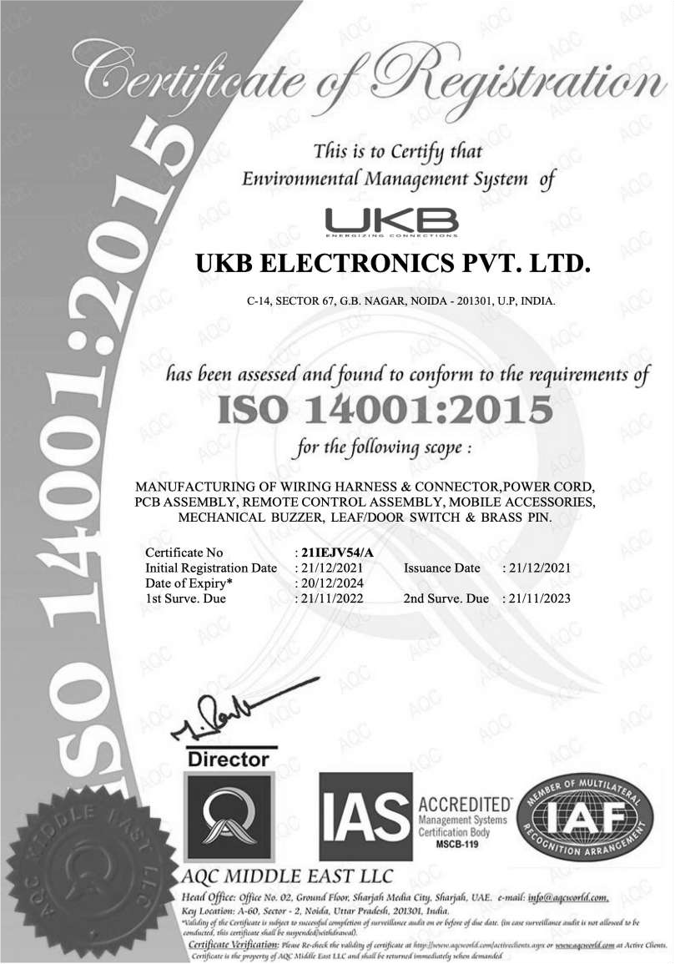
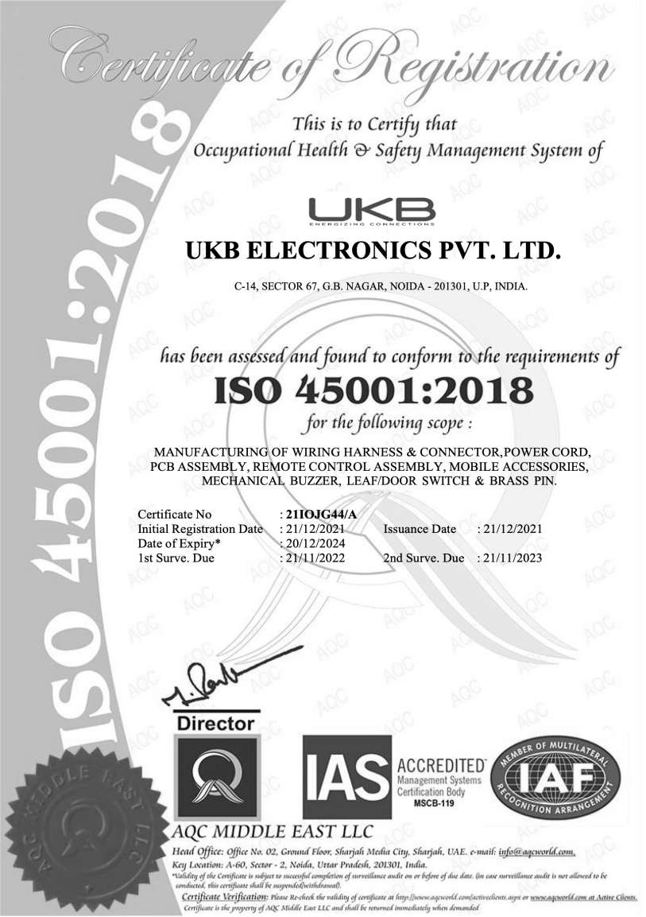
Industrial Certifications
ISO 9001:2015
ISO 14001: 2015
ISO 45001:2018

Slide 10
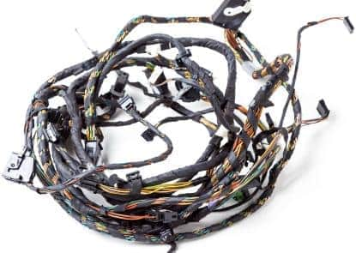
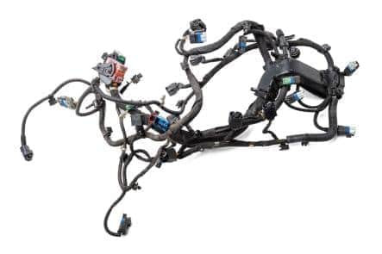
Wiring Harness
Capability to design and manufacture wire harness for variety of industries –
Industrial Automation / Machines
Elevators
Appliances
Marine & Defense
Power Back-up System
Renewable (Alternative) Energy
Railway Coaches

Slide 11



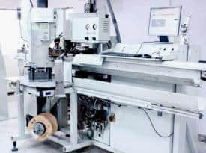
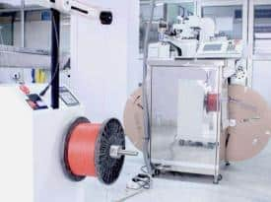

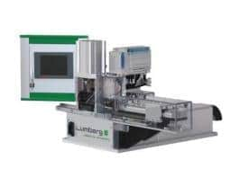



Cutting & Crimping Machines
Wiring Harness
KOMAX GAMMA Series
KODERA CASTUGNON HX Series
IDC Crimping Machines
Total 50+ Fully Automatic Both side cutting and crimping machines from Komax (Switzerland) & Kodera (Japan) with Crimp Force Analyzer capable of handling wire size from 28 AWG to 8 AWG

Slide 12

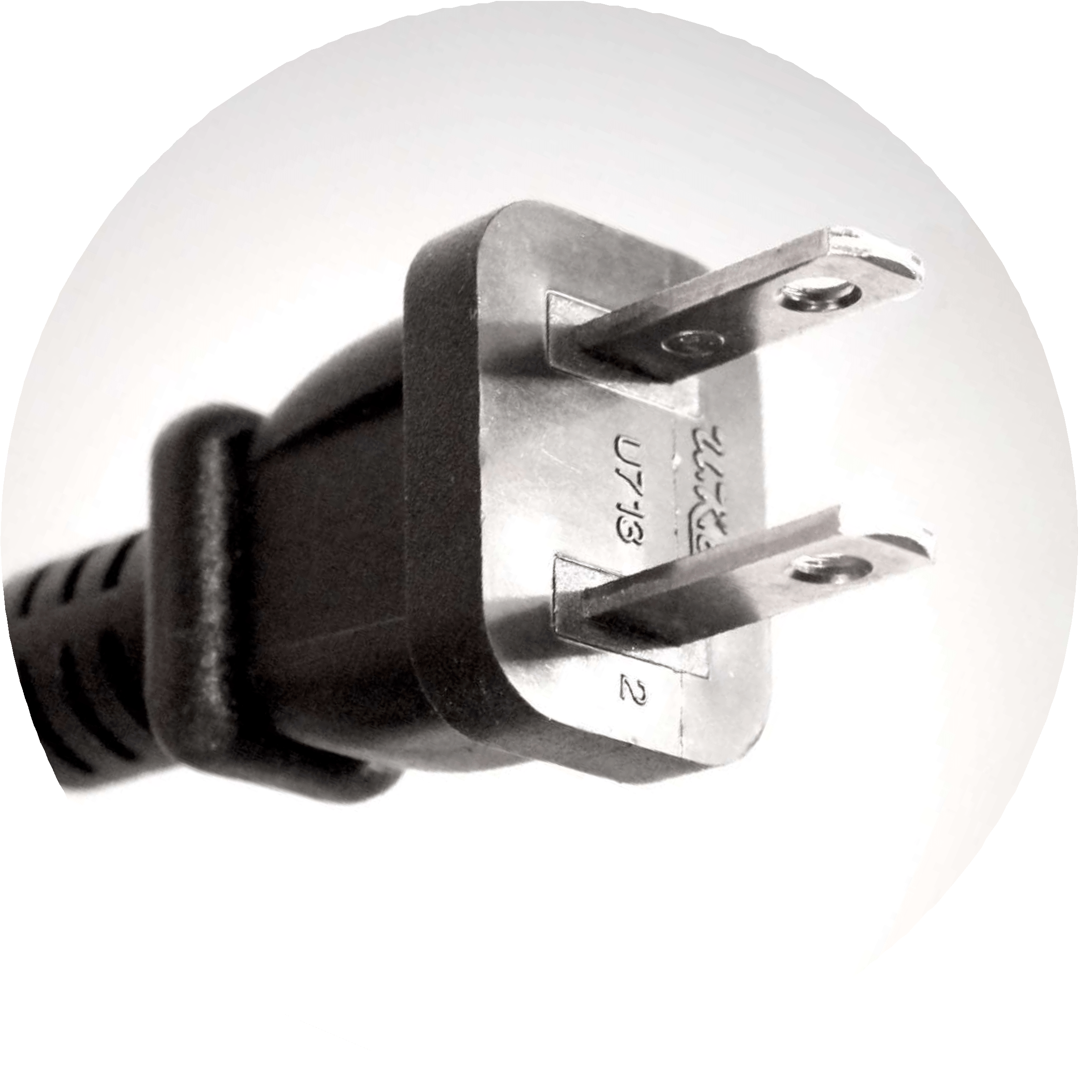



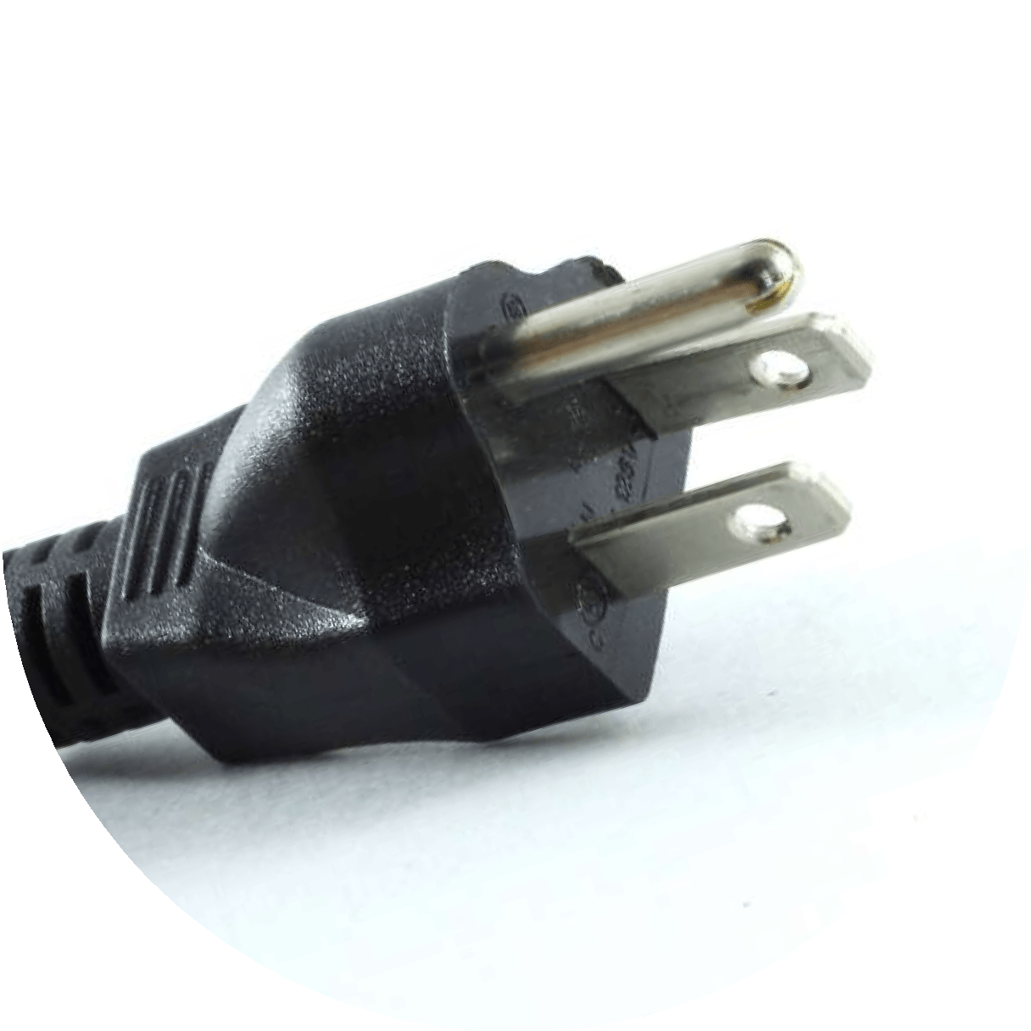

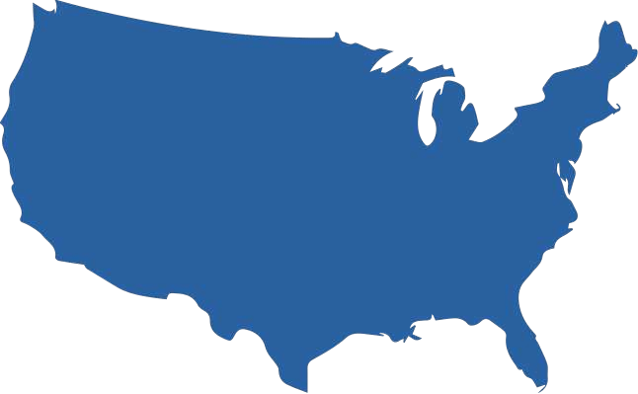



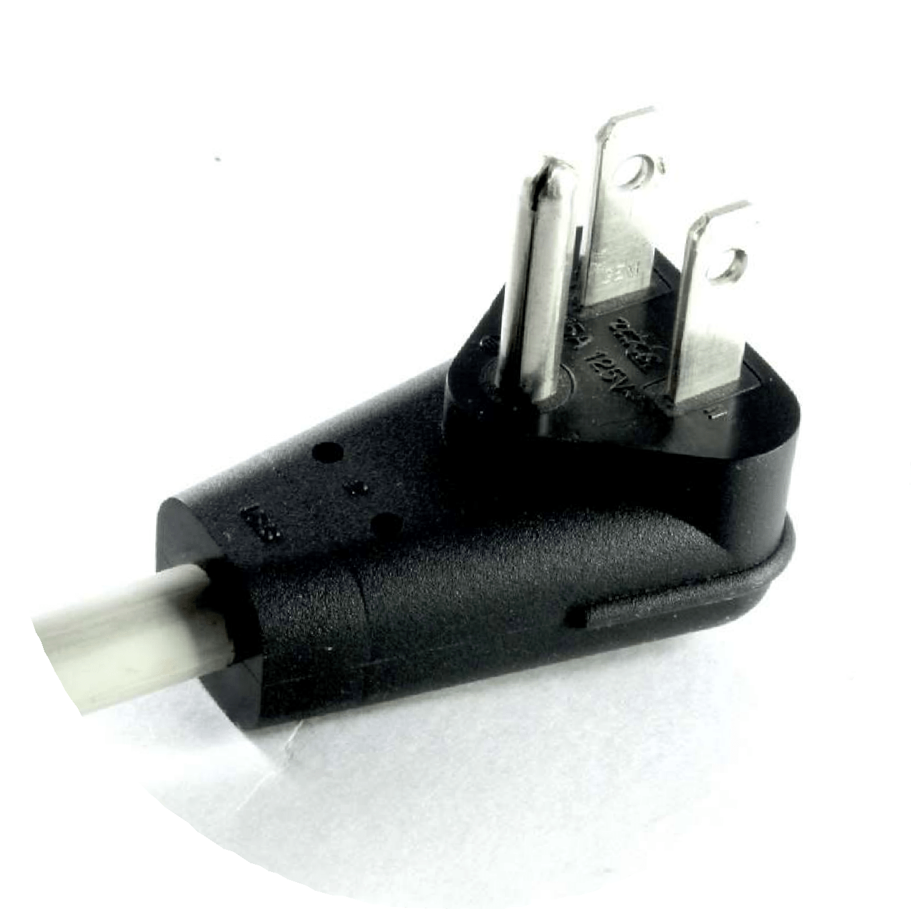



Power Cords
Power Cord - Plug Types
North America

Slide 13
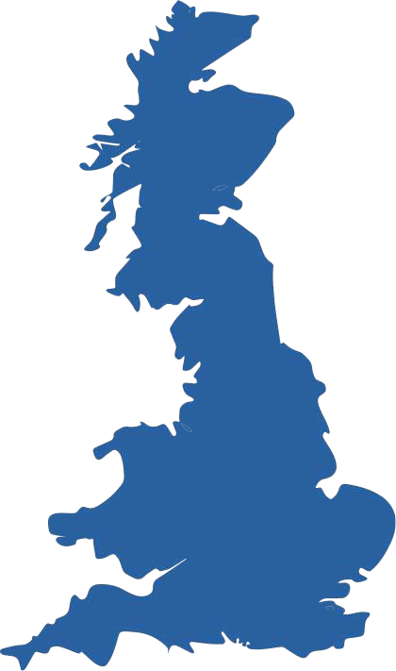

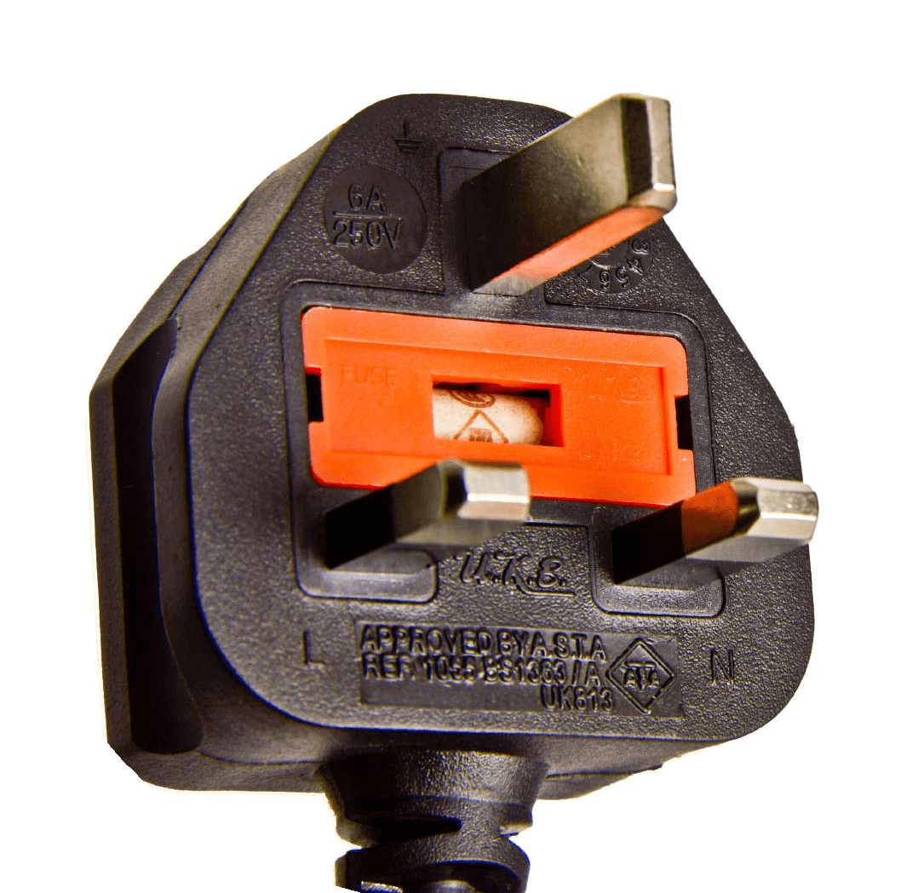

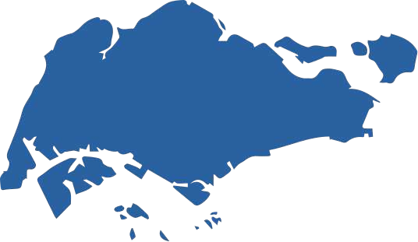


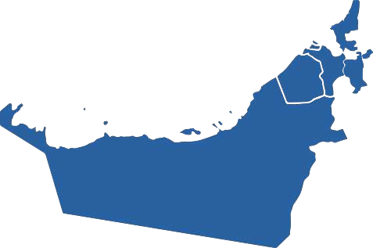
Power Cords
Power Cord - Plug Types
Singapore
Gulf Countries (GCC)
UK

Slide 14

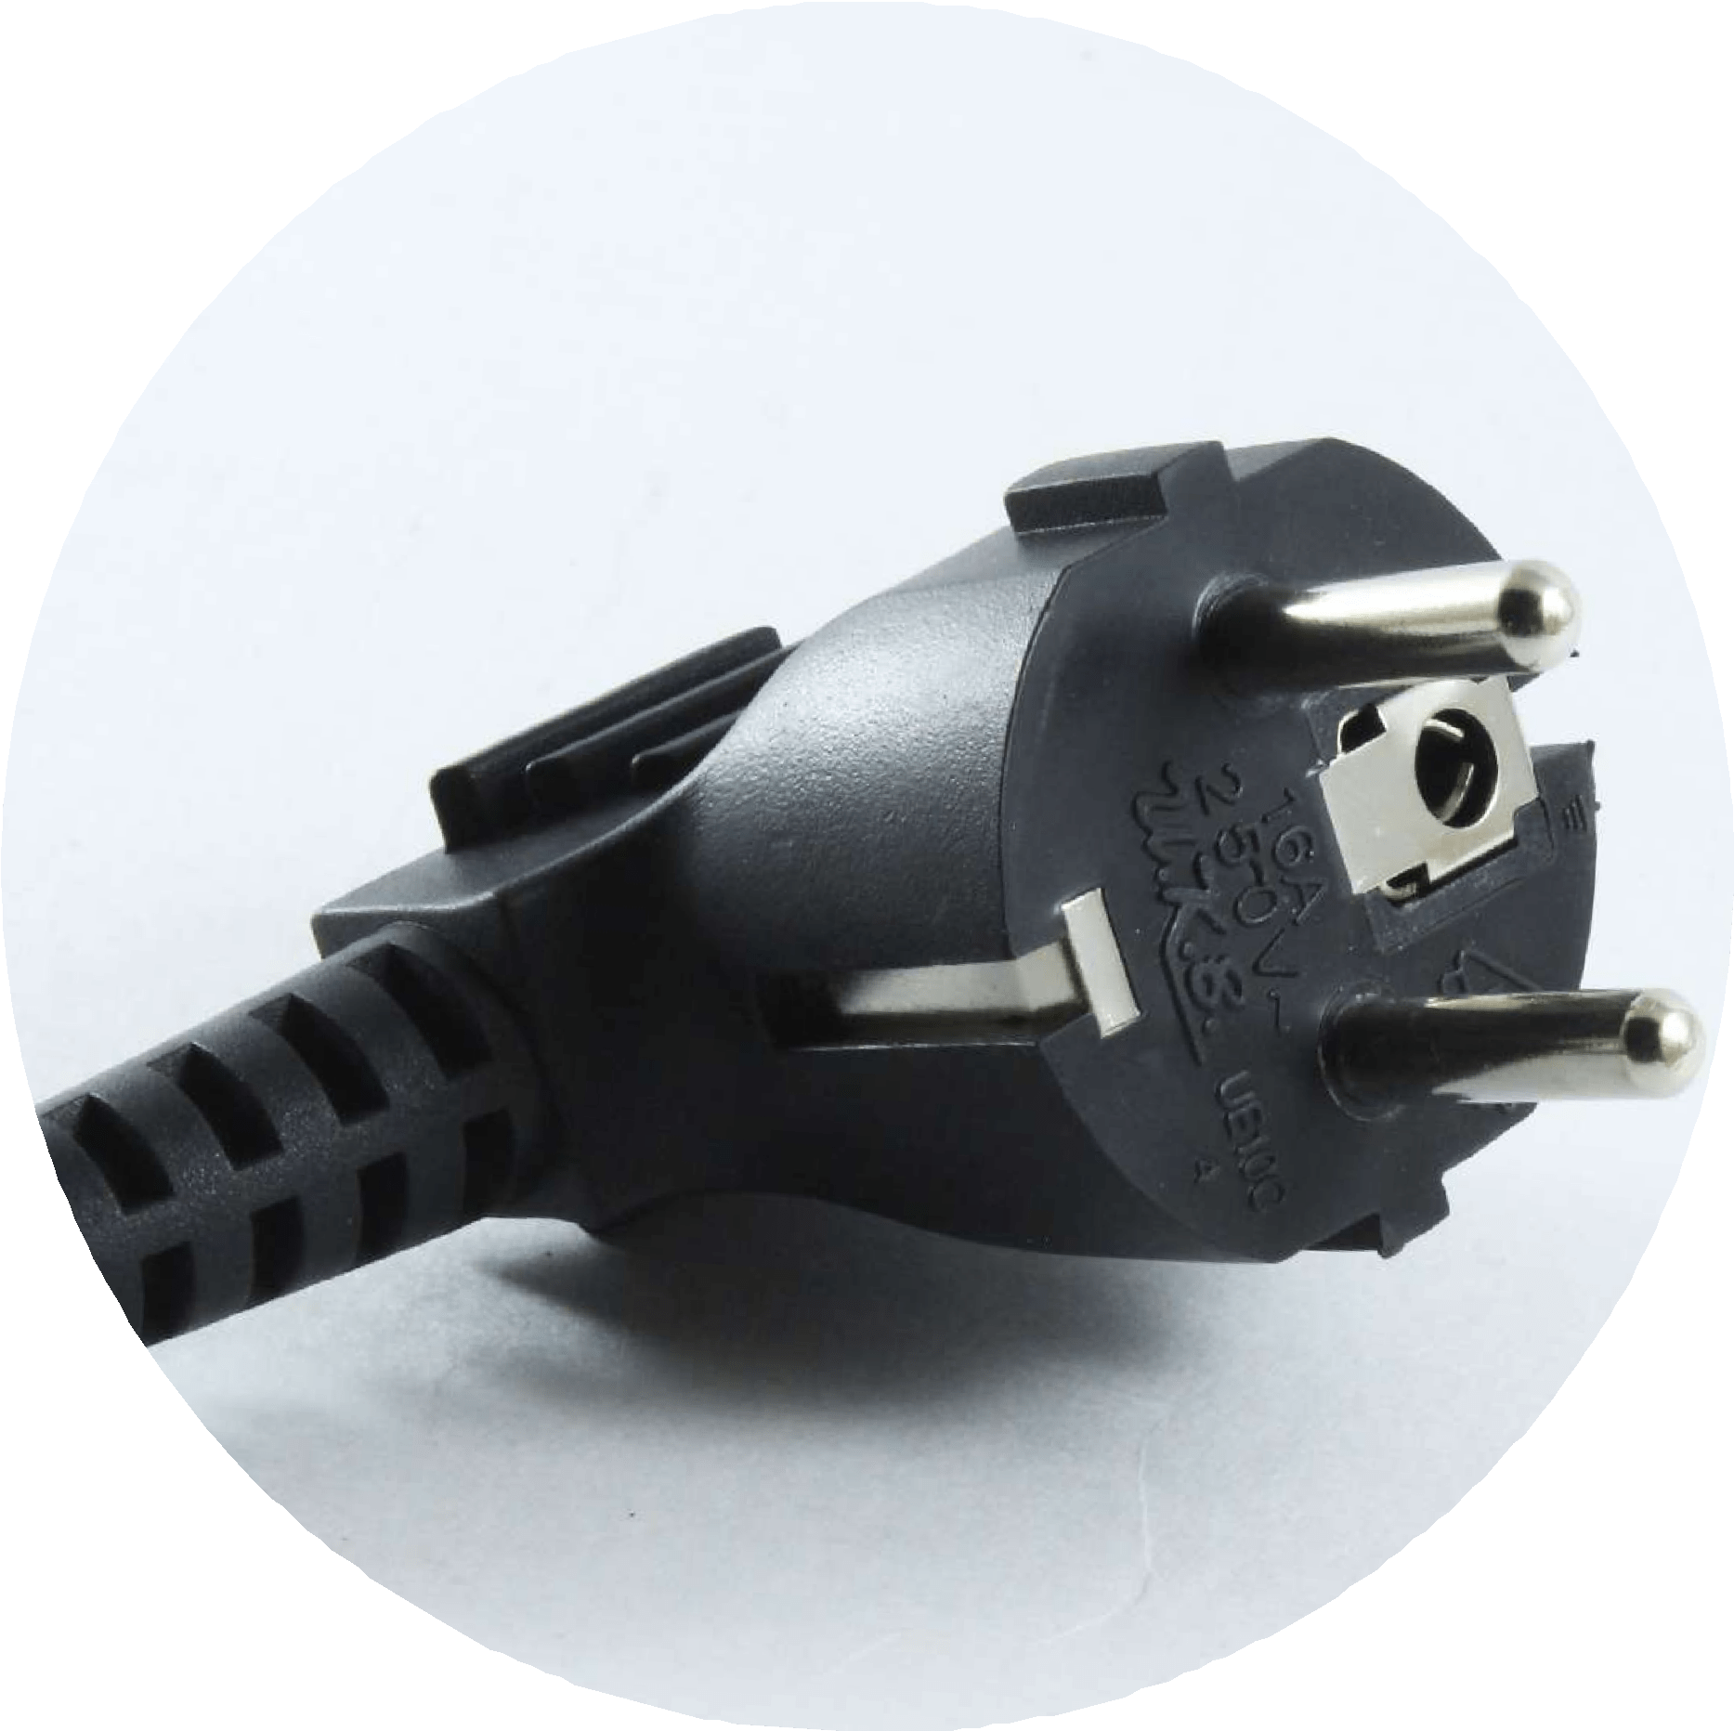
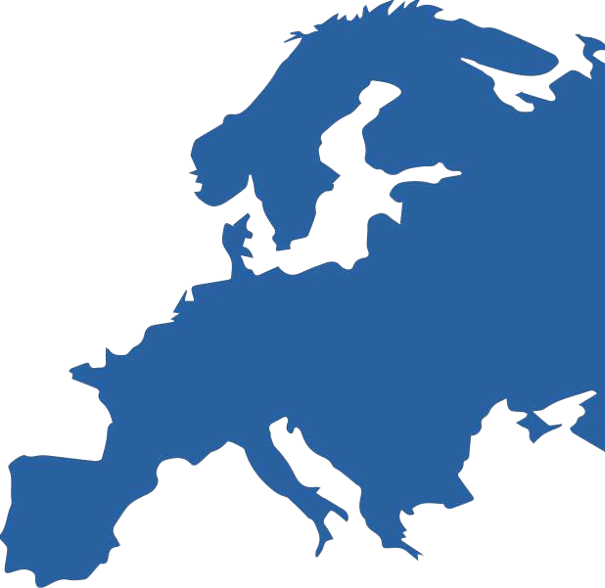

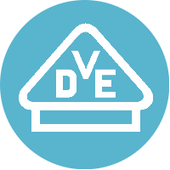

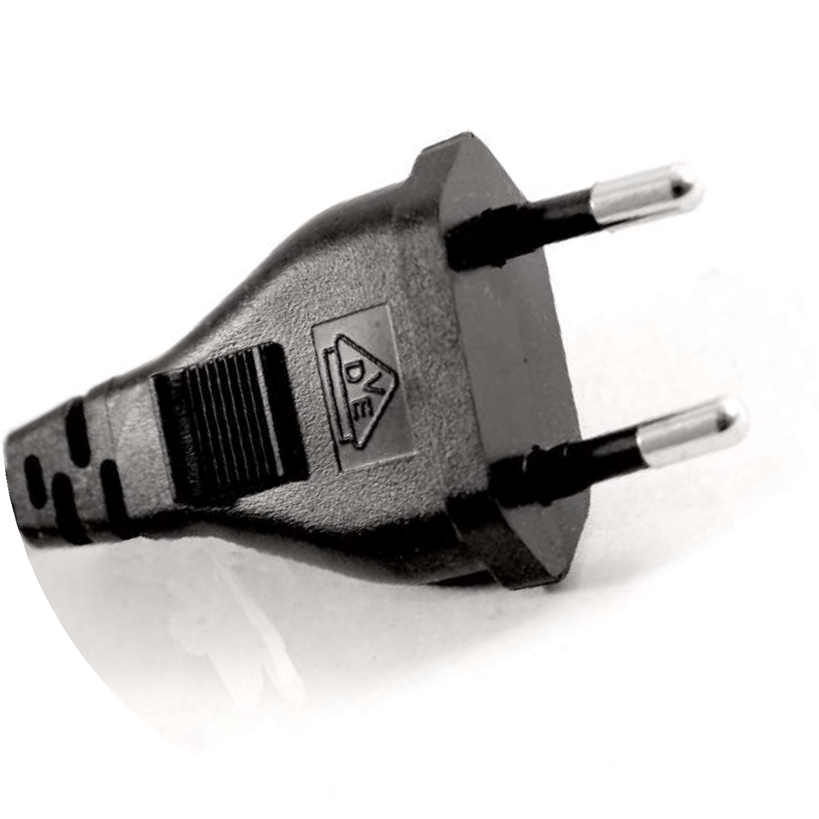



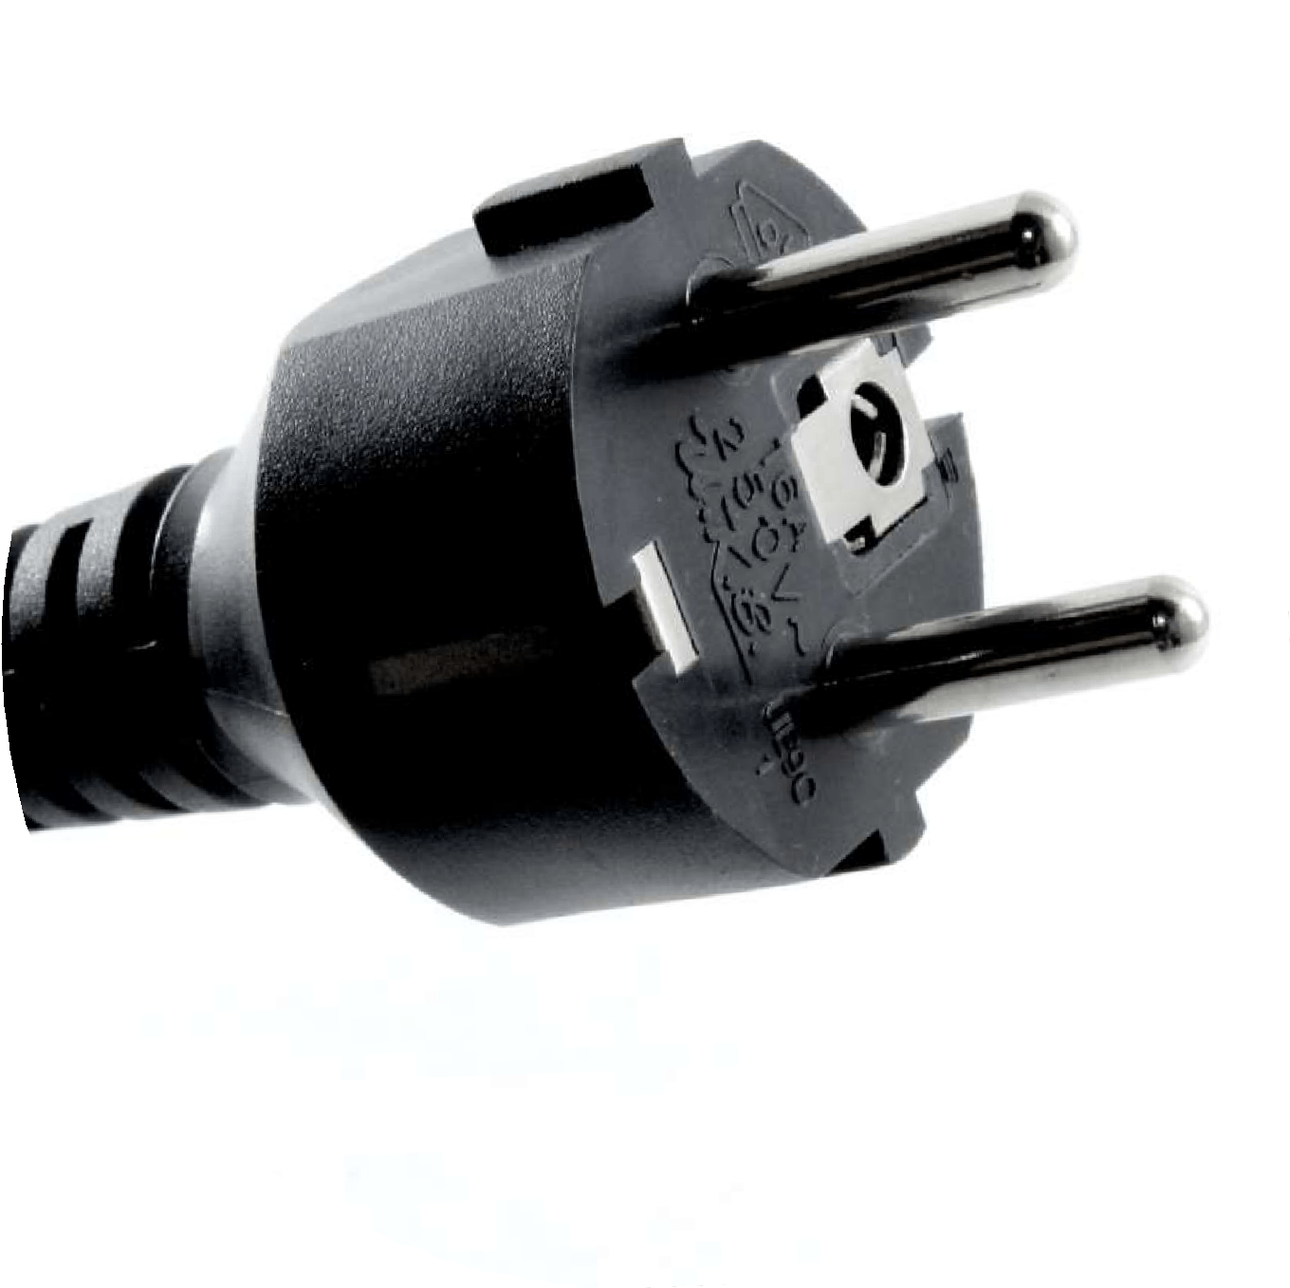
Power Cords
Power Cord - Plug Types
Europe

Slide 15


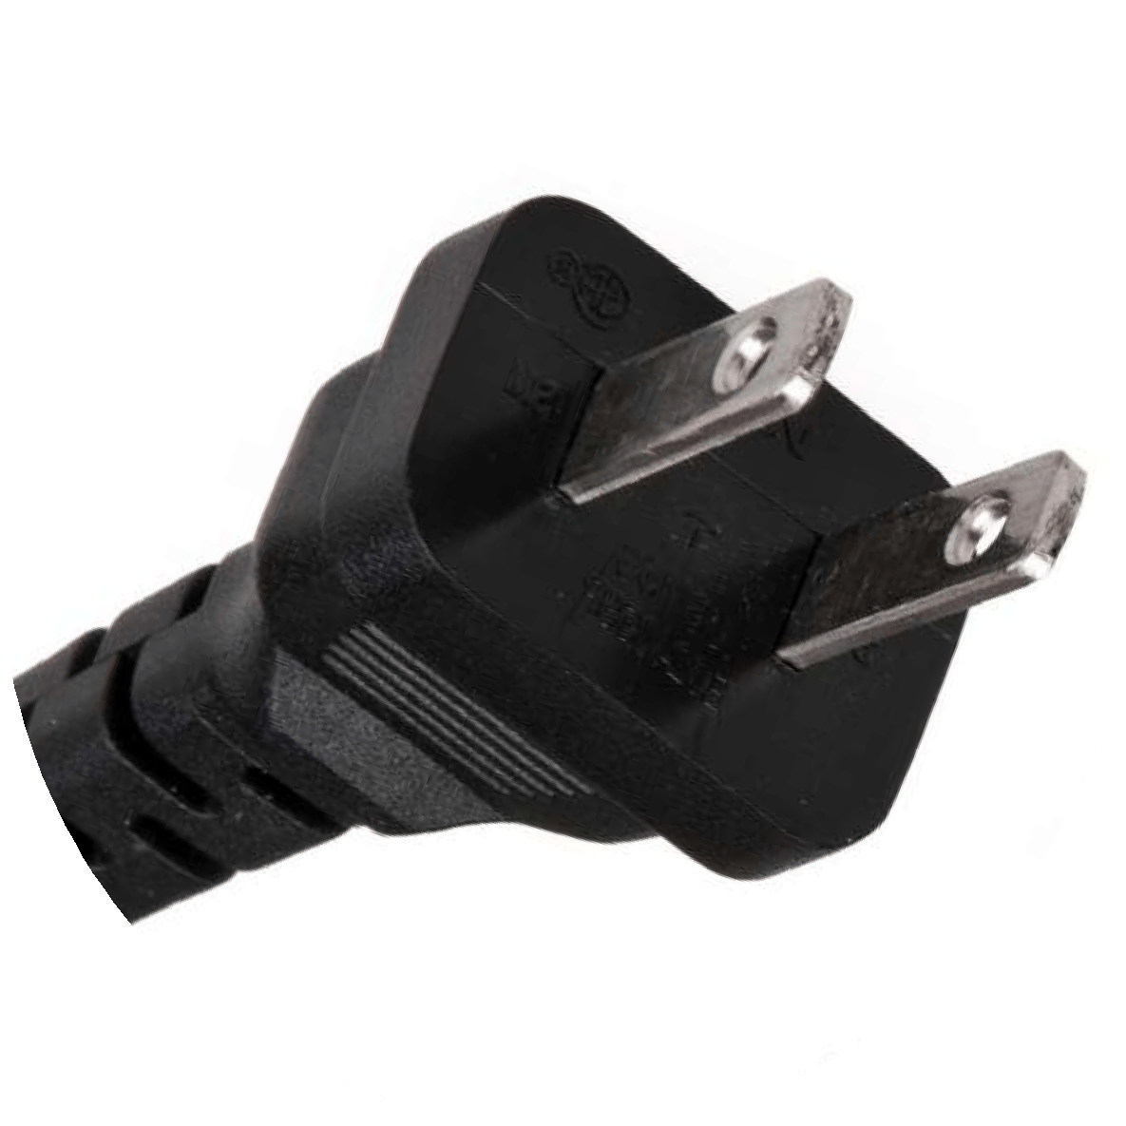

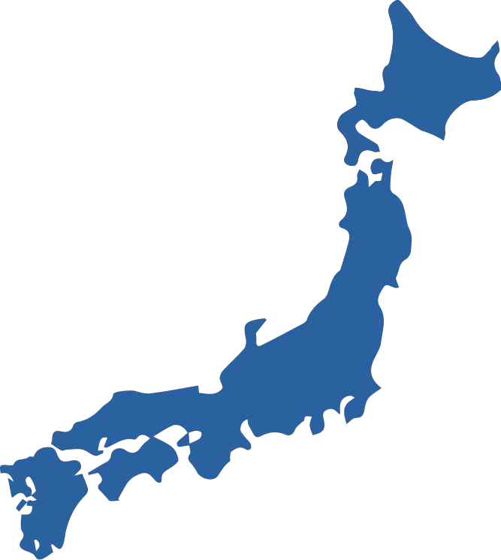
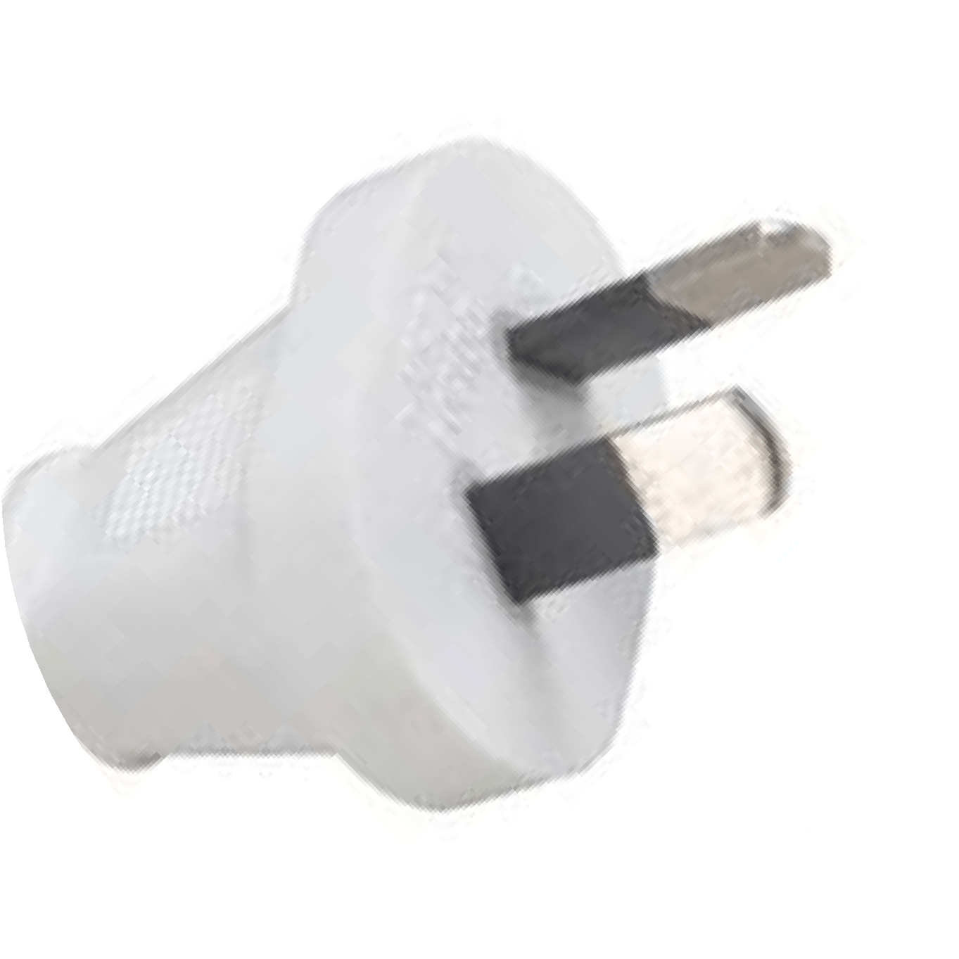


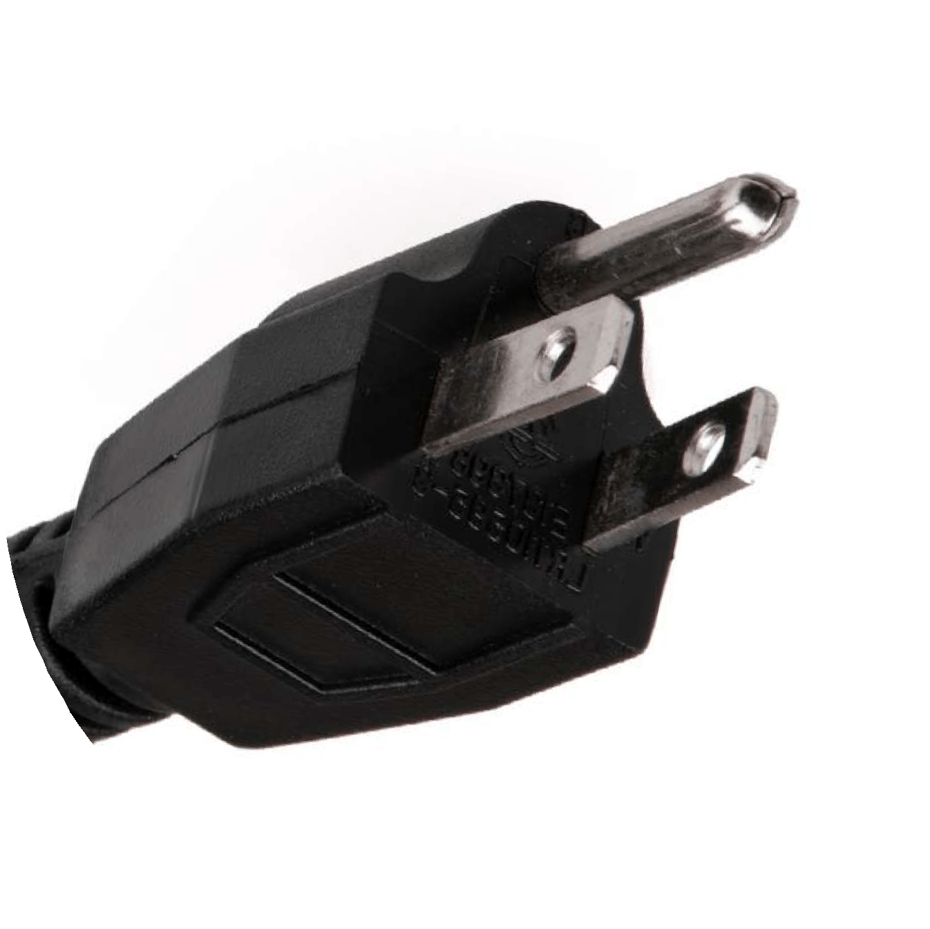




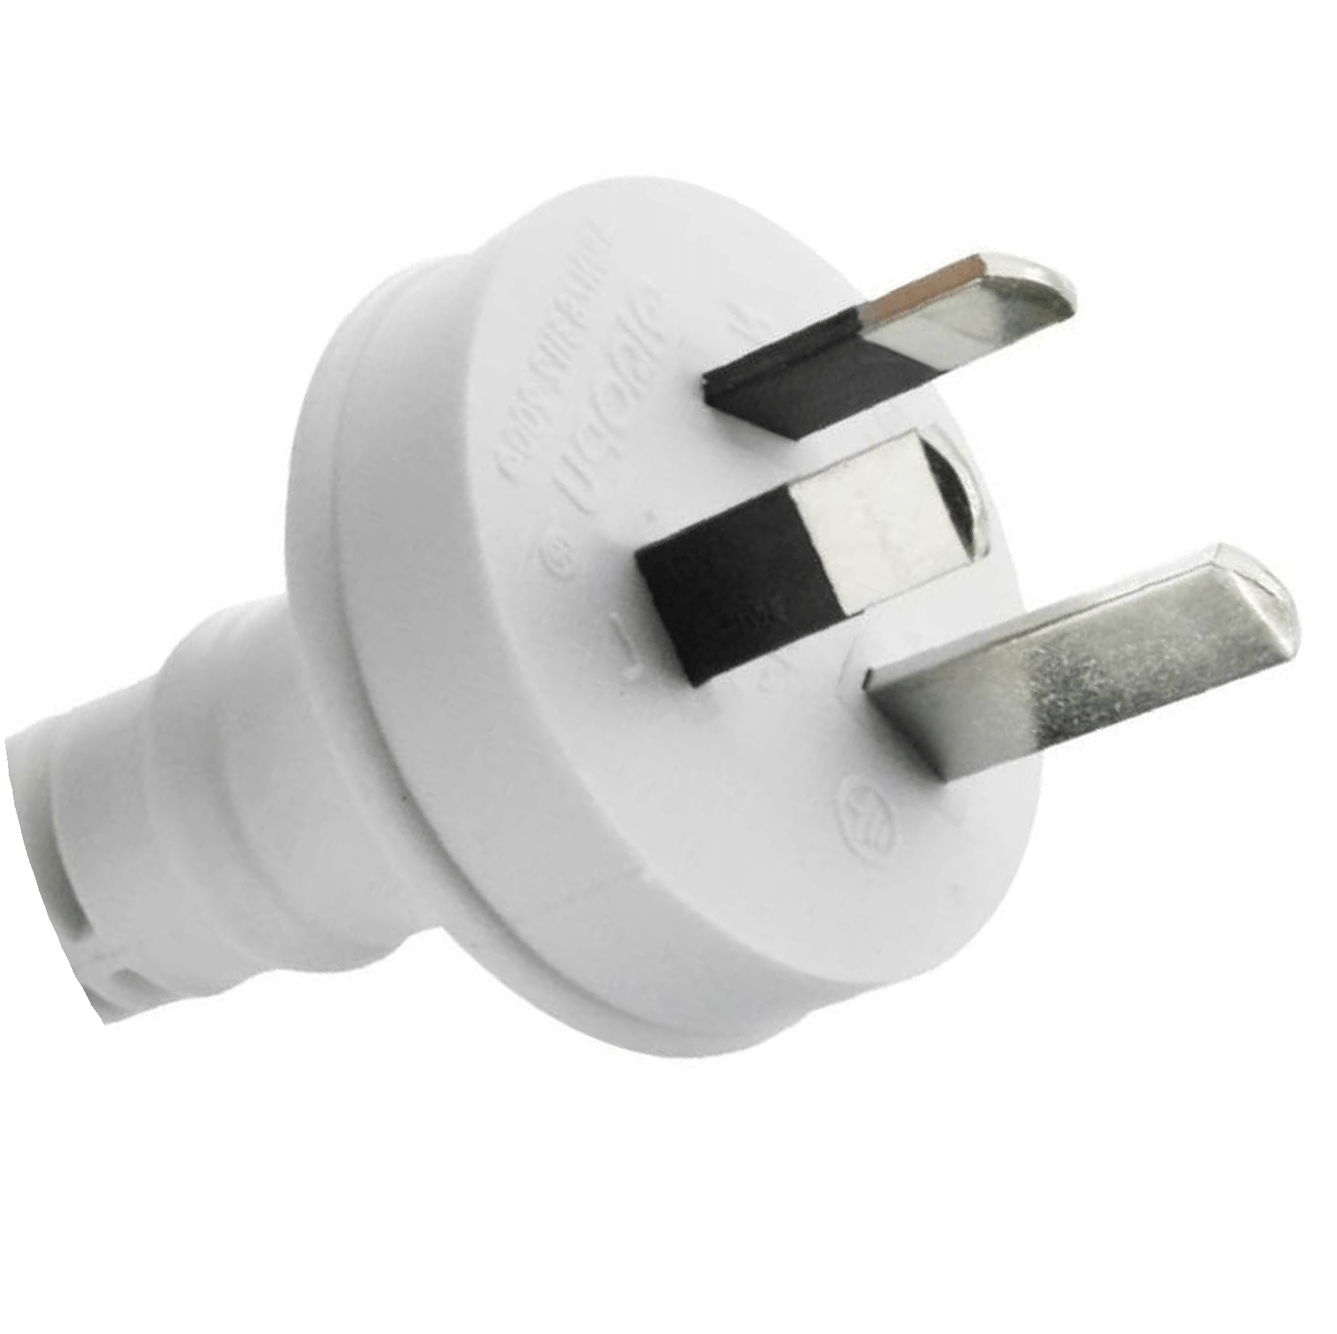




Power Cords
Power Cord - Plug Types
Australia
Japan

Slide 16
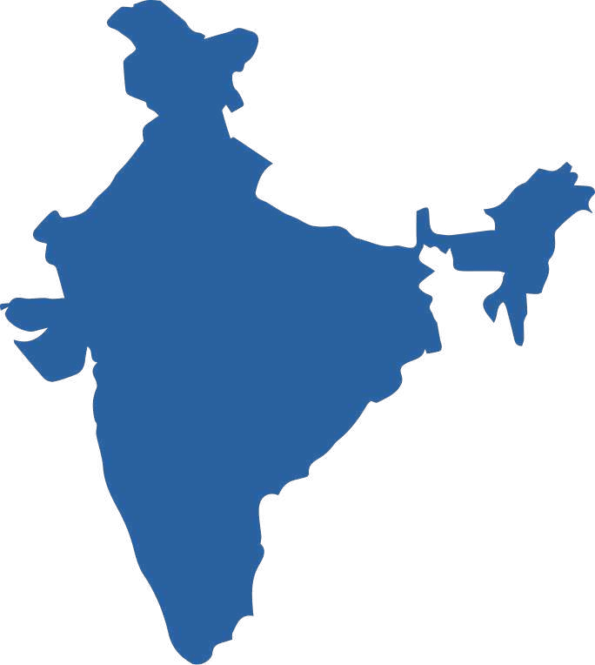


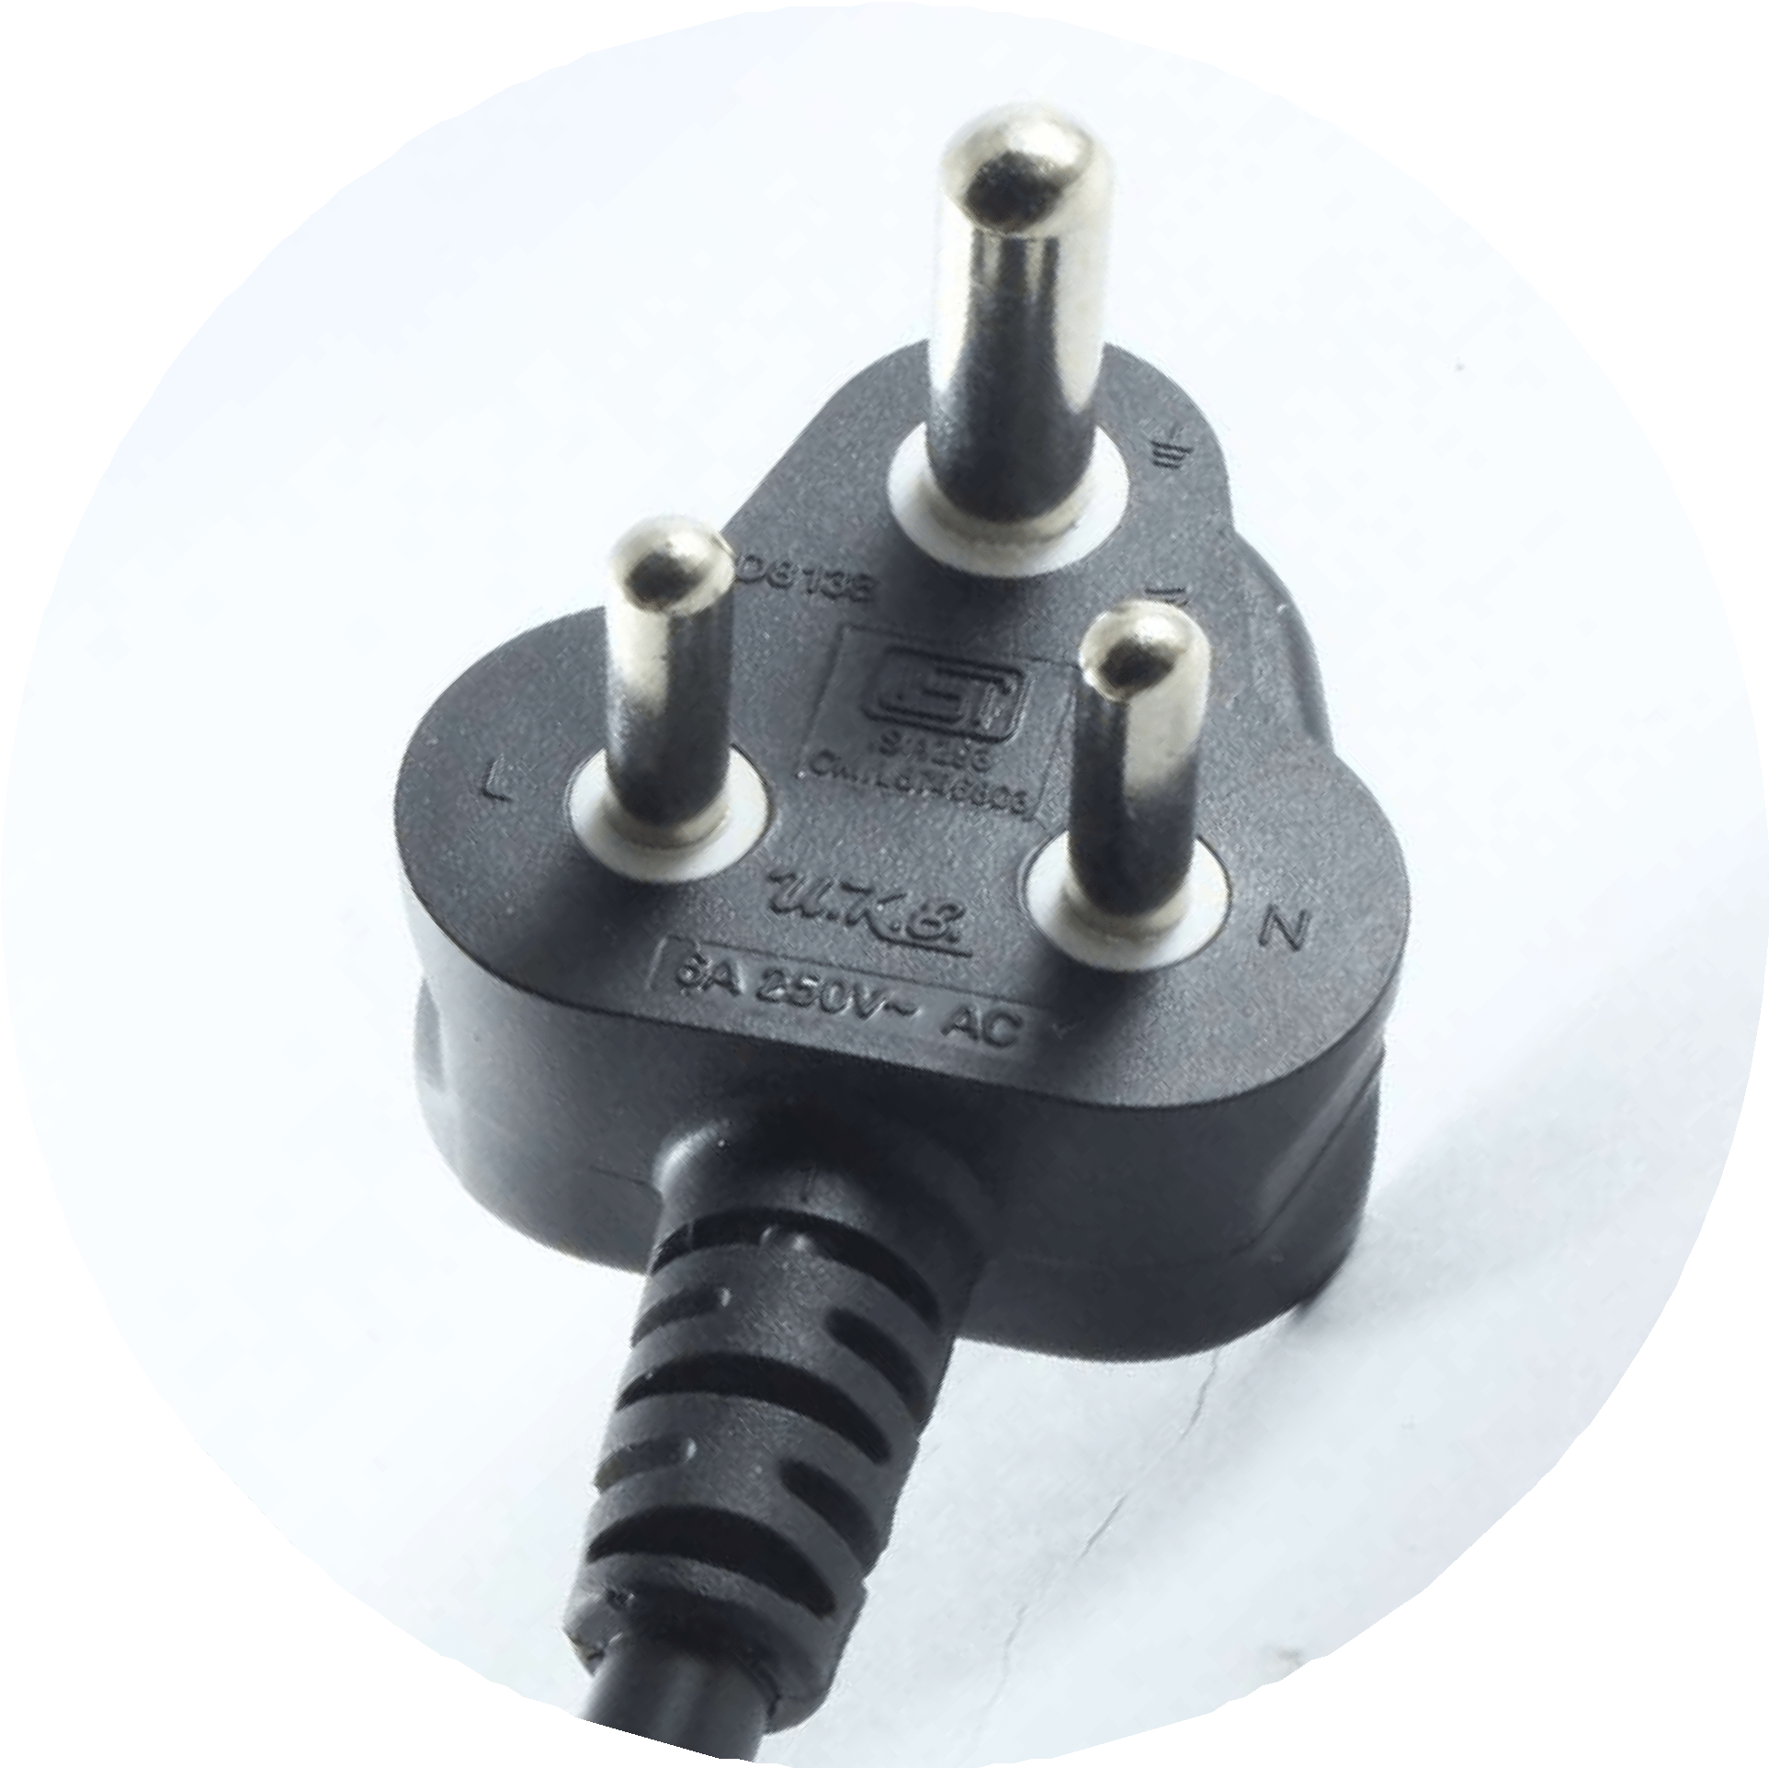


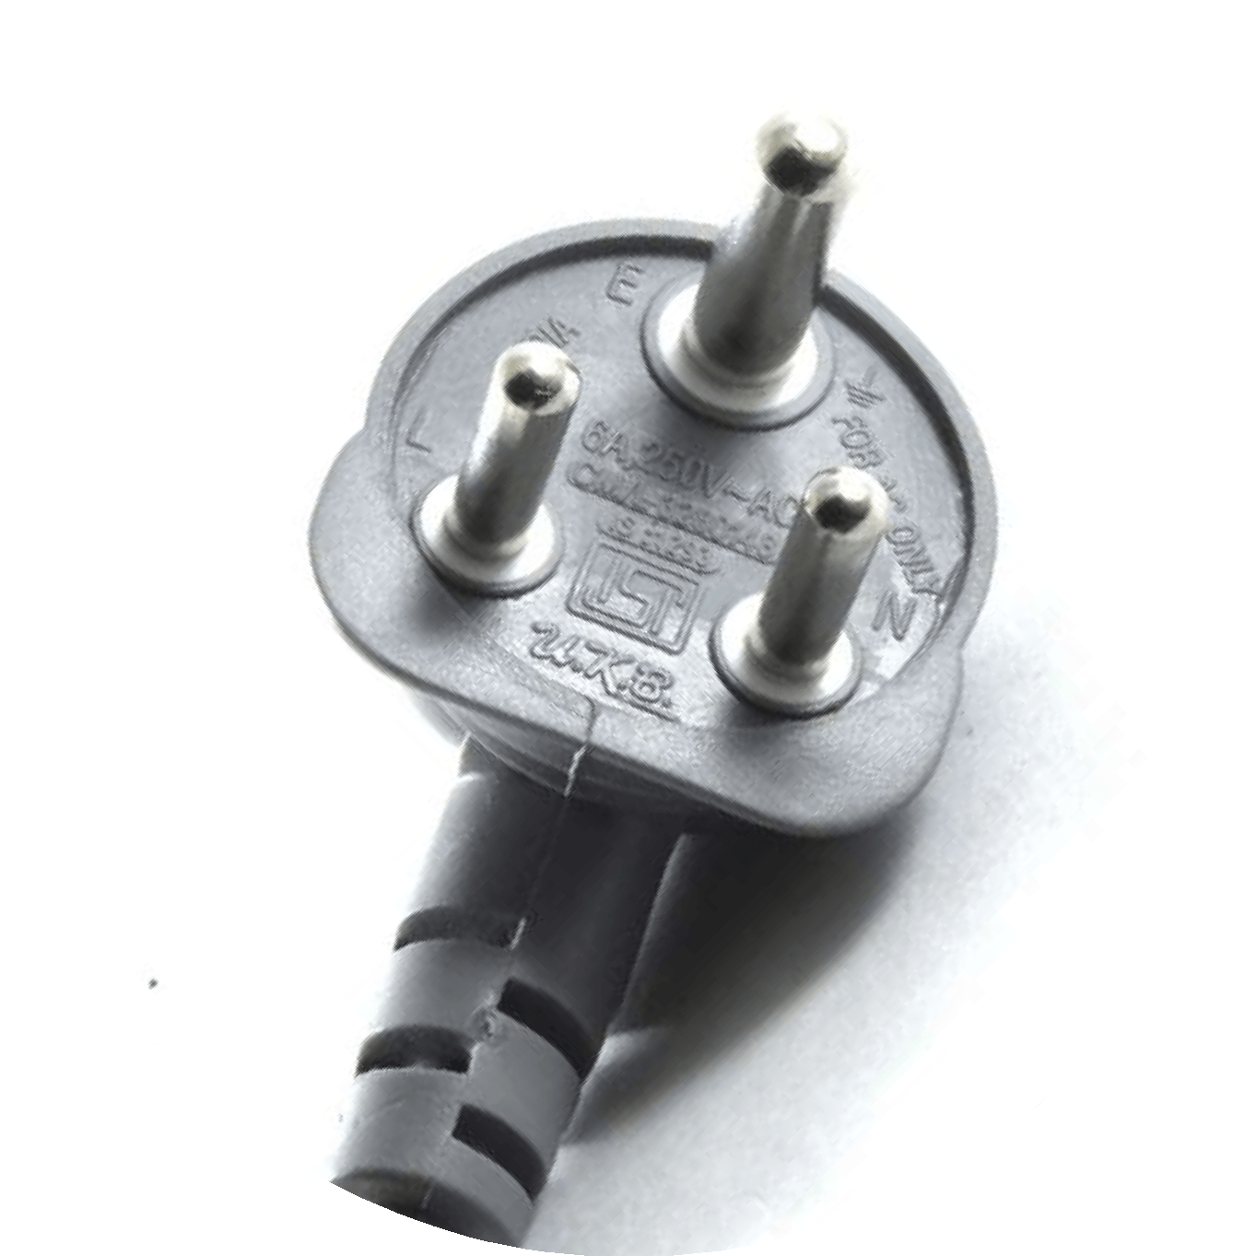






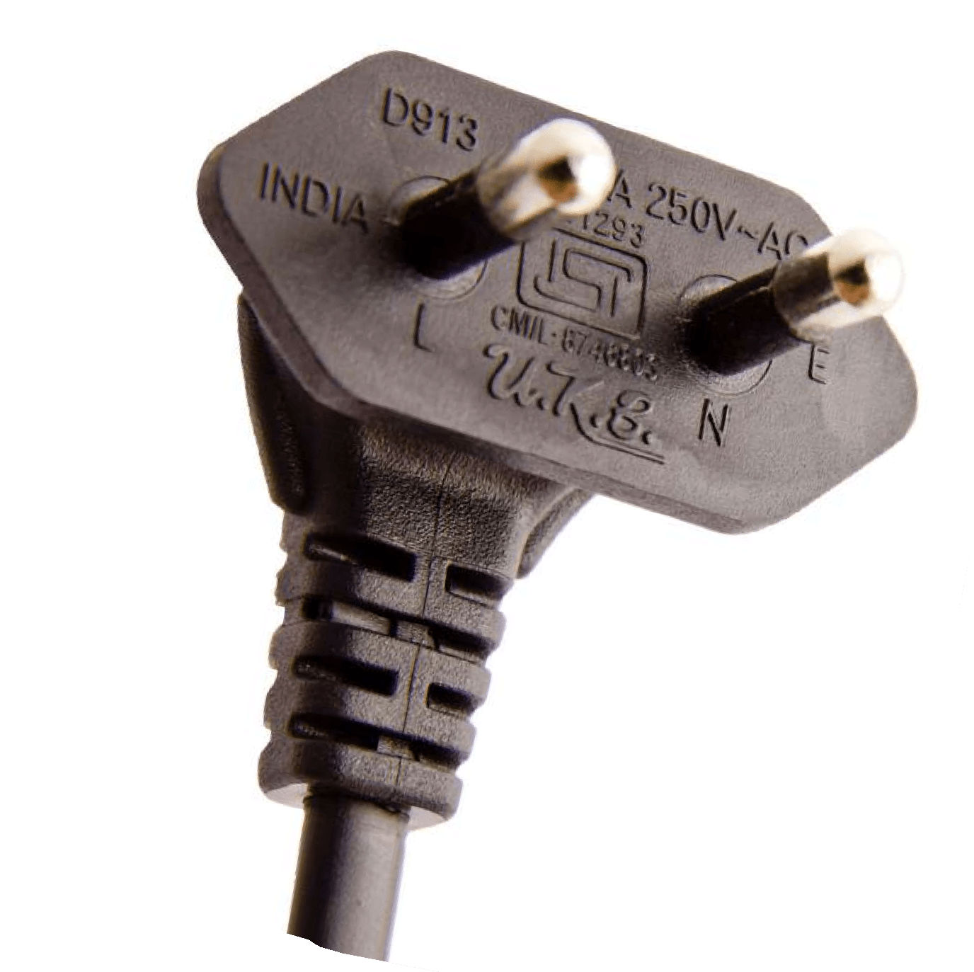

Power Cords
Power Cord - Plug Types
India

Slide 17
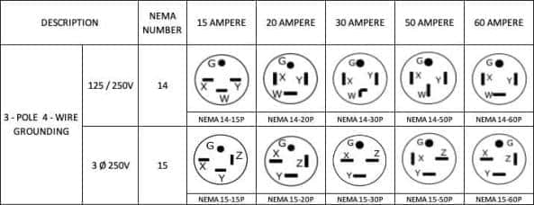
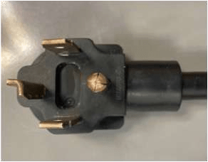
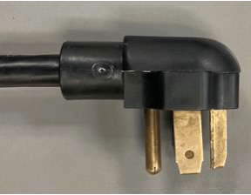
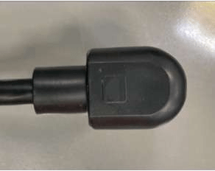
Power Cords
Under UL Approval
North America

Slide 18






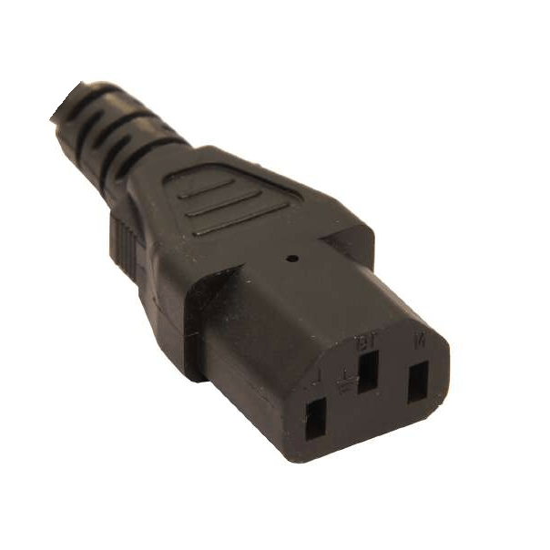
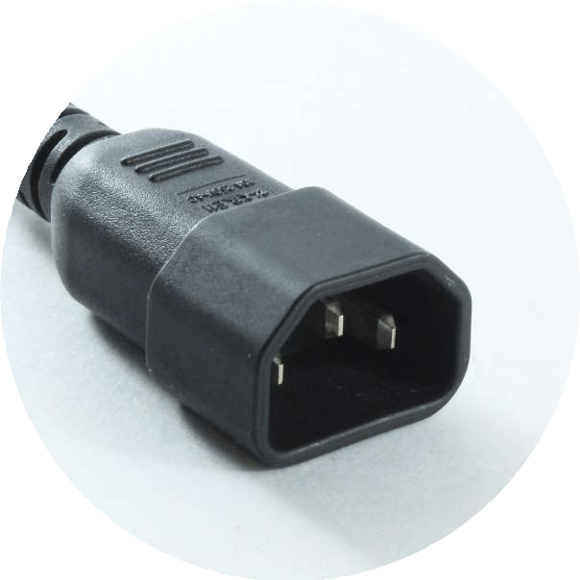
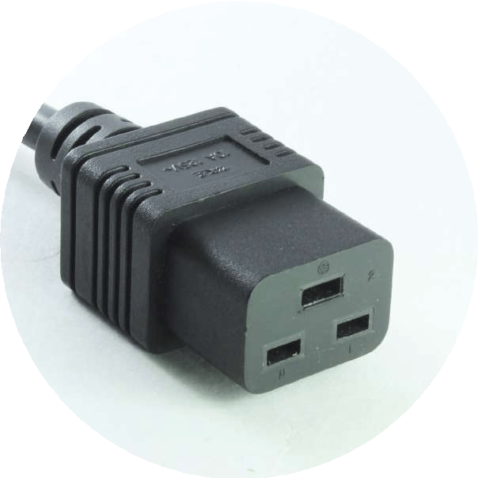
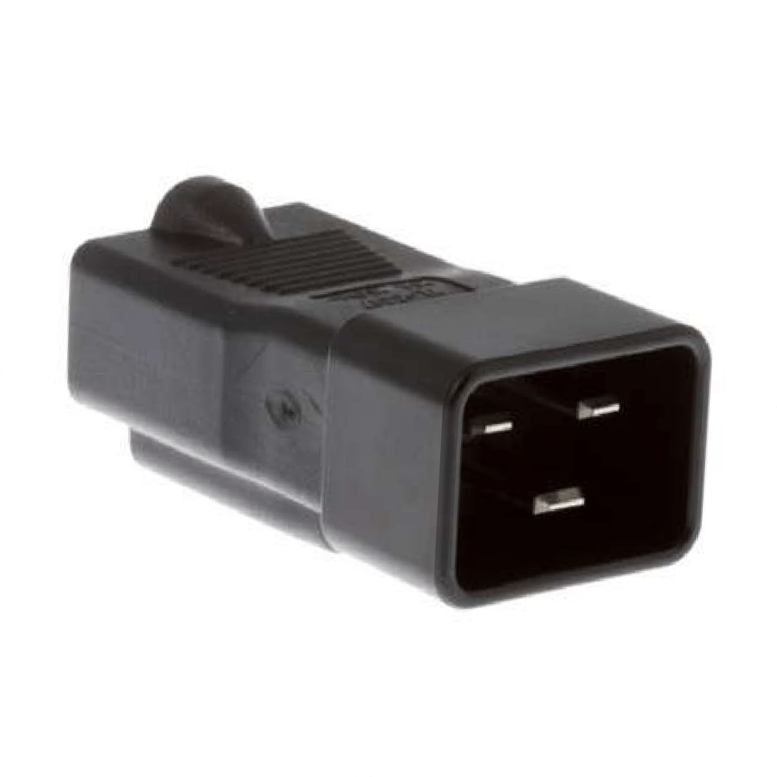
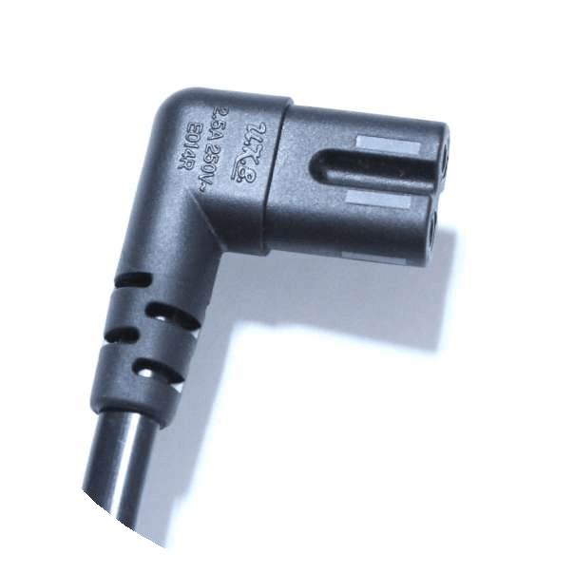

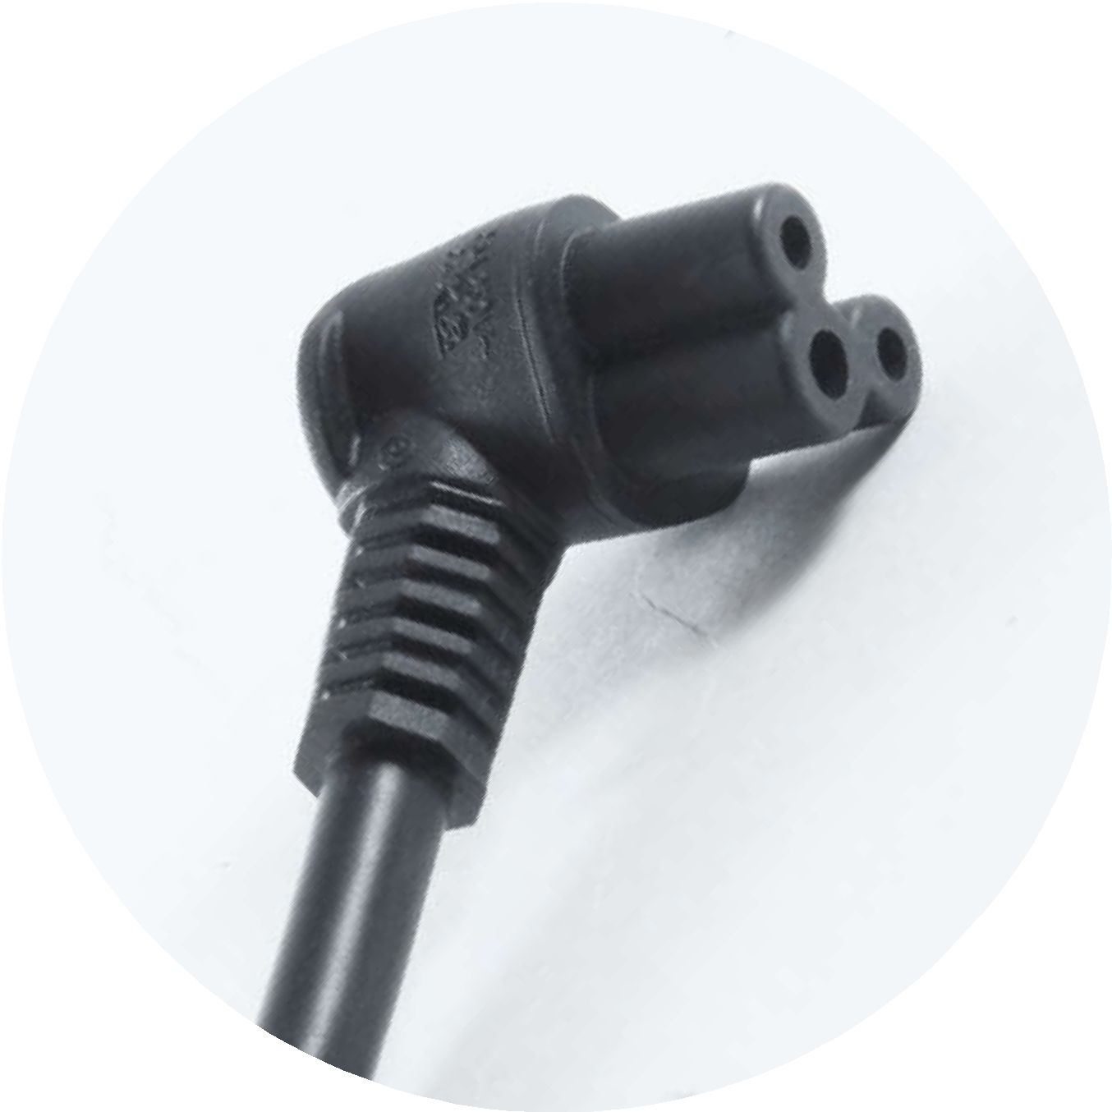



Power Cords
Power Cord - B Side Connectors
C13
C14
C19
C20
C7
C5

Slide 19
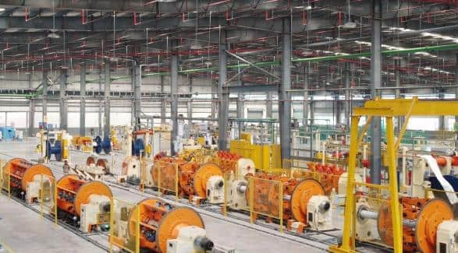
Wires & Cables Overview
UKB is one of the biggest manufacturer of Specialized Wires & Cables in India with one of it’s kind
Electron Beam (E Beam) Facility.
We have in-house facility for following manufacturing processes –
Copper Drawing
Compounding
Electro Plating
Wire Extrusion
E Beam Facility (3.0 MeV & 1.5 MeV)
Laying / Twisting
Braiding / Shielding
Armoring

Slide 20
Wires & Cables Manufacturing Capabilities
We specialize in manufacturing cables as per custom made design for specific applications
Conductor | : | Solid / Stranded : Annealed Bare / Tinned / Nickel / Silver Plated Copper
Insulation / Sheath Materials | : | Thermoplastic : PVC ( HR / FR / FRLS / Zero Halogen / Non-Migrating) / : PE / XLPE / Nylon / PU
 |  | Elastomeric / Rubber : Natural / Butyl Rubber / EPR / EPDM / PCP / CSP / CPE / EVA / Silicone / TPE / TPV
 |  | High Temperature : FEP / ETFE / PFA / PEEK / PVDF / KAPTON / XL-ETFE / PTFE
Unshielded / Shielded | : | Individual &/OR Overall – Al-Mylar / Mu-Metal / Semi-Conductive Tape Shielded
 |  | Braided – Bare / Tinned Copper / SS Wire
Unarmoured / Armoured | : | GI / Steel Wire – Round / Strip, Steel Tape
Special | : | Jelly-Filled / Water-Blocking Compound / Lacquered / Varnished / Cotton / Thread Braided
Global Standards | : | JSS 51034, JSS 51100, JSS 51038, JSS 6145-26, JSS 6145-18, UL 758, UL 1581, VG 95218, DEF STD 02- 525, 526, 527, DEF STD 02-512, DEF STAN – 61-12 Part 18 / 25 / 31, EED 50-12, EED 50-13, MIL C17, MILW 22759

Slide 21
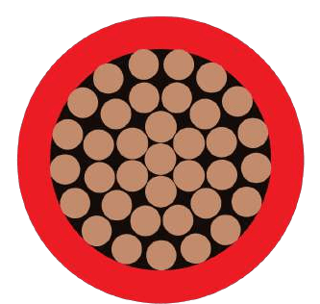














Wires & Cables
RAILWAY & METRO CABLE – ROLLING STOCK
CONTROL CABLE
SOLAR CABLE
EV GUN ASSEMBLY CABLE
FIRE PERFORMANCE CABLE
RAILWAY & METRO CABLE – S & T
INSTRUMENTATION CABLE
ARMORED CABLE – SWA & AWA
MARINE & OFFSHORE CABLE
HIGH TEMPERATURE CABLE
RUBBER FLEXIBLE CABLE
EV AUTOMOTIVE CABLE
THERMOCOUPLE CABLE
LSZH CABLE
MINING, DRILLING & TUNNELING CABLE
Max Size – 630 SQMM

Slide 22


In House Copper Drawing
Wires & Cables
Best in Class Machines from Germany -
Niehoff
Capable of drawing copper from 8 mm rod to 0.08 mm fine gauge wire
Machines Installed –
Rod Break Down
Multi Wire Drawing (24 Wire) & (32 Wire)
High Speed Bunchers

Slide 23


In House Compounding
Wires & Cables
Fully Automated 6 Compounding Lines
capable to manufacture Special Polymers –
EPR
EPDM
CPE
EVA
ZHFR
PVC (HR / FR / FRLS)
PVC is UL 94-V0 Approved

Slide 24


Wires & Cables
UL Approvals for USA Market

Slide 25


E Beam Technology
E Beam Cables
The electron-beam processing facility can be broken down into a number of sub systems:
High voltage generator
Electron accelerator
Scanning system and window
Product handling system
Control system
Radiation shielding and personnel safety system
Equipment for electron-beam crosslinking
In electron-beam cross-linking the electrons are generated by a hot filament and then accelerated in a vacuum chamber by a high voltage. At the end of the vacuum chamber there is a thin titanium foil which the electrons pass through onto the product. Typical values of the high voltage for wire and cable are between 500 kV and 3 MV. Higher and lower voltages are used for other applications. The product is passed through the beam of electrons in a variety of ways to allow optimization of the process.

Slide 26

E Beam Properties
E Beam Cables
Description | Unit | E Beam | Normal
Reduced Size (1 x 150 sq. mm) | Sq.mm | 21.9 | 29.3
Life of Cable (Arrhenious Plot) | Yrs. | > 35 | 15-19
Continuous operating temp | (ºC) | 125 | 90
Current rating (max.) | Amy | 579 | 378
Cold Bend at - 65ºC | Pass/Fail | Passed | Failed
Ruggedness # Dynamic Cut-Through (Kg) # Crush Resistance (Kg) (Kg to cause failure) | Kg | 169 3061 | 64 1482
Scrape Abrasion (No. of scrapes to failure) | Nos. | 11850 | 620
Minimum Bending Radius (Flexibility) | mm | 62 | 88
Oil Resistance (60ºC Diesel Oil) (% swell) | % | 13 | 20
Acid Gas Generation | PPM | <50 | >1000
Nuclear Radiation Resistance | Mrad | >200 | 100
Weight of Cable | Kg/Km | 1365 | 1970

Slide 27



Market Segments
Wires & Cables
RAILWAY & METRO CABLE
MARINE & SHIPBUILDING
RENEWAL ENERGY
OIL | GAS | PETROLEUM
STEEL & MINES
APPLIANCES
TRANSMISSION & DISTRIBUTION
COMMUNICATION & TELECOM
ARMY (LAND DEFENCE)
AEROSPACE & AIRPORTS
E-MOBILITY
BUILDING & CONSTRUCTION

Slide 28
EV Charging Solutions
UKB is one of the only company in India to be able to manufacture complete EV Solution in India without any Import Dependency under the Make in India Initiative.
We have in-house facility for following manufacturing processes –
EV Gun Cable (Through In-House E-Beam Curing)
Injection Molding (UKB owned unique design)
Pin Manufacturing
Silver Plating of Pins
Assembly & Testing
High Voltage Wires
Currently the AC Gun is under mass production and DC Gun under development

Slide 29









Product Range
Electronic Products
UKB Electronics has 2 SMT Lines and Multiple Injection machines which enables UKB to be a complete EMS Solution Provider for combination of Electronics and Electrical Products.
Charger‘s
Remote Control
PCBA
Adapters
These products are used in variety of industries ranging from Consumer Appliances, Automotive & EV, Industrial and Strategic Electronics.
Control Box
Controller
LED

Slide 30







USP - Backward Integration
Injection Molding Machines
PVC
Compounding
Brass Pin
Copper Drawing
In House Tooling
Wires & Cables

Slide 31


In House Brass Pins
USP - Backward Integration
One of the biggest Infrastructure in
India with 50+ Automatic Machines for
Brass Pin Manufacturing used in Power Cords
Surface Finishing M/C – Centrifugal Finishing Machine for Brass Component
100% AOI Certified parts

Slide 32
In House Injection Molding
USP - Backward Integration
Complete In-House Setup to manufacture
Variety of Injection Molded Components in
various polymers.
Total 18 Machines In-House with Capacity ranging from 60 Ton ~ 350 Ton

Slide 33








In-House Tool Room
USP - Backward Integration
State of the art in House Tool Room not only enables to execute new projects and changes faster but also ensures quality of tools is up to the mark.
Other Machines
Milling Machine (Microcut) Horizontal Lathe Machine Surface Grinders
ZNC EDM Machine
Vertical Milling Machine

Slide 34


R&D
In House Design Center capable of handling end to end Design of product
UKB has a strong R&D Team to design products as per requirement
Product Design as per customer / UKB
150+ Global Product Certifications
UKB teams works closely with customers right from product design
Team of 50+ R&D Engineers
2 Patents Granted
6 Under Approval

Slide 35



Reliability Labs
UKB has independent Reliability Labs in all locations to do all reliability testing in-house as per various Indian and International Standards (UL, VDE, ASTA etc)

Slide 36
Thank You
UKB Electronics Pvt. Ltd.
Visit us at www.ukbindia.com

