Slide 1
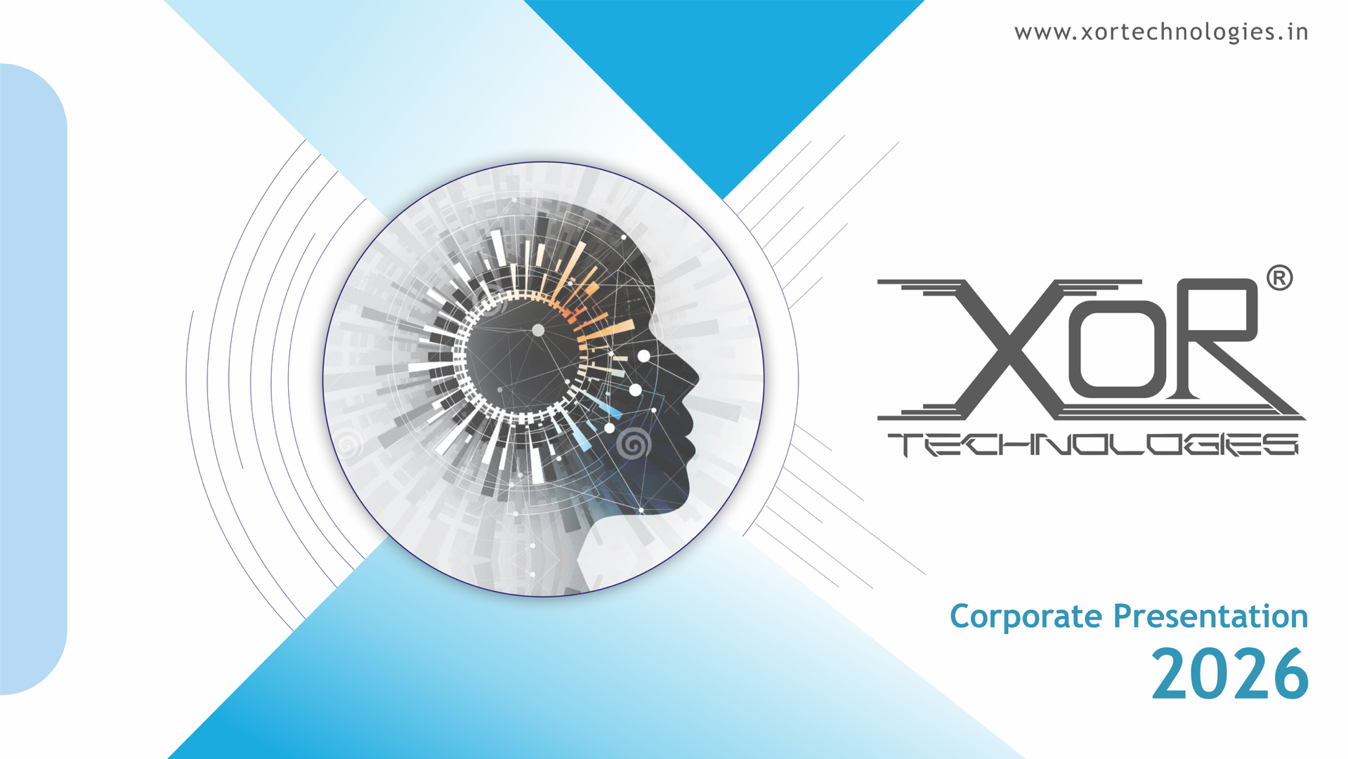

Slide 2

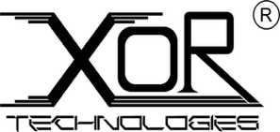
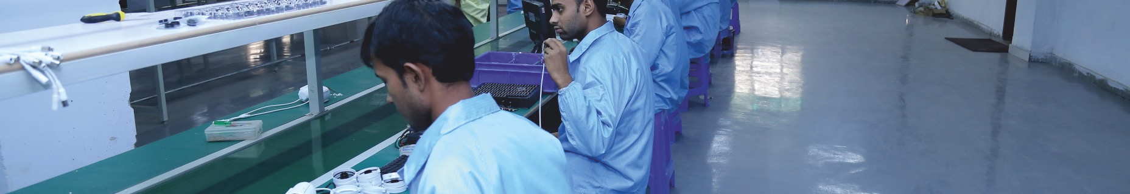
About Us
XOR Technologies is a premier electronics manufacturing company, specializing in audio products and Bespoke solutions. Committed to innovation, we provide comprehensive hardware and software solutions designed to meet the unique needs of our clients
VISION
MISSION
“Transform India into an industrial powerhouse while positioning it as a leader in the global consumer electronics market”
"To deliver top-tier products and services that provide an exceptional experience for owners."

Slide 3

Our Values
3Cs
Commitment
Conscience
Conviction
"We approach our work with
full ownership of commitments and
outcomes to drive and
support business decisions."
"We strengthen our position
by building on ideas, innovation, and
practices that drive our leadership
in the segment."
"we are strongly confident and
understand the importance
of R&D to drive progress,
improve products, and achieve
long-term success.”

Slide 4

Significant Milestones
2016
Established in New Delhi
2017
Partnered with renowned Chinese Manufacturer
for Chargers and Power Banks manufacturing
2018
Set up a State-of-the-Art In-House R&D Lab
2019
Expanded into LED Bulb Manufacturing
2020
Entered Personal Audio Segment and UPS Router
2021
Started Manufacturing of TWS and Neckbands
2022
Ventured into Home Audio with Soundbars
2023
Started manufacturing of Smart Audio products
2024
Scaling up Existing Verticals
2025
Proposed inauguration of Noida Facility

Slide 5
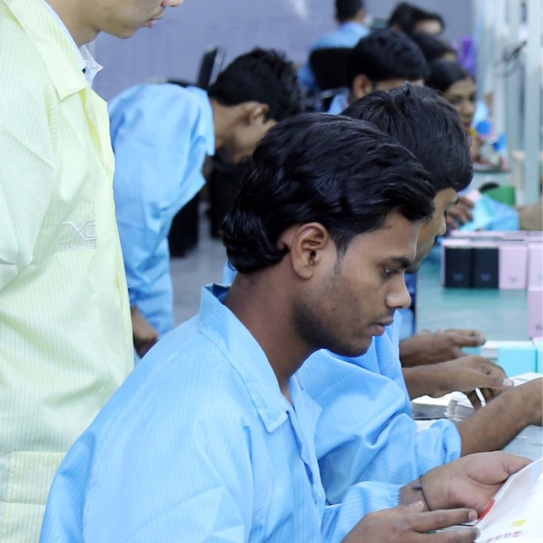
XOR Center for Research
Full hardware and software integration.
Prototype design and testing.
Customization based on client requirements.
Dedicated team with advanced tools for innovation.
Ground up engineering of Audio Solutions
Tailored solutions for different Geographies
Extensive Long term Reliability testing

Slide 6
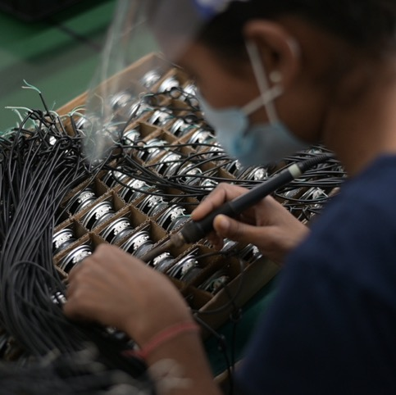
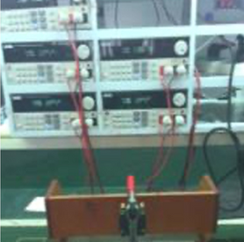
Leadership In Audio Technology
Seamless hardware-software integration from concept to mass production.
Advanced simulation tools and testing facilities to optimize product
performance and durability.
Rapid prototyping and market-specific customization to meet
unique client needs globally.

Slide 7
















Our Trusted Customers

Slide 8
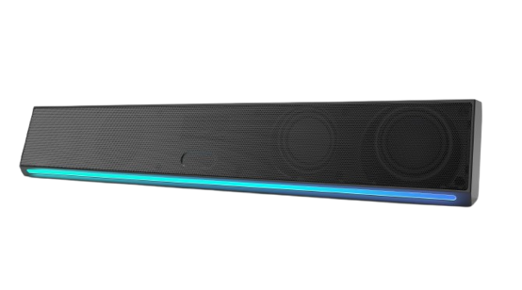
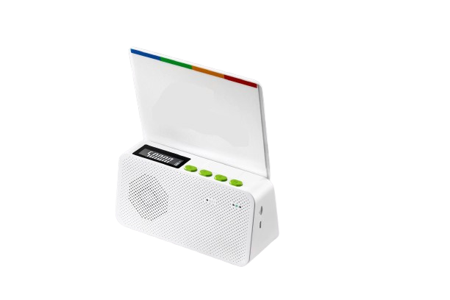
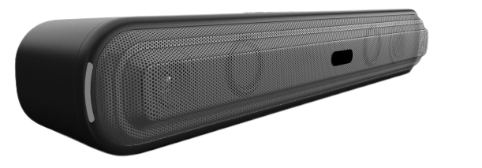
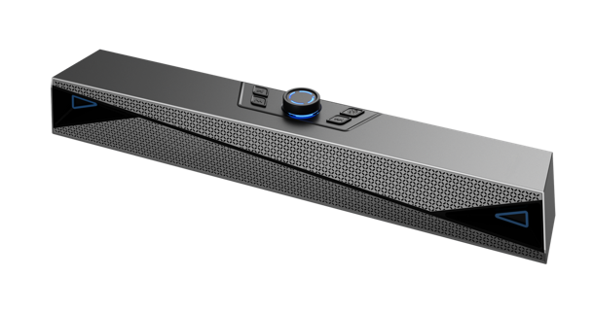
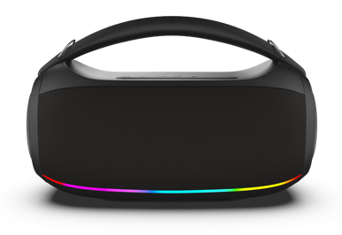
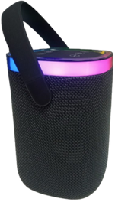
AUDIO
SOUNDBAR
PARTY SPEAKER
SOUNDBOX

Slide 9
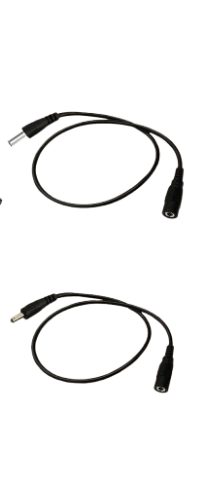
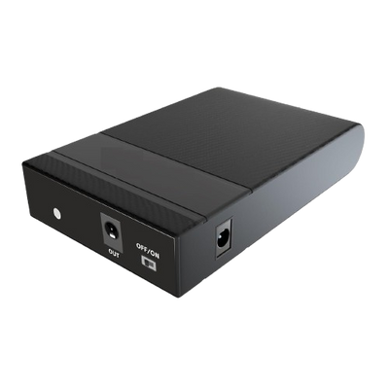
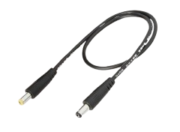
POWER
ROUTER UPS
Input Connector Female 3.5 * 1.35
to Male 5.5 * 2.1
Output Connector Female 5.5 * 2.1
to Male 3.5 * 1.35
1 Bridge Cable
Male 5.5 * 2.1 to Male 5.5 * 2.1

Slide 10
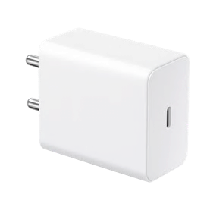
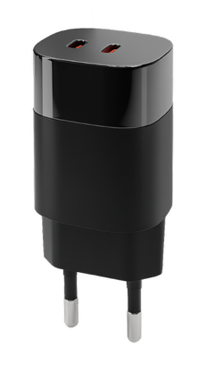
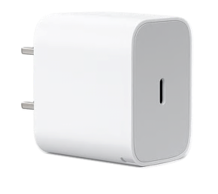
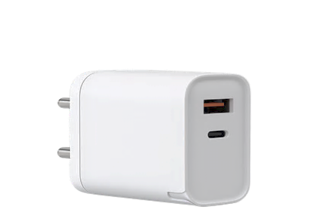
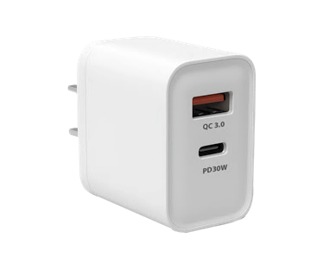
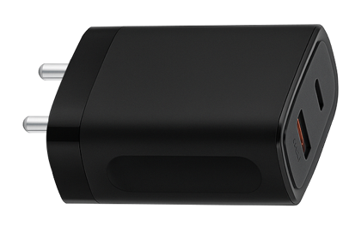
POWER

Slide 11
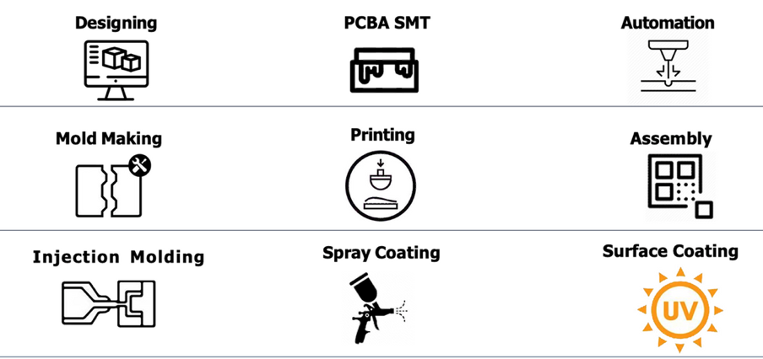
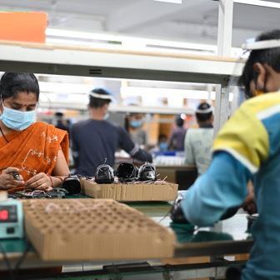
Where we can help!
We offer a comprehensive approach to product
development from the initial idea to full-scale
production. Our process includes:
  Ideation: Creative brainstorming and
market research to identify customer needs
and product potential.
  Design & Prototyping: Converting concepts into functional designs and building prototypes for testing and refinement.
  Engineering & Testing: Detailed engineering, quality testing, and product optimization to ensure peak performance.
  Mass Production: Scaling up for large-volume manufacturing while maintaining quality, efficiency, and cost-effectiveness.

Slide 12
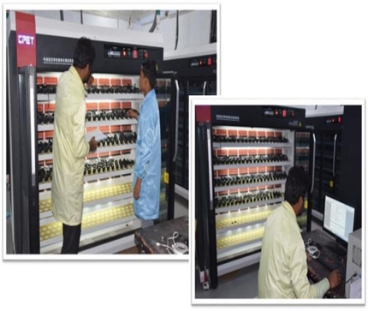
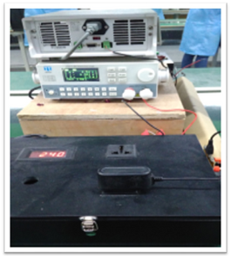
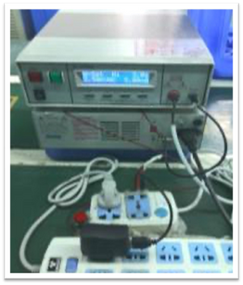
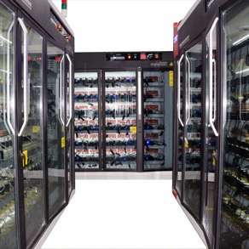
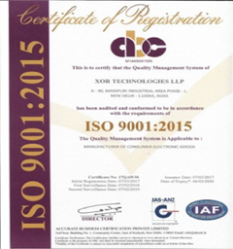

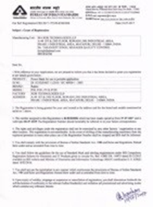
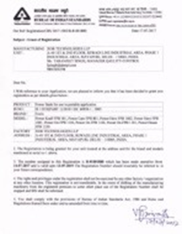
Quality Control Infrastructure
Ageing Workshop
Hi-POT Testing
Product Performance testing
Burn in testing
Company ISO Certificate
BIS Certificate

Slide 13

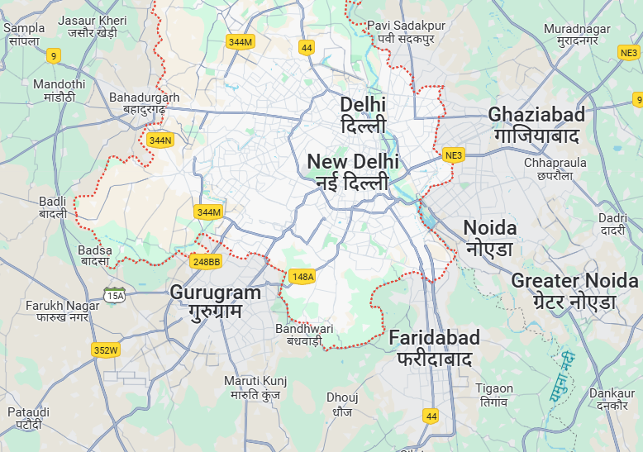

Here We Are
New Delhi: Alipur
Manpower: 100+
Area: 20,000 Sq. Ft.
Noida: Noida
Proposed Manpower: 1200+
Area: 1,25,000 Sq. Ft.
Strategically located 1,70,000sq.ft of State-of-the-art manufacturing,
in the heart of the nation's capital with access to key human and infrastructure resources. We stay at the center of innovation and opportunity.
Find Us at our Head office :
A-40 Mayapuri Industrial Area Phase-1 Delhi 110064
New Delhi: Mayapuri
Manpower: 350+
Area: 25,000 Sq. Ft.

Slide 14
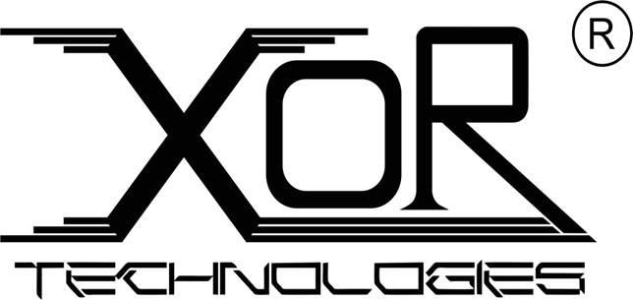

XOR Technologies LLP
A-40, Mayapuri Industrial Area, Phase – 1
New Delhi - 110064
Email: sales@xortechnologies.in
Phone: +91-8527374111, 8802307252
www.xortechnologies.in

