Slide 1



AN OVERVIEW
Safer, Smarter & Sustainable
ISO 9001:2015 Certified Company

Slide 2



Saalfo Tech - Background
| EMS - Education - Textiles |
SAALFO is a part of a successful business conglomerate that has over 35 years of experience in founding, developing and maintaining highly flourishing business in various industries i.e. Electronics Manufacturing Services, Education and Textile.
Our fundamental objective is to build a clean profitable business for all its stakeholders by innovating and deploying the best quality and smart processes with greater value system, integrity and team work.
Along with EMS, our long-term strategy is to support the 'Make in INDIA' initiative by having robust in-house bare PCB and critical electronic components design and manufacturing facilities with true end-to-end solutions that will help in freezing design faster, rapid prototype development and provides competitive edge to our Customers in their business growth and profitability.
Vision: “To set-up a world class manufacturing facility inspired by innovations, advanced engineering and smart technologies to design, build and deliver successful products and services”.
(Bare PCB > Components > PCBA > Cable Harness > Box Build Assembly)

Slide 3
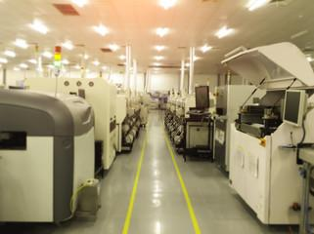













Saalfo Tech Pvt Ltd - Snapshot
Saalfo Tech is an established and fastest growing EMS Company in Mysore.
Founded in 2016.
Employees: Present >100
Total area 172,000 Sq. Ft. Over 40,000 Sq. Ft. is utilized for production
Facility is approved for Class II & Class III products
Expandable up to another 40,000 Sq. Ft.
Domain experience in EMS is over 20 years.
PCBA, Cable Harness and Box Build Assembly.
Quality Certifications ISO 9001:2015
(ISO 14001, ISO 45001, ISO 13485, AS 9100 -2025)
Volume from 10 nos to > 100K nos.
New Facility is coming up in next 3 months
with 2 New SMT lines.
Key Customers

Slide 4

Organisation Chart
BOD
MD & CEO
BD, Mkt & PM
COO
Engineering, NPI, Quality, SCM, Production, Maintenance and MR
Finance, Accounts & Admin
BD & PM
Junior Eng, NPI & Customer Quality
Production
Electrical & Maintenance
SCM
HR, Admin
Test Engg. Calibr. & ESD
Incoming, Process QC, QMS & FQA
Production
SMT Pgrmng & Maintenance
Stores & Dispatch
Consultant
Certification
Consultant
Business Strategy
Consultant
Legal, HR & Admin
STPL_OC_August2024 RV01.4_September 2024

Slide 5

New Marketing Strategy:

Slide 6

New Marketing Strategy:

Slide 7
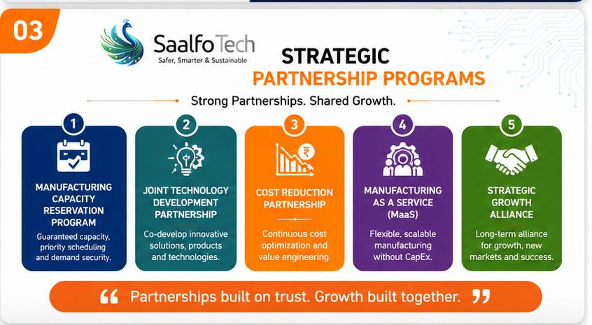
New Marketing Strategy:

Slide 8

New Marketing Strategy:

Slide 9
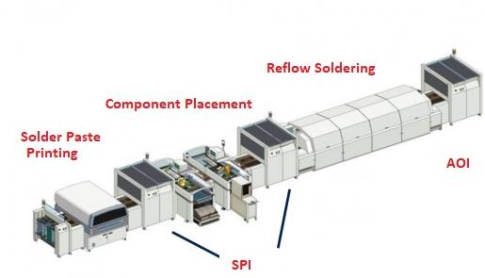
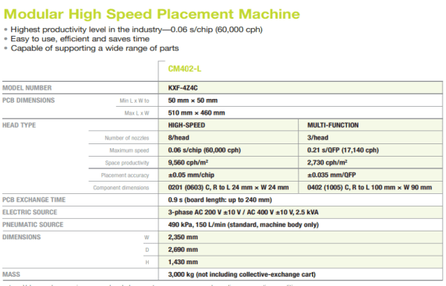
SMT LINE 1 FOR HIGH-MIX HIGH-TECH/ HIGH VOLUME

Slide 10

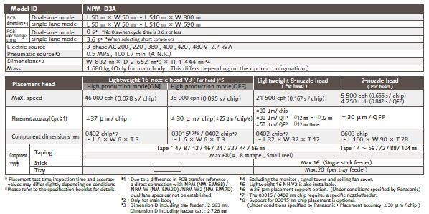
NEW SMT LINE 2 FOR HIGH-MIX HIGH-TECH/ HIGH VOLUME
Inline AOI
Inline SPI
SMT Line with PanaCIM Traceability Software

Slide 11
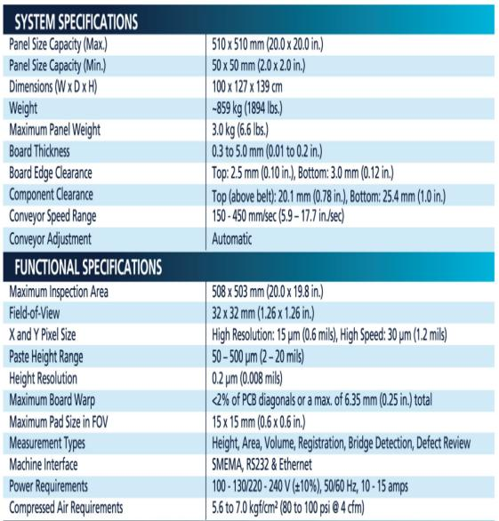
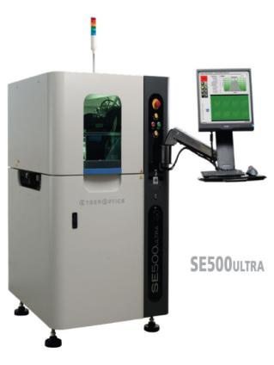
Cyberoptics – SPI

Slide 12
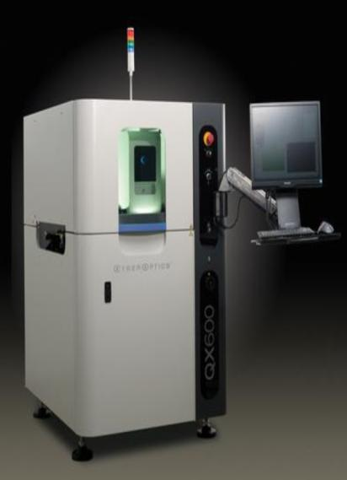
Cyberoptics – AOI
QX600 is equipped with SAM (Statistical Appearance Modeling) vision technology. SAM works in perfect harmony with AI² (Autonomous Image Interpretation) technology to enable fast programming and reliable discrimination against defects.
Features:
Typical Scanning Speed 200 cm2 /sec (31in.2 /sec)
Minimum Component Size 0402 mm (01005 in.)
Board Length (without re-inspection) QX600: Min. 50 mm (2 in.)/ Max. 457 mm† (18 in.) QX600-L: Min. 50 mm (2 in.)/ Max. 510mm†† (20.0 in.)
Board Width QX600: Min. 50 mm (2 in.)/ Max. 308 mm (12 in.) QX600-L: Min. 50 mm (2 in.)/ Max. 590mm (23.2 in.) Board Length + Width (QX600-D Model) Single Lane: Boarder up to 510 (L) x 300 (W) mm (20.0 x 11.8 in) Dual Lane: Min. 50 mm (2 in.)/ Max. 590mm (23.2 in.)
Component Height Clearance (max) 35mm (1.378 in.)
Board Edge Clearance (min) 3.0 mm (0.125 in.) – bottom side only
Component Types Inspected Standard SMT (chips, J-lead, gull-wing, BGA, etc.), through-hole, odd-form, clips, connectors, header pins, and others
Component Defect Categories Missing, polarity, tombstone, billboard, flipped, wrong part, gross body and lead damage, and others

Slide 13
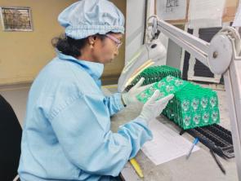
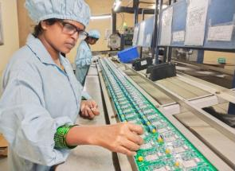
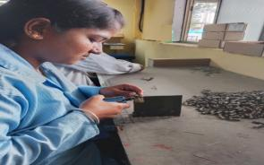
PCBA Facility
Hand soldering we do with control environment with password protected for monitoring temperature.
ESD safe workstations, calibrated soldering station and tools with temperature and humidity controlled zones
Each soldering joint is produced under rigid control of strict wetting, fillet and intermetallic layer requirements with correct thermal profile application.
Carries inspection with microscopic inspection with full traceability of materials, operators, tools and process parameters.
Application:
Defence and Aerospace.
Medical.
Railway.
Industrial.
Automotive.
EV

Slide 14
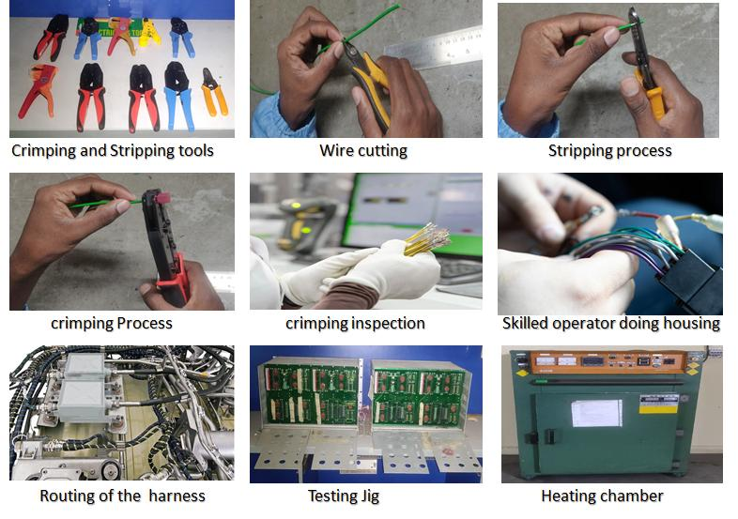
Cable Harness Facility

Slide 15
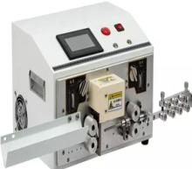
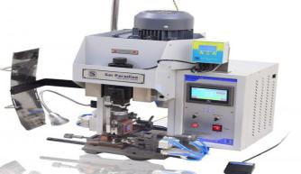
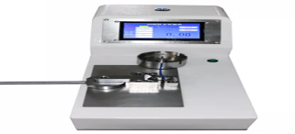
Automated Cable Harness Facility
Cable
Assembly Line
The machine details
Model SQ-BJYJ8114-3
  Production efficiency 2000 pieces/hour.
  Wire cutting range from 1mm to 99999.9mm.
  Wire Diameter ranging from 0.14sqmm to 16sqmm.
The machine details
Model HF2000 - Sai Paradise - Make
High Quality Precision Bench Top
Crimping with Optional Crimp Force
Monitor Available
The machine details
Model SQ-BJYJ8112-1
  The tester can pull test the crimped terminals with wire ranging from 1AWG to 22AWG as per the UL 486A with Test Accuracy 0.04kg
HIGH-MIX HIGH-TECH

Slide 16


Saalfo Capability & Performance
Hi-Tech SMT:
Handling complex and dense populated boards having >300 SMD parts with BGA & QFP packages. CPH 86K per hour with 4 sigma accuracy.
Cable Harness: Hi-Tech cable assembly for Railways segment with 11 types bunch cables in a single unit. Doing harness for chemical dosing pumps for Industrial segment.
Box Build Integrating with EOL Testing:
Doing PCBA, wiring harness, complete box build integration and final product level testing and in that some of the products are having displays.
Multi-Products Assembly Experience :
Doing high complex Smart Meters (IOT), Industrial Automation, Relay and Railway Signaling products with more than 12 different varieties. Each variety has 4-5 boards.
Special Process:
We can meet and follow the UL required assembly process for customer specs and UL file. We will provide the COC & traceability. Doing different types of Gluing & Conformal Coating with both spray and manual as per the customer requirement.
Jigs & Fixture Development:
We have developed in-house test jigs and fixtures based on the specifications and drawings provided by customer.
Vendor Development & Management:
Good Vendor Base for both local and global requirements… specially for plastics and mechanicals we have qualified suppliers locally who can give competitive prices along with highest quality.
Design & Development:
We have a local design partner APT who is supporting us for complete design and re-engineering activities including software development.

Slide 17
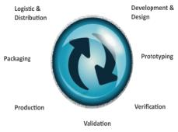





Our Offerings
Design Validation |  | NPI
Board Production |  | NPI | Production Engineering | PCB Assembly
Cable Harness |  | NPI | Production Engineering | PCB Assembly | Cable Harness
Product Integration |  | NPI | Production Engineering | PCB Assembly | Cable Harness | Box Build
Life Cycle Management |  | NPI | Production Engineering | PCB Assembly | Cable Harness | Box Build | Product Management
Design (DFX)
Engineering and Development (Proto / NPI Build)
Series Manufacturing
Box Build / Turnkey Manufacturing
Support Services (Integrated logistics with repair services and robust supply chain management)

Slide 18



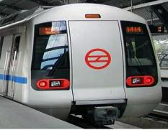
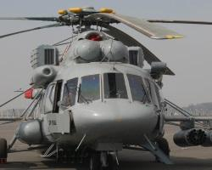
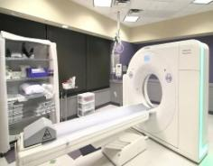

Focus Segments
Industrial | Railways | Defence & Aerospace |Healthcare | Automotive | EV I Advance Consumer Electronics
Automotive
Industrial
Railways
Defence & Aerospace
Healthcare
Electric Vehicle

Slide 19
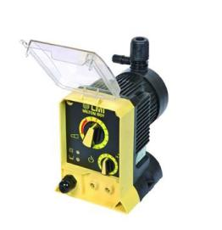
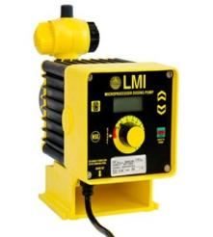
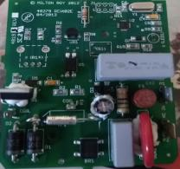
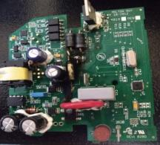
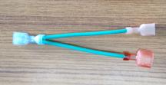
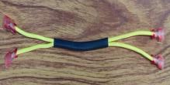
Key Projects – Industrial Segment for USA Company
Milton Roy manufactures controlled-volume metering pumps and equipment that deliver unsurpassed reliability and accuracy in critical chemical dosing and water treatment applications.
Project Handled at Saalfo : Box Build Mechanical Assembly, PCBA and Wiring Harness
Total PCBA Produced : 10000 No’s
Total Wiring Harness Produced : 12000 No’s
Average Monthly Quantity : 1500 No’s
Average Monthly OTD : 96%
Average Monthly Quality : < 250 PPM
Types of PCBA & Wiring Harness Produced:
P+0 (47123)
P+1 (47124)
P+7 (47125)
P+8 (47126)
Grounding Cable Y Assembly

Slide 20
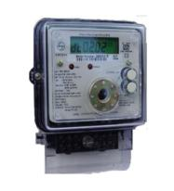

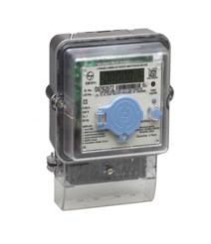
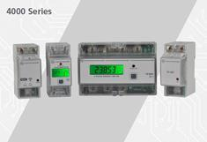
Key Projects – Industrial Segment – Smart Energy Meters (IOT - Bluetooth)
Complete Product Level Engagement : PCBA, Wiring Harness, Box Build Assembly & Final Testing
Total Meters Produced : > 20 Million
Average Monthly Quantity : 125K
Average Daily Quantity : 3-5K
Average Monthly OTD : 96.7%
Average Monthly Quality : < 750 PPM
Types of Meters Produced:
1Ph Energy Meter
1Ph Din Meter
3Ph Din Meter

Slide 21
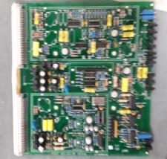
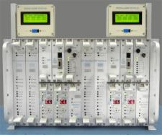
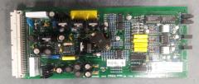
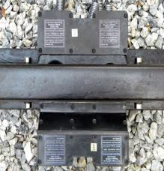
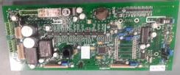
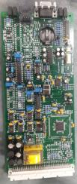
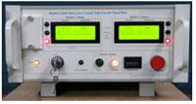
Key Projects – Railway Segment for Japanese Company
Project Handled at Saalfo : PCBA and Wiring Harness
Total PCBA Produced : 3000 No’s
Total Wiring Harness Produced : 4000 sets
Average Monthly Quantity : 1800 No’s
Average Monthly OTD : 98%
Average Monthly Quality : < 500 PPM
Types of PCBA & Wiring Harness Produced:
PD Card 21KHz
PD Card 25KHz
G36R Dual Display Reset PCBA
Relay Drive Card
SM CPU or Event Logger Card
Cable Bunching from Mother Board to MS Coupler

Slide 22
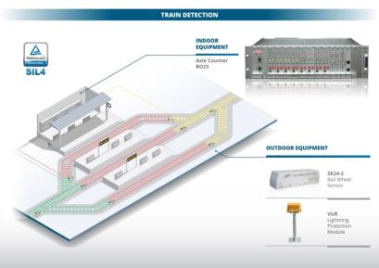
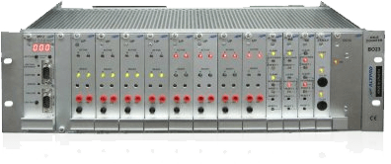
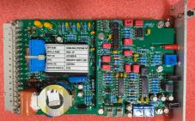
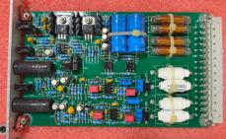
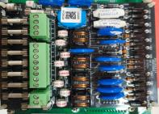
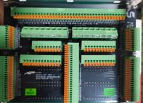
Key Projects – Railway Segment
European Company
Project Handled at Saalfo : PCBA, Wiring Harness & Box Build Integration
Total PCBA’s : 13 No’s
Total Wiring Harnesses : 2 sets
Total Box Build Assembly : 2 No’s
Average Monthly Quantity : 4900 No’s
Average Monthly OTD : 99%
Average Monthly Quality : < 500 PPM
Types of Products Produced:
Axle Counting BO23
VUR Unit

Slide 23
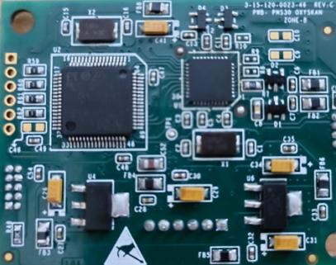
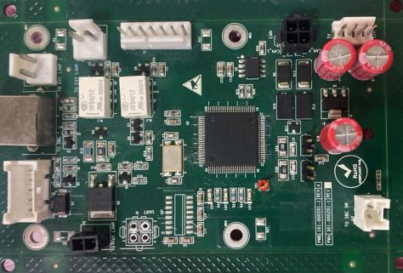
Key Projects – Medical Segment
Project Handled at Saalfo : Engineering and Development (Proto / NPI Build), PCBA

Slide 24
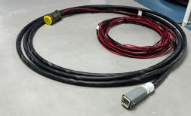
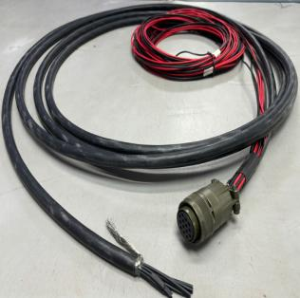
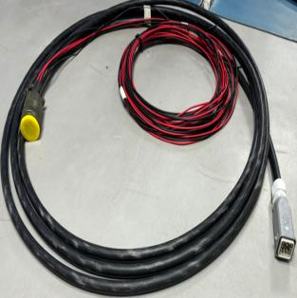
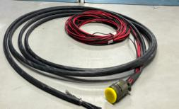
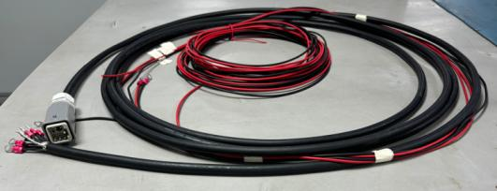
Key Projects – Railway Segment
Project Handled at Saalfo : Wiring Harness

Slide 25
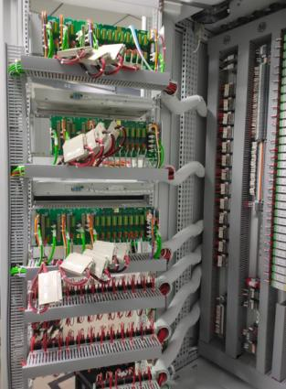
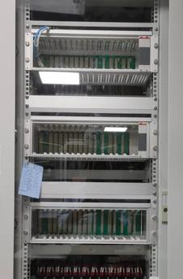

Key Projects - Railway Segment
Axle Counting Cubical Wiring for Austrian Company
Project Handled at Saalfo : Wiring Harness

Slide 26



Key Projects - Defence Segment
Drone Power Card
Project Handled at Saalfo : Design (DFX) , Engineering and Development (Proto / NPI Build), PCBA and Wiring Harness

Slide 27



Key Projects - Defence Segment
Drone Power Distribution Unit
Project Handled at Saalfo : Design (DFX) , Engineering and Development (Proto / NPI Build), PCBA and Wiring Harness

Slide 28




Key Projects - Automotive Segment
Regulator
Project Handled at Saalfo : Design (DFX) , Engineering and Development (Proto / NPI Build), PCBA.

Slide 29


Statutory and Regulatory Details

Slide 30

ISO 9001:2015 – Certification from TUV SUD
ISO 9001:2015 Certified Company
For
Electronic Contract Solutions & Manufacturing of
Printed Circuit Board Assembly, Wiring Harness & Box Build Assemblies and Mechanical Integration

Slide 31

ZED Bronze Certification from Ministry of MSME

Slide 32

MSME COMPETITIVE(LEAN) SCHEME CERTIFICATE

Slide 33



Photos of Kaizen Awards from
Schneider Electric for Year 2021, 2022, 2023

Slide 34


Thank You
Business Enquiries Contact:
Ayaz Ahmed
Sr. Engineer - BD and PM
Mob: +91 6363674212
Email: ayaz.ahmed@saalfo.com

