Slide 1
A Wire & Wireless Infrastructure and Automotive Solutions Company

Slide 2





Introduction
Company Overview
Rancommunication Global was founded and is managed by a group of elite Wireless Infrastructure, Fiber Optic and Automotive Industry professionals to strategize, design and manufacture high quality and high-performance radio frequency, fiber optic and automotive solutions and products.
Headquarters
Netherlands
Singapore
Operating Units
Rancom Wireless
Rancom Automotive Solutions
Rancom SatCom
Rancom Fiber Optic Solutions
Each connection point, from antennas to interconnect solutions to fiber optic components, is critical to the performance of your wired and wireless network. That is why at Rancommunication Global we are committed to providing our customers with most reliable, industry leading products built on innovations.
Rancom Green Energy
We understand the complexity of managing large amounts of data
that must be transferred quickly and safely. In times when bandwidth services are more demanding, our broad portfolio of Wireless, Fiber Optic, Automotive and Coaxial cabling systems will ensure the transmission and processing of your most valuable asset, the data.

Slide 3
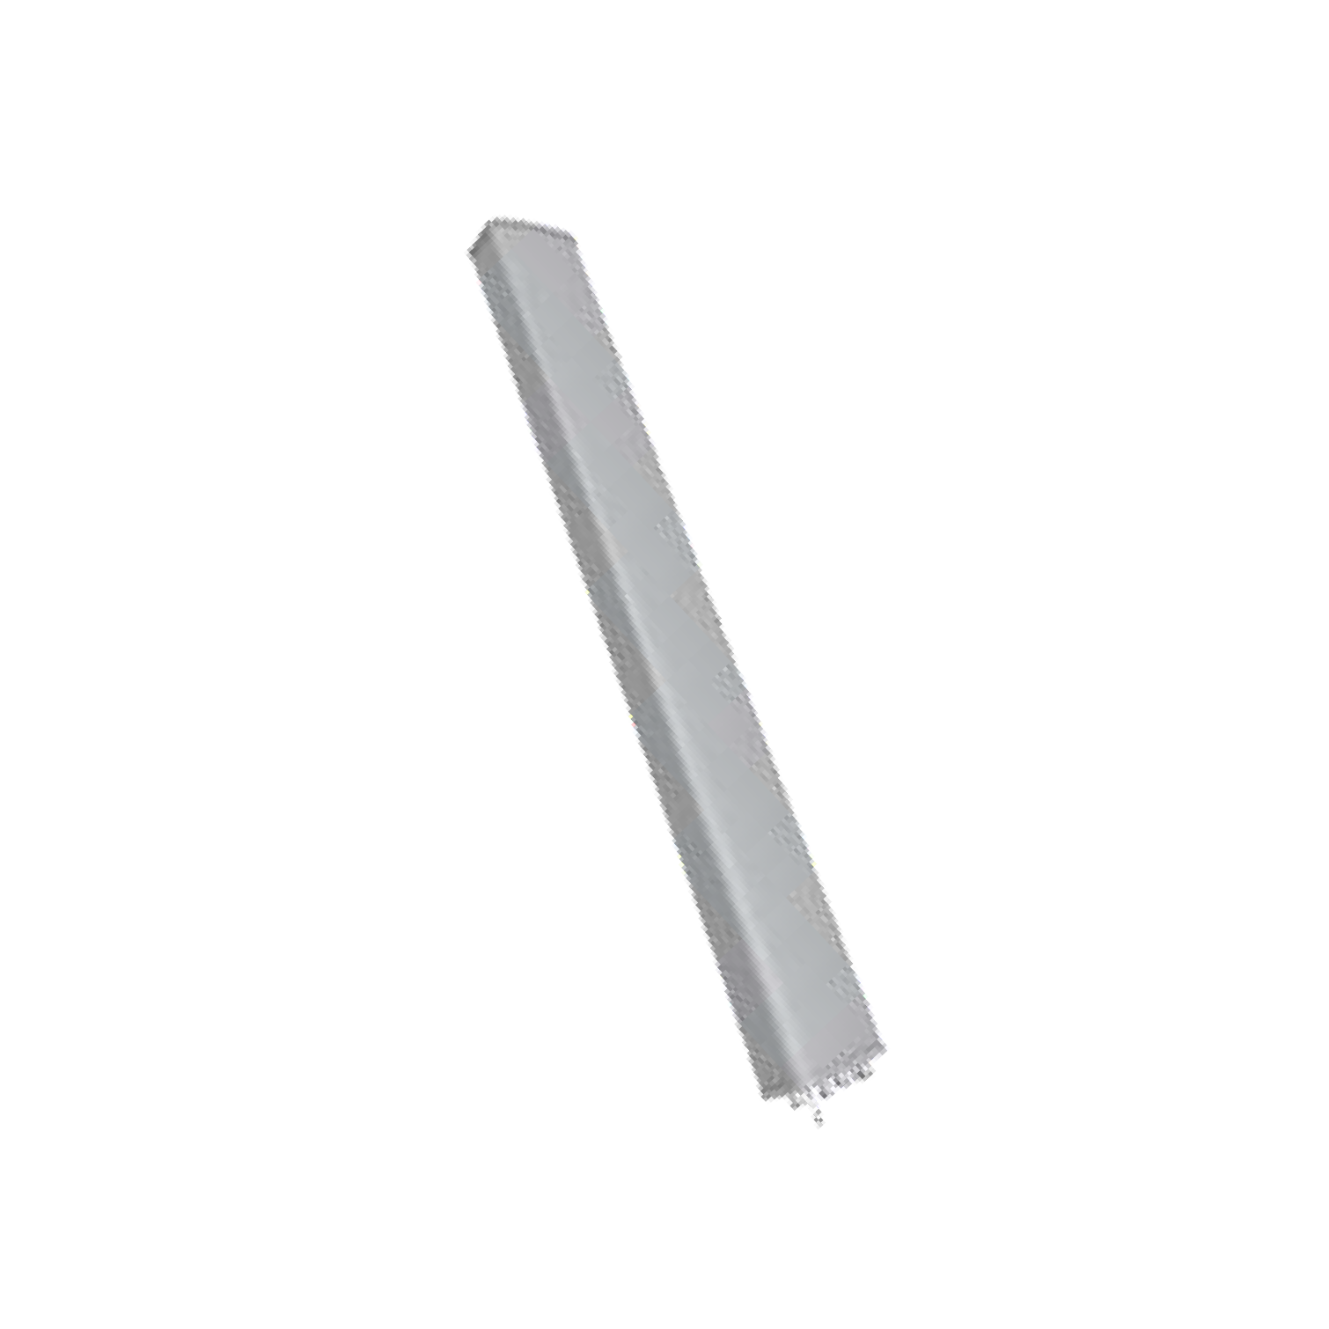




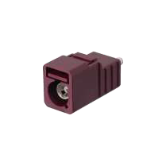
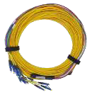
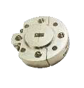

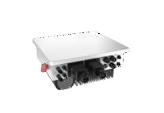
Product Range
Antennas
Mobile Broadband
IOT
CPE (4G, 5G)
Wireless Routers (ONT, ONU)
Repeaters
Digital DAS
Unlicensed Band Radio
Services
RF Planning
Macro site field services
IBS planning & site services
Wireline planning &
field services
Automotive
Base Station
Omni-Directional
DAS & Small Cell
Massive MIMO
Front- & Back-Haul mmWave
Satcom/6G
Telemetics
High Voltage Cable
Busbar
Sensors
Antennas
ESA
Fiber Optics
High Frequency & High Performance RF
20-130 GHz for Military & Aerospace
Quantum computing
EMC & Fiber Optic Testing
Commercial 5G
Automotive Applications
Industrial Interconnect Solutions
Rail system – traction, coupling,
braking
Off-shore
Civil aviation
Green Energy
Photos Technologies
FTTx Active Solutions
FTTx Passive Solutions
Lithium Battery
Solar Invertors
Hydrogen-Based Solutions

Slide 4
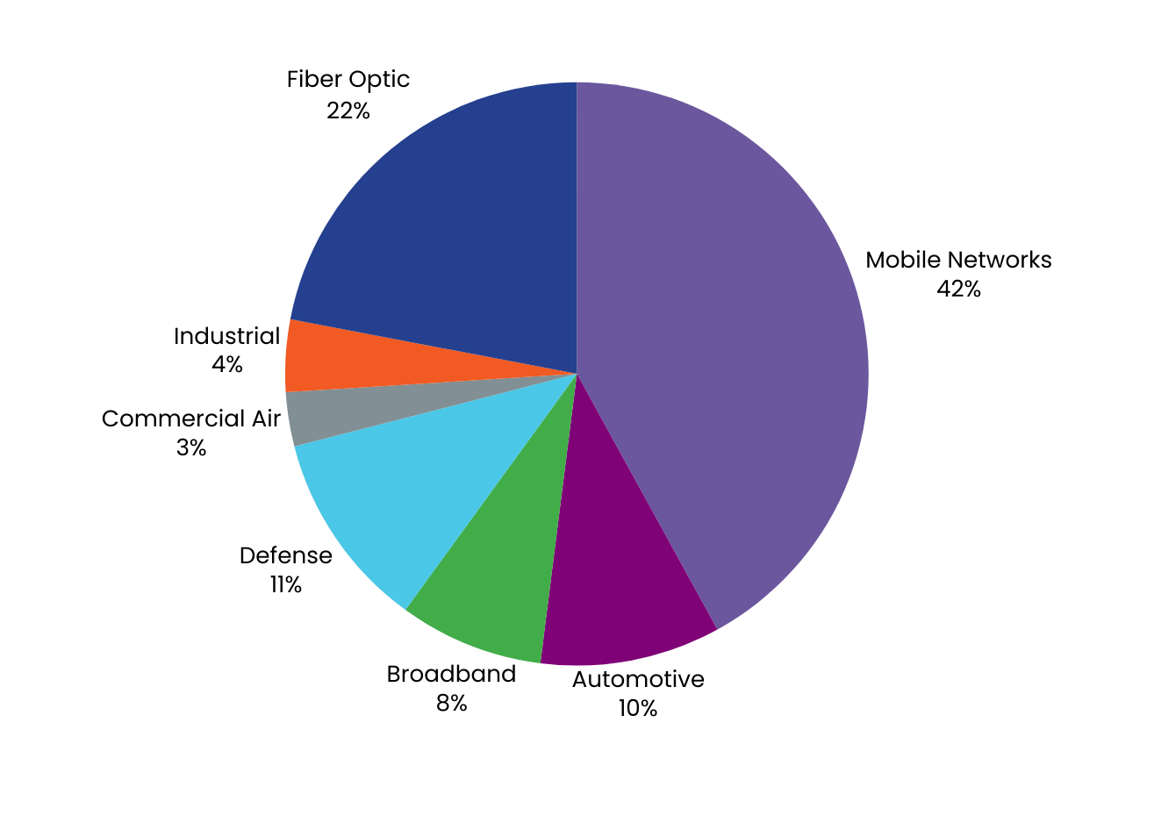

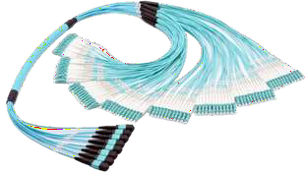
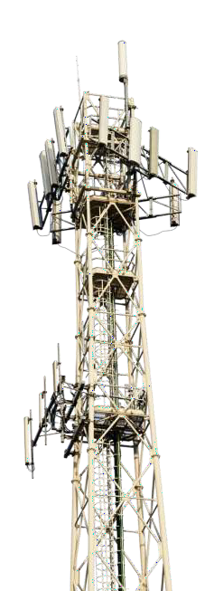
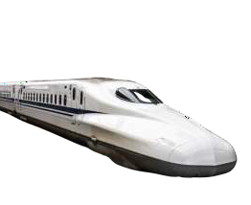


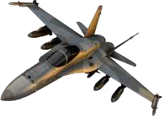
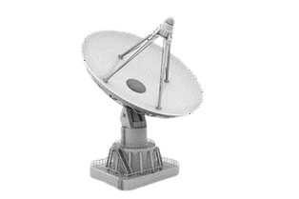
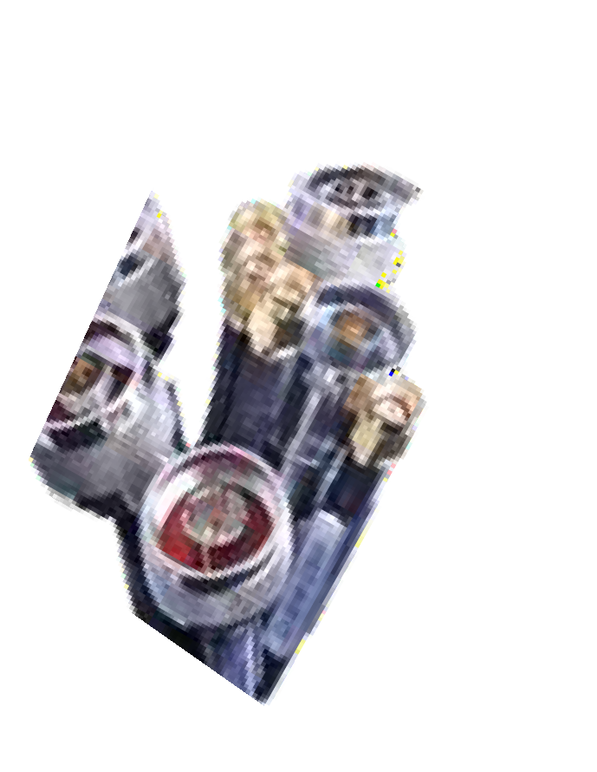

6
Operating Divisions
4,854
Employees
168
R & D engineers
Market Diversification

Slide 5


Global Presence
Headquarters
R & D Manufacturing Sales & Distribution

Slide 6






























































Customer Base
Wire- & Wireless Infrastructure
Automotive
Appliance/Industry

Slide 7

India Presence
Rancommunication Solutions Private Limited
Registered Address: Unit No. 8, 38-DLF Industrial Area, Kirti Nagar, New Delhi-110015
CIN: U26300DL2024PTC429179

Slide 8
Social Responsibility
Customer Satisfaction Through People Dedicated to Excellence
Our Goal is to exceed our customer expectations through the quality of our products and services. This is achieved through our drive for continuous improvement in quality, djesignjcost and delivery
Quality and Quality Improvement is every Rancom Wireless employees’ responsibility and ultimate goal
Our directives, processes, systems and goals are based on requirements from International standards, the expectations of our customers, our knowledge and experience. Knowledge of and compliance with these directives and processes is the foundation of our improvement activities
Preventing failures is more important than stopping defects. We apply methods and tools from preventative Quality Assurance in a systematic way, learning from opportunities to eliminate root causes without delay
Our suppliers contribute substantially to the quality of product and services, therefore, our suppliers must live up to the same high quality standards we have adopted
Communication and employee empowerment is the cornerstone of our principles; this is accomplished by our ongoing commitment to training and our employees’ direct involvement in continuous improvement

Slide 9
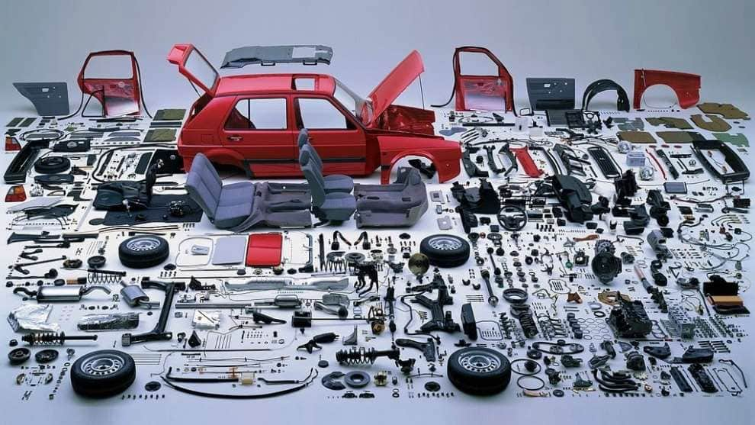
Automotive
One-Stop Shop Vertically Integrated Manufacturing Solution Provider with an extensive portfolio of automotive products

Slide 10
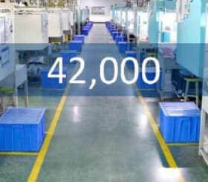
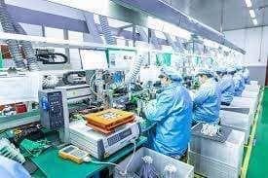

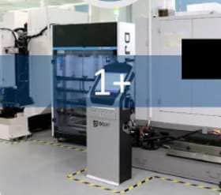
Automotive
Capabilities
Production Area
32,000 m2
Headcount
Staff : 100 (11 %)
Engineering : 120 (13%)
Quality staff: 100 (11 %)
Operators: 580 (65%)
Operations
P1 Precision Components
P2 Electronic Products
P3 Connectors and Cable Assemblies
1-Stop Shop
R&D
Tooling Fabrication
Precision Components Product Assembling, Inspection & Verification

Slide 11
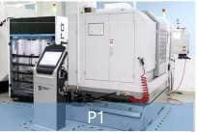
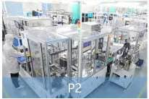
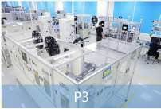

Automotive
Operations & Capacity
High flexibility and vertically integrated manufacturing capabilities enable a quick response to customer needs and to provide customers with high quality products and solutions.
Precision Components Zinc/Aluminum Die-casted Part Stamping and Injection Molding Part Optical Modules Structural Parts | Electronics & Switch Modules Switch Modules & Smart Control Knobs Encoders & Potentiometers & Switches | Connectors & Cable Assemblies Telematic Connectors Cable Assemblies
Plastic: 10~200 tons Stamping: 3 ~ 160 tons Zinc Die-casting: 25~ 170 tons Aluminum Die-casting: 180~ 500 tons | Lean production lines Automated production lines | Lean production lines Automated production lines
Precision Components : 91000K Expansion Capacity Ratio: 40% | Switch Modules & Smart Control Knobs: 500K Encoders & Potentiometers & Switches: 7000K | Connectors & Cable Assemblies 2200K Expansion Capacity Ratio: 100%
 | Expansion Capacity Ratio: 100%
Center Department Automated Assembly Workshop Tooling Fabrication Center In-house laboratory | Internal R&D expertise Automated assembly Workshop In-house laboratory

Slide 12

Automotive
Quality Certification
Lean Manufacturing & Quality Assurance
Lean-manufacturing offers competitive products to meet with market and customer needs; High quality requirements with strict goals in QA, QC and QS.
IATF16949
ISO9001
ISO14001
IECQ QC 080000
D-U-N-S
Product quality refers to how well a product satisfies customer needs, serves its purpose and meets industry standards. We have passed IATF16949, ISO9001, ISO14001, IECQ QC080000 and other quality system certifications. Our product quality control is implemented in strict accordance with specific industry requirements for automotive and communication industries.

Slide 13

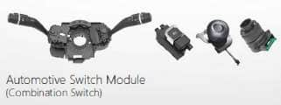
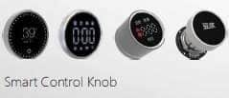

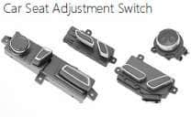


Automotive
Products – Switches/Telematic/Electronic/Precision
Product Development & Innovation
Rancommunication Global offers a comprehensive range of telematic connectors and cable assemblies, electronic products ranging from Automotive Switch Modules, Smart Control Knobs, Encoders, Potentiometers, Switches as well as precision components containing Die-casting, Stamping Injection Molding and Over-molded parts.
Our diversified product lines are widely utilized in the fields of automotive, smart home appliance, (SG) communication, etc.
2009
2017
2018
2019
2020-2022
2023
Pre 2009

Slide 14
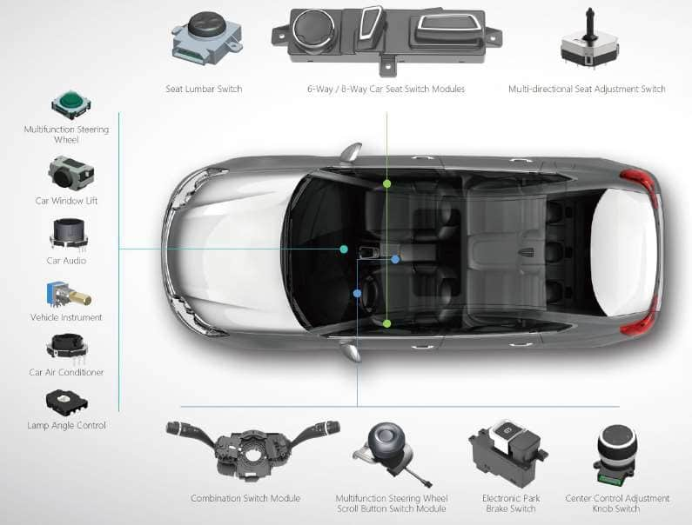
Automotive
Products – Switches & Modules
Switches & Modules
Car Seat Adjustment Switch Module
Combination Switch Module
Multifunction Steering Wheel Scroll Button Switch Module
Electronic Park Brake Switch
Center Control Adjustment Knob Switch
Encoder, Potentiometer, Switch
Application Area
Car Seat Adjustment
Car Seat Heating
Multifunction Steering Wheel
Electrical Parking Brake
Car Window Lift
Car Audio
Vehicle Instrument
Car Air Conditioner
Lamp Angle Control

Slide 15
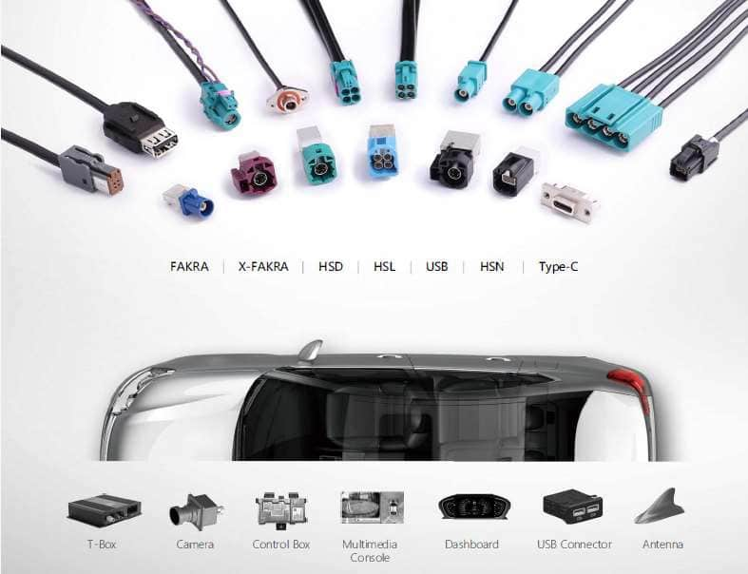
Automotive
Products - Telematic
Telematic Connectors & Cable Assemblies
FAKRA
X-FAKRA
HSD
HSL/USB
HSN (Ethernet Series)
Type-C
Application Area
360° Surround View Camera
Advanced Driver Assistance
System (ADAS)
In-Vehicle Infotainment System
Telematics
Wireless Communication
Autonomous Driving System
Automotive Instrument Cluster
GPS Navigation
RF Bluetooth
Radio Antenna

Slide 16
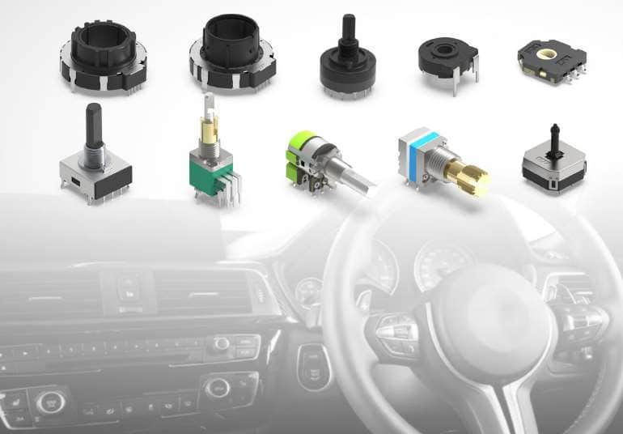
Automotive
Products - Electronic
Electronic Product Series
Encoders
Potentiometers
Switches
Application Area
Home Appliance
5G Communication
Automotive
Electronic Audio Equipment

Slide 17
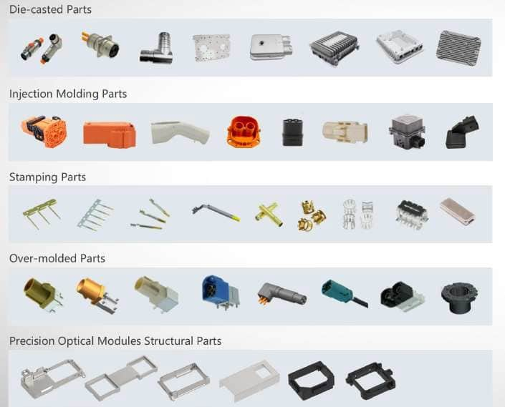
Automotive
Products – Precision Components
Precision Component Series
Zinc/Aluminum Die-casted Parts
Precision Injection Molding Parts
Precision Stamping Parts
Precision Over-molded Parts
Precision Optical Modules Structural Parts
Application Area
Automotive
Communication
Home Appliances
Optical Camera Module
Security
Smart Device
Consumer Electronics
Transportation

Slide 18
Automotive
Customer Satisfaction
Core Competitive Advantages
Customer Satisfaction
Vertically Integrated Manufacturing | Full-process design and manufacturing system Efficient coordination among business units In-house components manufacturing Internal control of production processes
R&D Customized Solutions | Considerable experience in independent R&D Follow the market and fulfill customer needs Actively responds to customer needs Product solutions and full-process services
Automation Focus | Self-owned automation engineering team Complete automation equipment Continued investment in automation Optimizing automated equipment and process
MES | MES (Manufacturing Execution System) WMS (Warehouse Manage System) QIS (Quality Information System)
Cost
Service
Quality
Technical Innovation
Cost
Quality
Cost
Quality
Service
Quality
Service
Cost

Slide 19
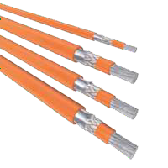
Automotive
High Voltage Cables
High Voltage Cables ensure reliable power supply in the vehicle. Rancommunication Global’s single- and multi-core cables are available in shielded and unshielded versions for all application relevant temperature ranges.
Only materials that meet the high requirements that are placed on vehicles with alternative drive systems in terms of electrical, mechanical, thermal and chemical properties are used.
Benefits
Life Cycle
Long life span in various temperatures and climates. Up to 20 year life span at 105° C and can meet short-term temperature resistance up to
+250°C.
Shield Effectiveness
Limits interference of data and electrical connections in automobiles.
Flexible,
Anti-Cracking
Simulation on the long-term use under different bending radius (2D~5D) in outdoor, normal and high temperature environment ensure the long-term stability of the cables.
Insulation Materials
Employ specially selected insulation materials for high voltage applications (thermoplastic elastomers, crosslinked polymers, silicone) that all meet with RoHS, REACH.
High Mechanical Strength
Copper or Aluminum Conductor

Slide 20











Automotive
High Voltage Cables
125° C Series
125°C Copper, XLPO
Insulation, Single-Core, Unscreened, High Voltage Cables
Temp Range: -40° C to +125° C Voltage: 600 V AC / 900 V DC Core: Single-core, Unscreened Insulation material: XLPO Conductor material: Copper
125°C Copper, XLPO Insulation,
Single-Core, Screened, High Voltage Cables
Temp Range: -40° C to +125° C Voltage: 600 V AC / 900 V DC Type: Single-core, Screened Insulation material: XLPO Conductor material: Copper
125°C Copper, XLPO
Insulation, Multi-Core, Unscreened, High Voltage Cables
Temp Range: -40° C to +125° C Voltage: 600 V AC / 900 V DC Core: Multi-core, Unscreened Insulation material: XLPO Conductor material: Copper
125°C Copper, XLPO Insulation, Multi-Core, Screened,
High Voltage Cables
Range: -40° C to +125° C Voltage: 600 V AC / 900 V DC
Core: Multi-core, Screened Insulation material: XLPO Conductor material: Copper
125°C Copper, XLPO Insulation, Single-Core, Unscreened, High Voltage Cables
Temp Range: -40° C to +125° C
Voltage: 1000 V AC / 1500 V DC
Core: Single-core, Unscreened
125°C Copper, XLPO Insulation,
Single-Core, Screened, High Voltage Cables
Temp Range: -40° C to +125° C Voltage: 1000 V AC / 1500 V DC Core: Single-core, Screened Insulation material: XLPO Conductor material: Copper
125°C Copper, XLPO Insulation, Multi-Core, Unscreened, High Voltage Cables
Temp Range: -40° C to +125° C
Voltage: 1000 V AC / 1500 V DC
Core: Multi-core, Unscreened Insulation material: XLPO
125°C Copper, XLPO Insulation,
Multi-Core, Screened, High Voltage Cables
Temp Range: -40° C to +125° C Voltage: 1000 V AC / 1500 V DC Core: Multi-core, Screened Insulation material: XLPO Conductor material: Copper
125°C Aluminum, XLPO Insulation, Single-Core, Unscreened, High Voltage Cables
Temp Range: -40° C to +125° C Voltage: 600 V AC / 900 V DC Core: Single-core, Unscreened Insulation material: XLPO Conductor material: Aluminum
125°C Aluminum, XLPO Insulation, Single-Core, Screened,
High Voltage
Cables
Temp Range: -40° C to +125° C Voltage: 600 V AC / 900 V DC Core: Single-core, Screened Insulation material: XLPO Conductor material: Aluminum
125°C Aluminum, XLPO Insulation, Single-Core, Unscreened, High Voltage Cables
Temp Range: -40° C to +125° C Voltage: 1000 V AC / 1500 V DC Core: Single-core, Unscreened Insulation material: XLPO Conductor material: Aluminum
125°C Aluminum, XLPO Insulation, Single-Core, Screened,
High Voltage Cables
Temp Range: -40° C to +125° C Voltage: 1000 V AC / 1500 V DC Core: Single-core, Screened Insulation material: XLPO Conductor material: Aluminum

Slide 21
Automotive
High Voltage Cables
150° C Series
150°C Copper, XLPO Insulation, Single-Core, Unscreened, High Voltage Cables
Temp Range: -40° C to +150° C
Voltage: 600 V AC / 900 V DC Core: Single-core, Unscreened Insulation material: XLPO Conductor material: Copper
150°C Copper, XLPO Insulation,
Single-Core, Screened, High Voltage Cables
Temp Range: -40° C to +150° C Voltage: 600 V AC / 900 V DC Type: Single-core, Screened Insulation material: XLPO Conductor material: Copper
150°C Copper, XLPO Insulation, Multi-Core, Unscreened, High Voltage Cables
Temp Range: -40° C to +150° C Voltage: 600 V AC / 900 V DC Core: Multi-core, Unscreened Insulation material: XLPO Conductor material: Copper
150°C Copper, XLPO Insulation, Multi-Core, Screened,
High Voltage Cables
Range: -40° C to +150° C Voltage: 600 V AC / 900 V DC
Core: Multi-core, Screened Insulation material: XLPO Conductor material: Copper
150°C Copper, XLPO Insulation, Single-Core, Unscreened, High Voltage Cables
Temp Range: -40° C to +150° C
Voltage: 1000 V AC / 1500 V DC
Core: Single-core, Unscreened
150°C Copper, XLPO Insulation, Single-Core, Screened,
High Voltage Cables
Temp Range: -40° C to +150° C Voltage: 1000 V AC / 1500 V DC Core: Single-core, Screened Insulation material: XLPO Conductor material: Copper
150°C Copper, XLPO Insulation, Multi-Core, Unscreened, High Voltage Cables
Temp Range: -40° C to +150° C
Voltage: 1000 V AC / 1500 V DC
Core: Multi-core, Unscreened Insulation material: XLPO
150°C Copper, XLPO Insulation,
Multi-Core, Screened, High Voltage Cables
Temp Range: -40° C to +150° C Voltage: 1000 V AC / 1500 V DC Core: Multi-core, Screened Insulation material: XLPO Conductor material: Copper
150°C Aluminum, XLPO Insulation, Single-Core, Unscreened, High Voltage Cables
Temp Range: -40° C to +150° C Voltage: 600 V AC / 900 V DC Core: Single-core, Unscreened Insulation material: XLPO Conductor material: Aluminum
150°C Aluminum, XLPO Insulation, Single-Core, Screened,
High Voltage
Cables
Temp Range: -40° C to +150° C Voltage: 600 V AC / 900 V DC Core: Single-core, Screened Insulation material: XLPO Conductor material: Aluminum
150°C Aluminum, XLPO Insulation, Single-Core, Unscreened, High Voltage Cables
Temp Range: -40° C to +150° C Voltage: 1000 V AC / 1500 V DC Core: Single-core, Unscreened Insulation material: XLPO Conductor material: Aluminum
150°C Aluminum, XLPO Insulation, Single-Core, Screened,
High Voltage Cables
Temp Range: -40° C to +150° C Voltage: 1000 V AC / 1500 V DC Core: Single-core, Screened Insulation material: XLPO Conductor material: Aluminum

Slide 22
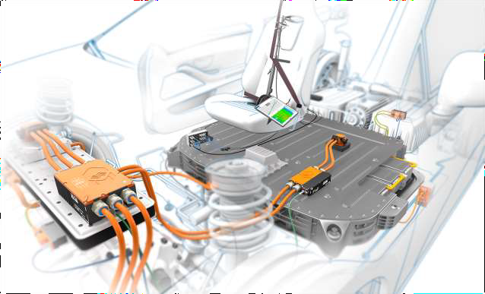
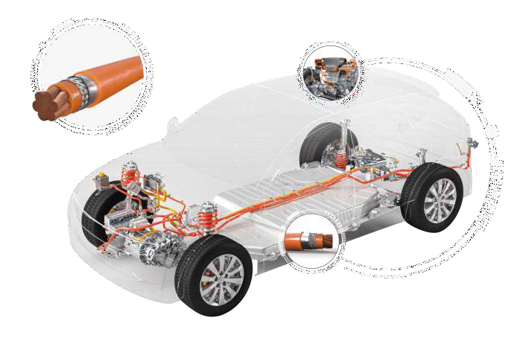

Automotive
High Voltage Cables
180° C Series
180°C Copper, Silicone Insulation, Single-Core, Unscreened,
High Voltage Cables
Temp Range: -40° C to +180° C Voltage: 600 V AC / 900 V DC Core: Single-core, Unscreened Insulation: High Tear Resistant Silicone
Conductor material: Copper
180°C Copper, Silicone Insulation, Single-Core, Screened,
High Voltage Cables
Temp Range: -40° C to +180° C Voltage: 600 V AC / 900 V DC Type: Single-core, Screened Insulation: High Tear Resistant Silicone
Conductor material: Copper
180°C Copper, Silicone Insulation, Single-Core, Unscreened,
High Voltage Cables
Temp Range: -40° C to +180° C
Voltage: 1000 V AC / 1500 V DC
Core: Single-core, Unscreened
180°C Copper, Silicone Insulation, Single-Core, Screened,
High Voltage Cables
Temp Range: -40° C to +180° C
Voltage: 1000 V AC / 1500 V DC Core: Single-core, Screened Insulation: High Tear Resistant Silicone
Conductor material: Copper
Insulation: High Tear Resistant
180°C Aluminum, Silicone Insulation, Single-Core, Unscreened, High Voltage Cables
Temp Range: -40° C to +180° C Voltage: 600 V AC / 900 V DC Core: Single-core, Unscreened Insulation: High Tear Resistant Silicone
Conductor material: Aluminum
180°C Aluminum, Silicone Insulation, Single-Core, Screened,
High Voltage Cables
Temp Range: -40° C to +180° C Voltage: 600 V AC / 900 V DC Core: Single-core, Screened Insulation: High Tear Resistant Silicone
Conductor material:
180°C Aluminum, Silicone Insulation, Single-Core, Unscreened, High Voltage Cables
Temp Range: -40° C to +180° C Voltage: 1000 V AC / 1500 V DC Core: Single-core, Unscreened Insulation: High Tear Resistant Silicone
Conductor material: Aluminum
180°C Aluminum, Silicone Insulation, Single-Core, Screened,
High Voltage Cables
Temp Range: -40° C to +180° C Voltage: 1000 V AC / 1500 V DC Core: Single-core, Screened Insulation: High Tear Resistant Silicone
Conductor material: Aluminum
Aluminum

Slide 23
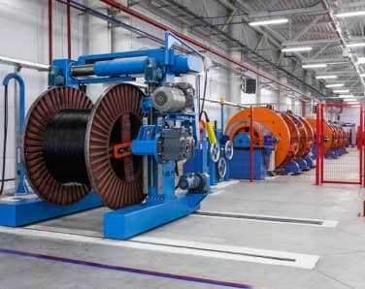
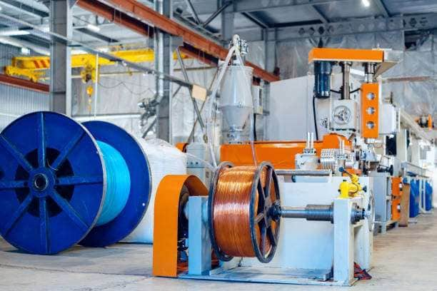
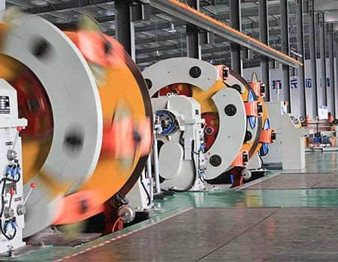
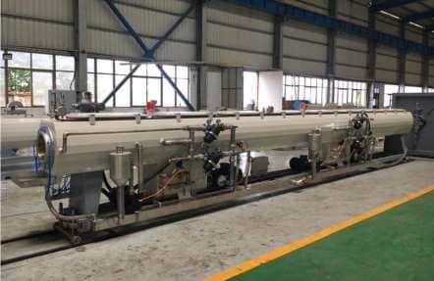
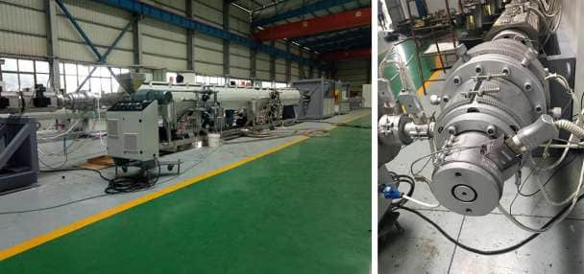
Automotive
High Voltage Cables – Equipment Capacity
Extruders

Slide 24
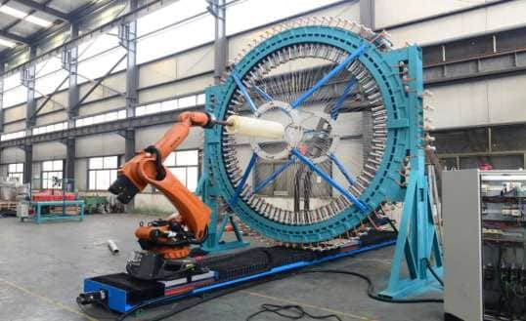
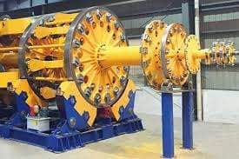
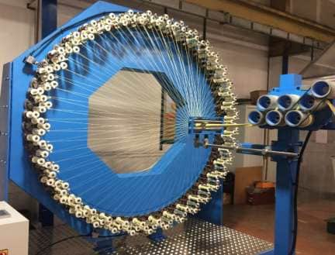
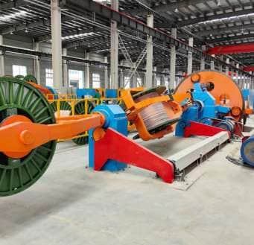
Automotive
High Voltage Cables – Equipment Capacity
Braiding Machine

Slide 25
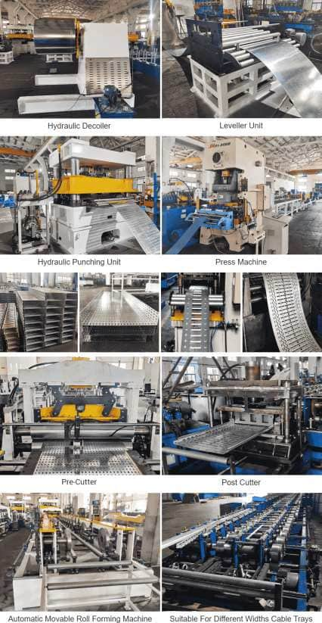
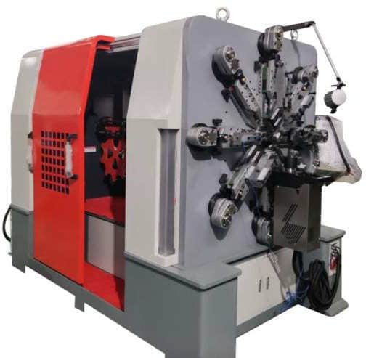
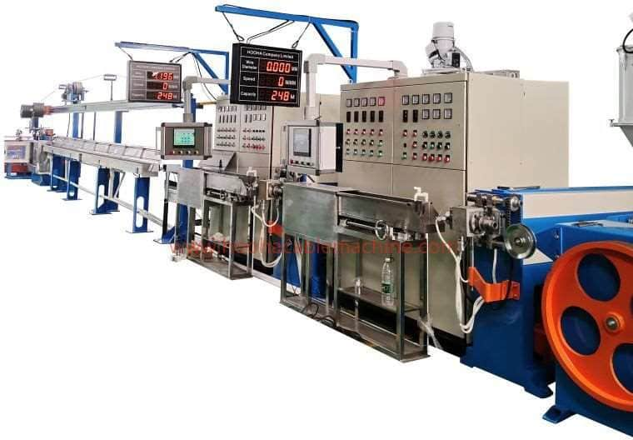
Automotive
High Voltage Cables – Equipment Capacity
Cable Forming & Packaging Machines

Slide 26
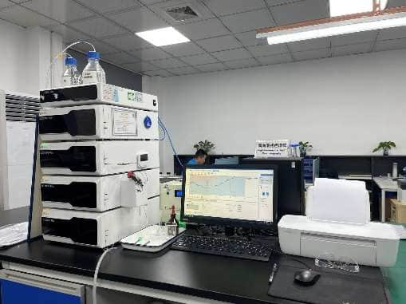



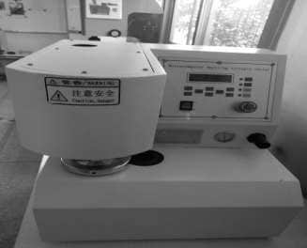
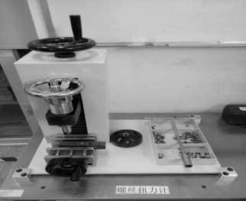
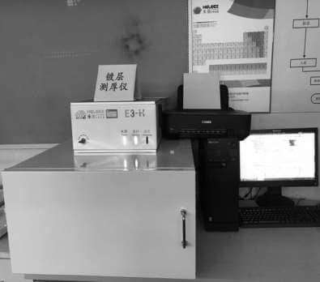
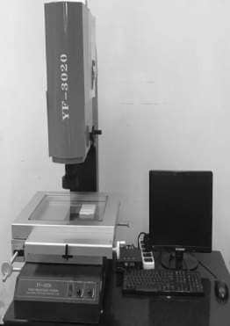
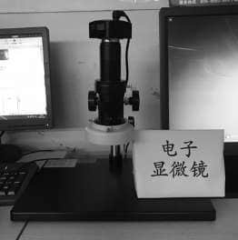

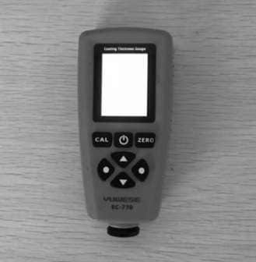
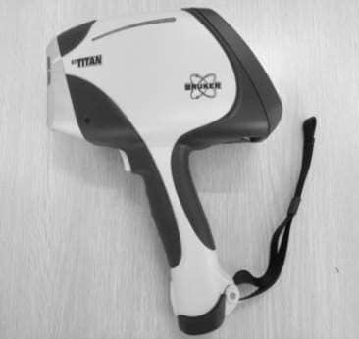
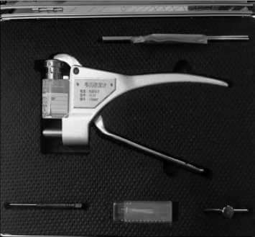
Automotive
High Voltage Cables – Quality Assurance
Electrical Performance Testing Equipment
ROHS
Carton burst strength
Screw torque
Coating thickness
Dimension Metering
Electron microscope
Coating
Alloy material analyzer
Wechsler hardness tester

Slide 27


Automotive
High Voltage Cables – Quality Assurance
Mechanical Property Testing Equipment Environmental Performance Testing Equipment

Slide 28

Automotive
High Voltage Cables – Quality Assurance
Combustion Performance Testing Equipment

Slide 29

Automotive
Sensor Technologies
Rancommunication Global is a market leader in sensor technologies and optical device production.
Rancom Automotive Sensor Products Offer A Wide Range Of Sensors For Use In Monitoring Various Vehicular Functions In The Areas Of Passenger Safety, Comfort And Convenience. Specialized in thermistor (temperature sensor) R&D, design, manufacturing and service since 2016, we have an annual output of 1 billion pieces of various multi-functional sensors. Among them, air conditioning sensors cover 25% of the global market share and cover 32% of the new energy vehicle market.
Multi-functional sensors such as temperature, humidity, light, and air, and PTC heating systems for
new energy vehicles

Slide 30












Automotive
Sensor Technologies – Test Lab
Partical Size Tester
Environmental Simulation Wind Tunnel
Walk-in Low Temperature Room
Dustproof Testing Machine
Water Resistance Testing Machine
X-Ray Machine
SEM
High And Low Temperature Impact Test Chamber
High And Low Temperature Test
Chamber
High Temperature Oven
Grinding Equipment
Humidity, Temperature And Vibration Comprehensive Environmental Test Chamber

Slide 31












Automotive
Sensor Technologies – Manufacturing
Automated production line for multi-functional sensors for smart home appliances and smart cars
Annual production capacity of 1 billion pieces.
World's largest multi-functional sensor manufacturing base

Slide 32

Automotive
Sensor Technologies – Thermistors
The ability of thermistors to provide highly accurate and sensitive readings makes them an essential component in various applications.
Applications
Medical Devices
Automotive Engines
Consumer Electronics
HVAC Systems

Slide 33









Automotive
Sensor Technologies – Automotive Electronic
Evaporator Temperature Sensor
Features:
Specifications can be customized according to customer requirements
The accuracy can reach ≤±1% accuracy
Highly sensitive, reaction time constant ≤3s
Temperature and moisture resistance, high sealing and moisture resistance
Working temperature -40℃~+100℃
Applications:
Temperature measurement at evaporator locations for automotive air
conditioning systems

Slide 34












Automotive
Sensor Technologies – Automotive Electronic
Car Interior Temperature Sensor
Features:
Specifications can be customized according to customer requirements
Use self-suction fan or negative pressure design
Easy to install, with multiple interface functions
Working temperature -40℃~+100℃
Applications:
Used for interior temperature measurement in automobile air
conditioning systems

Slide 35









Automotive
Sensor Technologies – Automotive Electronic
Outdoor Temperature Sensor
Features:
Specifications can be customized according to customer requirements
Adopt injection molding or potting packaging process
It has good waterproof performance and the protection level can reach IP67
Designed with corrosion-resistant materials
Working temperature -40℃~+120℃
Applications:
Used in automobile air conditioning systems to detect the ambient temperature outside the car

Slide 36





Automotive
Sensor Technologies – Automotive Electronic
Air Duct Temperature Sensor
Features:
Specifications can be customized according to customer requirements
Simple structure, capable of sensing air temperature in all directions
Design a sponge or sealing ring to facilitate the fitting of the air conditioner housing
Rotating buckle or double-ear clip for easy installation and removal
Working temperature -40℃~+100℃
Applications:
Used for temperature measurement in the air duct of automobile air conditioning system

Slide 37








Automotive
Sensor Technologies – Automotive Electronic
Water Temperature / Refrigerant Sensor
Features:
Specifications can be customized according to customer requirements
Using copper temperature sensing head, it can quickly realize heat conduction
Select high temperature resistant materials, the working temperature can reach 200℃
The product adopts thread, wall sticker, and pipe access methods to
achieve better fixation.
Working temperature -40℃~+150℃
Applications:
Used to measure the temperature of automobile water tanks/refrigerant pipes

Slide 38










Automotive
Sensor Technologies – Automotive Electronic
Sunlight Sensor
Features:
Working voltage 5V
Single zone and dual zone functions
Low angle sensitivity, easy to calibrate with air conditioning system
Working temperature -40℃~+100℃
Applications:
Used to measure light irradiance and provide compensation control for air conditioning systems

Slide 39








Automotive
Sensor Technologies – Automotive Electronic
Ambient Light Sensor
Features:
Working voltage 9~16V
Ambient light and sunlight sensor platform integration functions
Low power consumption, control accuracy ±3LX
Comply with EMC requirements
Working temperature -40℃~+100℃
Applications:
Car headlight automatic on/off control

Slide 40







Automotive
Sensor Technologies – Automotive Electronic
Humidity Sensor
Features:
Rated voltage 5V
Output accuracy ±3%RH
Output range: 0~100%RH
Output control: analog output and digital output
Humidity response time: ≤30s
Working temperature -40℃~+105℃
Applications:
Used for automotive and household air conditioners, refrigerator defogging and defrosting detection

Slide 41





Automotive
Sensor Technologies – Automotive Electronic
PM2.5 Sensor
Features:
Rated voltage 12V
With enabling control terminal
Output PWM waveform, frequency 200Hz
PM2.5 concentration effective value low-level duty cycle 10%-85%, representing 0-500ug/m³
Applications:
Used in automobile air conditioning systems to detect PM2.5 concentration in the passenger cabin in real time

Slide 42





Automotive
Sensor Technologies – Automotive Electronic
Fuel Vehicle Auxiliary Heater
Project: JAC H1
Application Model: JAC Ruifeng
Project: SAIC SV91
Application Model: SAIC Maxus D90
Specifications:
Specifications:
Rated Power: 1000W+5/-10%@0℃, 400m³/h
Rated Voltage: 12V
Withstand Voltage: 36V/1min
Inrush Current: ≤115A
Curie Temperature: ≤170℃
Core Size: 250x173x27mm
Rated Power: 1000W+5/-10%@0℃, 300m³/h
Rated Voltage: 13.5V
Withstand Voltage: 36V/1min
Inrush Current: ≤110A
Curie Temperature: ≤180℃
Core Size: 275x73x14mm

Slide 43




Automotive
Sensor Technologies – Automotive Electronic
Fuel Vehicle Auxiliary Heater
Project: SAIC EV78
Application Model: SAIC Maxus G10
Project: BYD C200
Application Model: BYD Qin EV200
Specifications:
Specifications:
Rated Power: 1000W+5/-10%@0℃, 300m³/h
Rated Voltage: 13.5V
Withstand Voltage: 36V/1min
Inrush Current: ≤110A
Curie Temperature: ≤180℃
Core Size: 245x103x13mm
Rated Power: 1000W+5/-10%@0℃, 400m³/h
Rated Voltage: 12V
Withstand Voltage: 36V/1min
Inrush Current: ≤100A
Curie Temperature: ≤170℃
Core Size: 176x140x20mm

Slide 44





Automotive
Sensor Technologies – Automotive Electronic
New Energy Vehicle Heater
Project: SAIC-GM-Wuling E100
Application Model: Baojun E100
Project: Bonaire M1A
Application Model: Chery Arrizo 5
Specifications:
Specifications:
Rated Power: 3000W+5/-5%@25℃, 400m³/h
Rated Voltage: 110V
Withstand Voltage: 220V/1min
Inrush Current: ≤2 times working current
Curie Temperature: ≤22 0℃
Core Size: 215.8x108x30
Rated Power: 5500W+10/-5%@-15℃, 300m³/h
Rated Voltage: 353V
Withstand Voltage: 500V/1min
Inrush Current: ≤2 times working current
Curie Temperature: ≤200℃
Core Size: 220x193x37.5

Slide 45




Automotive
Sensor Technologies – Automotive Electronic
New Energy Vehicle Heater
Project: Bonaire S15
Application Model: Chery EQ
Project: Bonaire W11 Application Model: Zotye E100
Specifications:
Specifications:
Rated Power: 3600W+5/-5%@-15℃, 400m³/h
Rated Voltage: 336V
Withstand Voltage: 500V/1min
Inrush Current: ≤2 times working current
Curie Temperature: ≤200℃
Core Size: 200x140x40
Rated Power: 3000W+5/-10%@-15℃, 220m³/h
Rated Voltage: 320V
Withstand Voltage: 500V/1min
Inrush Current: ≤2 times working current
Curie Temperature: ≤200℃
Core Size: 223x125x40mm

Slide 46



Automotive
Sensor Technologies – Automotive Electronic
New Energy Vehicle Heater
Specifications:
Specifications:
Project: JAC Fourth Generation, JAC Fifth Generation Application Model: JAC fourth-generation electric vehicle, JAC fifth generation electric vehicle
Rated Power: 2500W+5/-10%@25℃, 4.5m/s
Rated Voltage: 320V
Withstand Voltage: 500V/1min
Inrush Current: ≤2 times working current
Curie Temperature: ≤200℃
Core Size: 195x168x36mm
Rated Power: 2500W+5/-10%@25℃, 4.5m/s
Rated Voltage: 320V
Withstand Voltage: 500V/1min
Inrush Current: ≤2 times working current
Curie Temperature: ≤200℃
Core Size: 220x184x36mm

Slide 47


Automotive
Sensor Technologies – Automotive Electronic
New Energy Vehicle Heater
Specifications:
Rated Power: 2500W+5/-10%@25℃, 400m3/h
Rated Voltage: 320V
Withstand Voltage: 500V/1min
Inrush Current: ≤2 times working current
Curie Temperature: ≤200℃
Core Size: 220x148x36mm
Project: JAC A0
Application Model: JAC sixth-generation electric vehicle

Slide 48





Automotive
Sensor Technologies – Automotive Electronic
PTC Air Heater
Project: SAIC EV79
Appliction Model: SAIC Maxus EG10a
Project: SAIC EV69
Application Model: SAIC Maxus EV80
Specifications:
Specifications:
Rated Power: 6000W+5/-10%@0℃, 400m³/h
Rated Voltage: 336V
PTC Withstand Voltage: 500V/1min
Inrush Current: ≤1.5 times working current
Curie Temperature: ≤170℃
Insulation Resistance: 1000V for 2 minutes >100MΩ
PWM Control Method: integrated design of control module and PTC, LIN communication, 7-speed adjustment
Temperature Protection: PTC over-temperature protection, IGBT over-temperature protection
Core Size: 337x193x96mm
Rated Power: 6000W+5/-10%@0℃, 400m³/h
Rated Voltage: 336V
Withstand Voltage: 500V/1min
Inrush Current: ≤2 times working current
Curie Temperature: ≤200℃
Core Size: 224x199x46mm

Slide 49




Automotive
Sensor Technologies – Automotive Electronic
PTC Water Heater
Project: Geely FE-3HP
Application Model: Emgrand PHEV
Project: Liuqi S50
Application Model: Jingyi S50EV
Specifications:
Specifications:
Rated Power: 4000W @0℃, 10L/min
Rated Voltage: 350V
Electrical Strength: 3000VDC
IP Rating: IP6K9K & IP67
Curie Temperature: no more than 230℃
Insulation Resistance: 1000V/2min >100MΩ
Heater Size: 157×118×76
Rated Power: 5000W @60℃, 10L/min
Rated Voltage: 350V
Electrical Strength: 3000VDC
IP Rating: IP6K9K & IP67
Curie Temperature: no more than 230℃
Insulation Resistance: 1000V/2min >100MΩ
Heater Size: 257 × 199 × 61

Slide 50




Automotive
Sensor Technologies – Automotive Electronic
Application Specific Development Projects
Project: Geely platform parts (KC-2HB, VF11P, SX11P, FS11, FE-5HA, DNL-5P)
Applicable Models: Boyue EV, Borui EV, etc.
Project: Dongfeng Nissan 322EV, 331EV
Application Model: Venucia D60EV
Specifications:
Specifications:
Rated Power: 5000W @60℃, 10L/min
Rated Voltage: 350V
Electrical Strength: 3000VDC
IP Rating: IP6K9K & IP67
Curie Temperature: no more than 230℃
Insulation Resistance: 1000V/2min >100MΩ
Heater Size: 185×159×105
Rated Power: 5000W @60℃, 10L/min
Rated Voltage: 350V
Electrical Strength: 3000VDC
IP Rating: IP6K9K & IP67
Curie Temperature: no more than 230℃
Insulation Resistance: 1000V/2min >100MΩ
Heater Size: 185×159×105

Slide 51



Automotive
Sensor Technologies – Automotive Electronic
Application Specific Development Projects
Project: Dongfeng Nissan 322EV, 331EV Application Model: Venucia D60EV
Project: Valeo M01
Application Model: Chehejia M01
Specifications:
Specifications:
Rated Power: 5000W+10/-10%@-10℃, 300m³/h
Rated Voltage: 350V
Withstand Voltage: 500V/1min
Inrush Current: ≤1.5 times working current
Curie Temperature: ≤200℃
Core Size: 230x160x32
Rated Power: 2500W+5/-5%@0℃, 400m³/h
Rated Voltage: 353V
Withstand Voltage: 500V/1min
Inrush Current: ≤1.5 times working current
Curie Temperature: ≤200℃
Core Size: 180x150x36

Slide 52


Automotive
Sensor Technologies – Automotive Electronic
Application Specific Development Projects
Project: Changan platform parts Application Model: Changan Yidong EV
Specifications:
Working Voltage: 50VDC-600VDC
Power Range: 100-500W
Inrush Current: less than 2.5 times rated current
Surface Temperature: less than 80℃, plane temperature difference less
than 5℃
Operating Temperature: -40℃—110℃
Temperature Stabilization time: ≤30S
Electrical Strength: 3000V/15mA/S
Insulation Resistance: >50MΩ, test voltage 1000VDC, duration 1min

Slide 53

A Wire and Wireless Infrastructure Site Solutions and Automotive Company

