Slide 1

UNITED PCB PRIVATE LIMITED
Smart PCB Manufacturing for India’s Electronics Future
Precision in Every Layer
DPIIT Recognized Startup
MSME Registered

Slide 2
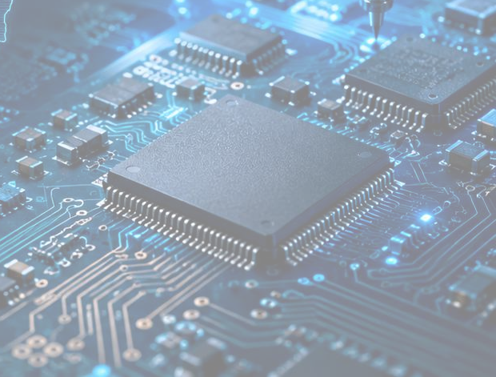
Company Overview
Building scalable PCB solutions for India’s fast-growing electronics ecosystem
The company provides PCB design support, Gerber development, reverse engineering, prototype support and PCB sourcing while building scalable domestic PCB manufacturing capabilities.
2025
Established / brand foundation
DPIIT
Recognized startup
MSME
Registered enterprise
Vision
Mission
To build a smarter and self-reliant PCB manufacturing ecosystem for India’s electronics future.
To provide fast, reliable, and high-quality PCB solutions for startups, OEMs, and electronics manufacturers.

Slide 3

The Problem — India’s PCB Manufacturing Gap
High import dependency, slow prototyping and quality inconsistency create a bottleneck for electronics growth
Indian OEMs still depend heavily on imported PCBs for prototypes and production.
Supply Gap Impact
75%+
Import dependency
15–25%
Cost premium on imported PCBs
Higher Cost
Imported PCBs increase per-unit cost and working capital pressure
4–8 Wks
Typical imported lead time
01
Delayed Launch
Long lead times slow testing, iterations and product
02 commercialization
Import reliance limits domestic manufacturing growth Slow prototype cycles delay product development
Limited eco-friendly PCB producers weaken sustainability goals Flexible MOǪ and engineering support remain underserved
Ǫuality Risk
Inconsistent quality creates rework and reliability concerns
03

Slide 4
Our Solution
Integrated PCB support and manufacturing roadmap designed for speed, quality and import substitution
A localized PCB partner that combines design support, prototyping, reverse engineering and future AI-enabled manufacturing workflows.
Design G Engineering
Prototype G Sourcing
Scale-Up Manufacturing
PCB layout support Gerber development DFM review
Reverse engineering
Rapid prototype support Small-batch requirements Flexible MOǪ
Vendor network
Single C double layer PCB Multilayer PCB roadmap Ǫuality testing systems
AI-assisted platform

Slide 5

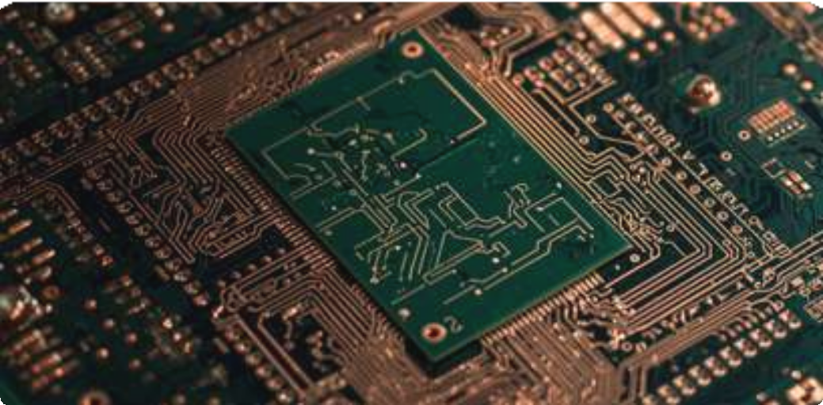
Products G Capabilities
From design support to advanced multilayer PCB capability roadmap
CURRENT SERVICES
PCB Design Support
PCB Layout Development Gerber File Development PCB Reverse Engineering Prototype PCB Support
PCB Trading C Sourcing

Slide 6
Innovation G Technology Roadmap
A future-ready PCB workflow built around automation, DFM and intelligent quality control
Smart Ǫuotation
AI-powered pricing based on specifications, material and complexity
Gerber Validation
Automated file parsing to detect errors before production
Automated DFM
Manufacturability checks to reduce defects and rework
01
02
03
Workflow Tracking
Digital order visibility from quote to dispatch
AI-Assisted PCB Platform
Cost optimization, design suggestions and predictive ǪA
Advanced Manufacturing
HDI PCB, smart inspection and Industry 4.0 automation roadmap
04
05
06

Slide 7
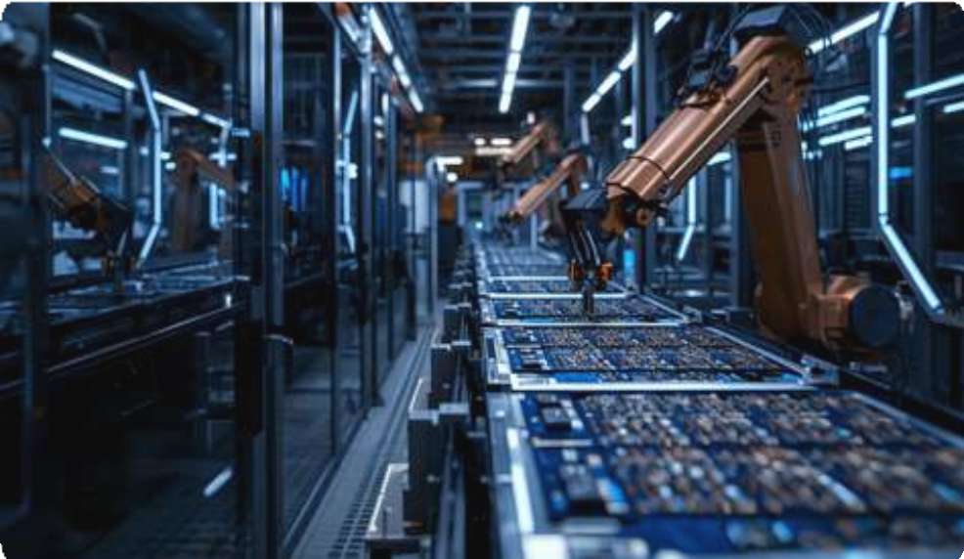
Market Opportunity
Growth Sectors
Make in India, electronics manufacturing and import substitution create a large addressable opportunity
EVs
Medical
$80B+
Global PCB market
15%
Projected market CAGR
$12B
India PCB market 2025
$22B
India PCB market 2030
IoT
Automotive
Healthcare
Smart Devices
Why now?
PLI schemes and Make in India are accelerating electronics manufacturing EV, IoT, medical, automotive and smart devices require reliable PCBs Domestic PCB manufacturing reduces import risk, cost and time-to-market

Slide 8
Target Customers
B2B-first approach across OEMs, innovation teams and export partnerships
01
Electronics OEMs
Consumer, embedded and industrial electronics manufacturers
04
Medical Electronics
Diagnostics, monitoring and healthcare devices
Automotive G EV
Control modules, battery systems and charging
products
05
Startups G RGD Labs
Prototype boards, engineering support and low
02
MOǪ
03
Industrial G IoT
Automation systems, sensors and connected devices
Export Markets
US, EU and Asia manufacturing partnerships
06

Slide 9
Traction G Progress
Commercial foundation and manufacturing scale-up preparation are underway
01
DPIIT Recognition
Recognized under DPIIT, strengthening startup credibility and funding eligibility.
Electronics Expo Participation
Participated in electronics expo to build visibility and industry connections.
05
MSME Registration
Registered as an MSME to support formal business growth and scheme benefits.
06
PCB Design G Reverse Engineering Projects
Initial PCB design support projects started for customer requirements.
02
Initial Customer Development
Started customer outreach and prototype order development with startups, OEMs, and electronics innovators.
GST Registration
GST registration completed for compliant B2B transactions and operations.
07
03
Website Launch
Company website launched to showcase services and generate customer enquiries.
Multiple PCB Design, Reverse Engineering G Initial Customer Orders
Multiple customer requirements and initial orders received.
08
04

Slide 10
Competitive Advantage
Features / Factors | United PCB | Large PCB Manufacturers | Imported Suppliers | Local Vendors
Made in India Support | Yes | Yes | No | Yes
Fast Prototyping | Yes | Limited | No | Limited
Startup-Friendly MOQ | Yes | No | Limited | Yes
PCB Design Support | Yes | Limited | No | Limited
Customization Flexibility | Yes | Limited | Limited | Yes
Quality Testing Focus | Yes | Yes | Limited | Limited
AI / Smart Manufacturing Roadmap | Yes | Limited | Limited | No
Import Dependency Reduction | Yes | Yes | No | Yes
Reverse Engineering Expertise | Yes | No | No | No

Slide 11
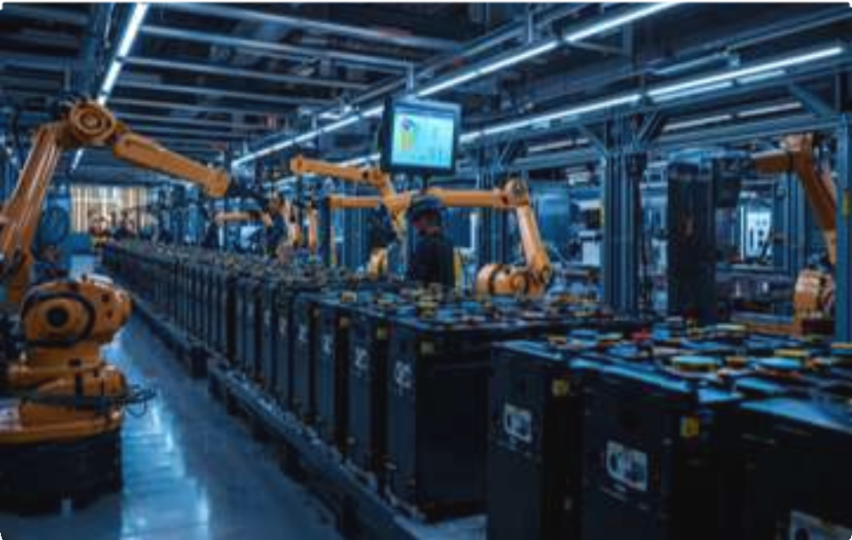
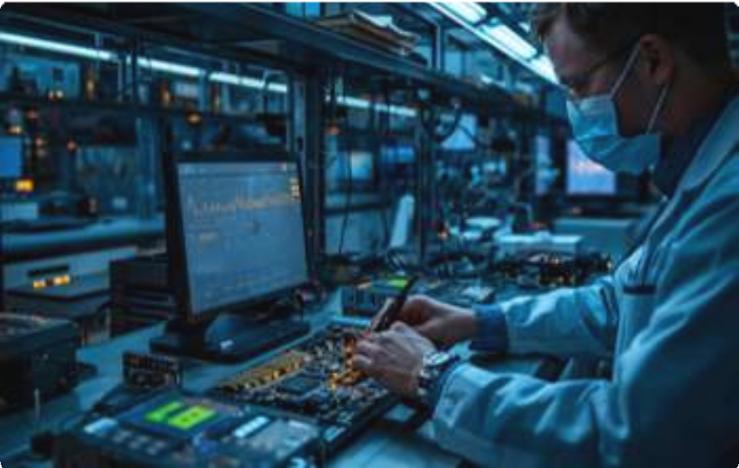
Business Model G Revenue Streams
Multiple B2B revenue lines with repeat order potential and scalable unit economics
PCB Manufacturing Single, double and multilayer PCB production
Prototype Orders
Fast-turnaround boards for startups and RCD teams
Design Support Layout, Gerber review, DFM and technical consulting
Reverse Engineering
Recreating PCB designs from existing boards
OEM Contracts Long-term manufacturing contracts with electronics companies
PCB Trading G Global Sourcing
Importing and supplying high-quality PCBs through a global manufacturing partner network while domestic manufacturing is being established.
Export Orders
International PCB manufacturing partnerships

Slide 12
Financial Projection G Growth Goals
Three-phase approach from domestic traction to OEM scale-up and export growth
Year 1
Year 2
Year 3
Build foundation and start recurring orders
2x–3x revenue growth
Sustainable profitability and market expansion
Facility setup, prototype orders, domestic customer acquisition
OEM partnerships, production scale-up, wider B2B sales
Multilayer PCB expansion, export enquiries, long-term contracts
Projected Revenue
₹25–40 Lakh
₹75 Lakh–
₹1.25 Cr
₹2–3 Cr
“Projections are based on phased manufacturing setup, existing customer pipeline, PCB trading revenue and planned OEM acquisition strategy.”

Slide 13
Company Timeline / Roadmap
Focus on foundation, operational scale-up and export-led expansion
Year / Phase | Milestone
2025 | Company incorporation, GST registration, MSME registration, DPIIT recognition and brand setup.
2026 | PCB design support, reverse engineering projects, prototype support, business development and customer outreach.
Future Phase 1 | PCB manufacturing facility setup with machinery, testing equipment, utilities and quality systems.
Future Phase 2 | Expansion into single-layer, double-layer and multilayer PCB manufacturing.
Future Phase 3 | AI-enabled PCB design platform, smart DFM checking, automation and export market expansion.
Sustainable growth through precision manufacturing.

Slide 14
Go-To-Market Strategy
Three-phase approach from domestic traction to OEM scale-up and export growth
Phase 1
Phase 2
Phase 3
Foundation G Domestic Base
Growth G OEM Expansion
Scale-Up G Export
Build startup/RCD customer base, focus on prototype orders, small batches and design support.
Digital campaigns, trade expos, OEM outreach, regional distribution and technical branding.
Expand OEM contracts, advanced multilayer PCBs, export partnerships and global market access.
Prototype Focus
SEO + Expos
OEM
Contracts
Export Partnerships

Slide 15
Current vs Future Business
Business Area | Current / Future | Details
PCB Design Support | Current Business | Providing PCB layout support, Gerber development and design assistance for customer requirements.
Reverse Engineering | Current Business | Supporting redesign and recreation of PCB layouts from existing boards.
Prototype Support | Current Business | Helping startups, R&D teams and OEMs with prototype PCB requirements.
PCB Trading & Sourcing | Current Business | Supporting customers through PCB sourcing and vendor network development.
PCB Manufacturing | Expansion Phase | Funding is being sought to set up machinery, testing systems, factory infrastructure and production capacity.
AI-Enabled PCB Platform | Future Roadmap | Planned smart platform for AI-assisted PCB design, DFM checking, quotation and workflow automation.

Slide 16
Fund Utilisation
Fund Area | Amount
Manufacturing Machinery & Factory Setup | ₹4,500,000
Technology & Automation | ₹2,000,000
Raw Material & Working Capital | ₹1,500,000
Marketing & Customer Acquisition | ₹1,000,000
Team Expansion & Operations | ₹1,000,000
Total | ₹10,000,000
Team Expansion C Operations
10%
Marketing C Customer Acquisition 10%
Manufacturing
Machinery C Factory Setup
45%
Raw Material C Working Capital 15%
Technology C Automation 20%

Slide 17


Founder details
Deep Pathak
Director
Jigna Pathak
Process Management
Deep Pathak Strong focus on operations, administration, strategic planning, customer coordination and execution of the PCB manufacturing growth roadmap..
Jigna Pathak supports process management, Skilled in process coordination, documentation, workflow management, operational discipline and internal execution support..

Slide 18


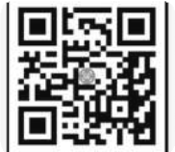
THANK YOU
Building India’s next generation PCB manufacturing cap
+ G1- GG748G1748
Unitepcbpvtltd@gmail.com Rajkot, Gujarat, India
Unitedpcb.com

