Slide 1

Advanced Ceramic Packaging
Solutions for Electronics

Slide 2
Who We Are
Who We Are
INCERAM is a technology-driven company with global expertise and strong Indian roots, backed by decades of engineering and business experience and a proven record of successful projects across Europe and Russia
Built on the strong foundation of C-Component (Russia), whose well-established production and business model we expand further, INCERAM inherits excellence and reliability
We are bringing this expertise to India, developing advanced local manufacturing to strengthen the country’s fast-growing electronics industry

Slide 3
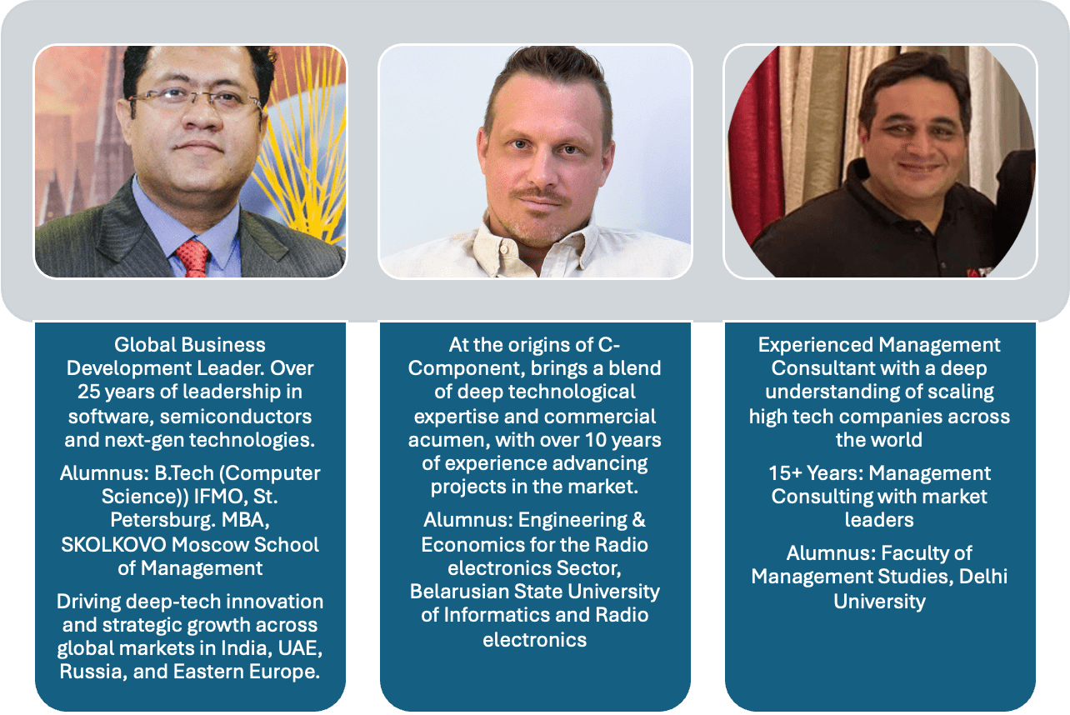
Our Team
Co-Founders and Managing Partners

Slide 4
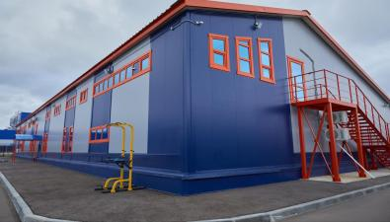
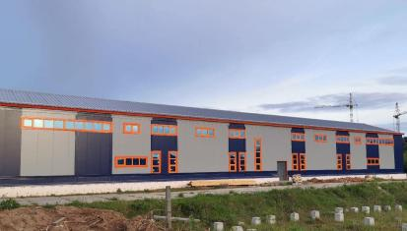
Where it all started (C-Component Profile)
Founded: 2008
Head office: Moscow, Russia
Manufacturing Facilities: production plant in Dubna, Moscow Region, Russia

Slide 5
Recognition & Industry Leadership
Awarded the status of a National Champion in 2024 – a prestigious national title, conferred by the Ministry of Economic Development of Russia with the support of Innopraktika and the Higher School of Economics, honoring the country’s most dynamic and export-oriented technology leaders
Qualified supplier to the nuclear sector
Preferred supplier to the space sector
Included in the registry of reliable suppliers for the automotive industry (Government of Russia)

Slide 6
















Our Clientelé

Slide 7
Technologies Overview
Ceramic Substrates Processing | Metallization | Assembly
Wide choice of materials (96% and 99.6% Al2O3, AlN, Si3N4, ferrite etc.) Precision laser processing (machining, drilling, cutting, scribing, ablation, marking) Diamond dicing and profiling Lapping and polishing | Thick film (conductors Ag, AgPd, AgPt, AgPdPt, Au, PtAu, Pt, resistors Ru, RuPdAg, glass coatings) Includes R&D and manufacturing of technical glasses and thick film pastes Thin film (Cr, V, Ti, NiCr, Ni, Nb, Cu, Al, Au, Pt, Si alloys) Direct Bonded Copper Electro- and electroless plating (Ni, Au, ENIG, ENIPIG, Ag), solder masking | Die attach (epoxy, solder) Wire bond (Al, Au, Pt wire, ultrasonic or thermocompression bonding) Sealing/encapsulation (epoxy, solder, glass, laser welding)

Slide 8
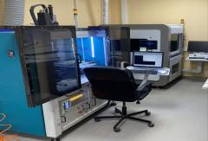
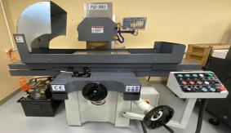
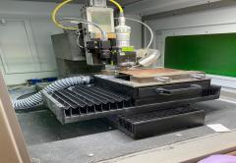
Facilities & Capabilities
Ceramic Processing
Lasers - 8 machines (CO2, solid-state, fiber)
Diamond dicing machine; lapping/polishing equipment
Any shapes and 3D features (holes, grooves, slots, etc.); pulsed/continuous scribing; surface treatment, ablation, and marking; smooth edges; tolerances down to 10 um or lower
Precise adjustments for geometry, parallelism, flatness, and thickness reduction to 100 um or less
High-speed, very cost-effective processing for standard products, along with precision craftsmanship for complex military/aerospace/scientific tasks

Slide 9
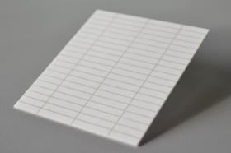
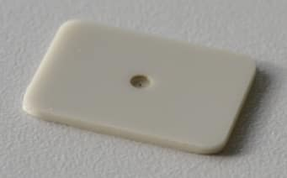
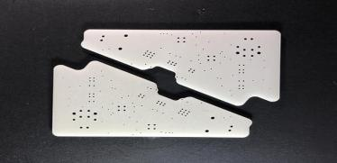
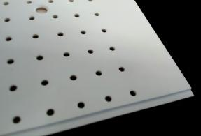
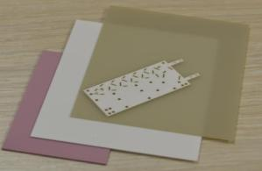

Insights into some of our LIVE projects

Slide 10
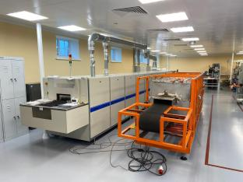
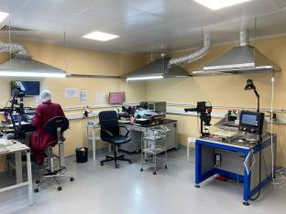
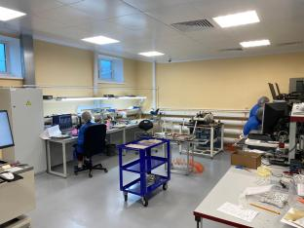
Facilities & Capabilities
Thick Film. Metallization
Screen printers (semi-automatic); conveyor furnaces (9-zone)
Cost-effective custom thick film circuits from simple one or two-print-sided substrates to high-complexity and fine line circuits with multilayers, metallised vias, plated through holes, integrated resistors, wraparounds and more special features; substrate size up to 270x270mm
Conductor thickness from 6~8 to 40~50 um; fine line|gap width up to 50/50 um

Slide 11
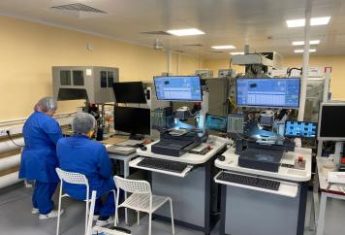
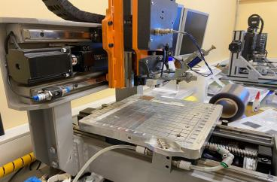
Facilities & Capabilities
Thick Film. Postprocessing
High-capacity laser resistor trimming machines (including developed and produced in-house)
various in-house equipment for sorting, marking, and other auxiliary tasks
High-performance, highly efficient processes with automated manual operations for standard products

Slide 12
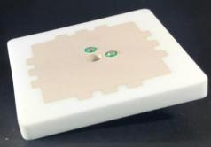
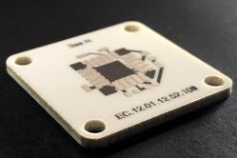
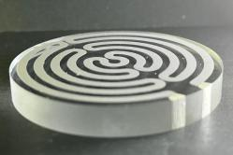
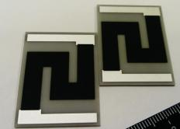
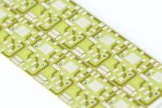
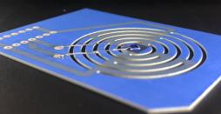
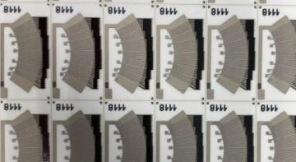
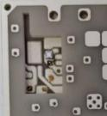



LIVE projects Overview :
Thick Film

Slide 13
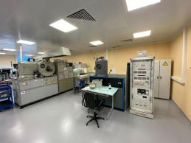
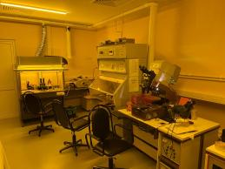
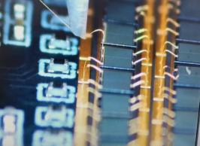
Facilities & Capabilities
Other Processes
Thin Film Metallization - for superior line resolution, high-density designs, and precise control of material properties
Direct Bonded Copper Metallization - for high thermal conductivity, low thermal expansion, and high current-carrying capacity in power electronics
Electro- and electroless plating - for enhancing surface conductivity, corrosion resistance, and solderability
Micro Assembly (Die Attach, Wire Bonding, Encapsulation) - for miniaturisation, robust connections and environmental protection for long-term durability

Slide 14
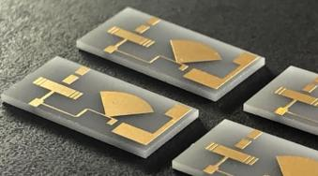
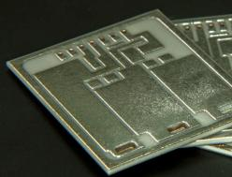
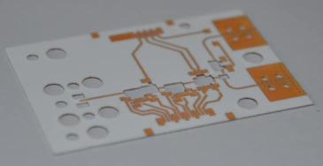
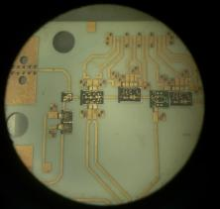
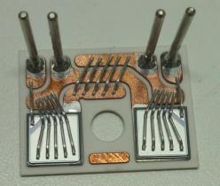

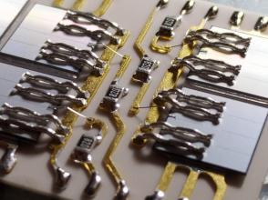
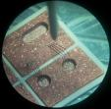
LIVE projects overview (across technologies)

Slide 15
Facilities & Capabilities
Thick Film Pastes; Technical Glasses
Technical Glasses and Thick-Film Pastes: synthesis, analysis, development, and manufacturing (including those without analogues)
Electrovacuum glasses for encapsulation , lead sealing (metal-to-metal and metal-to-ceramic), ceramic glazing, and thick film printing (Al2O3, AlN, Si3N4, ZrO2, etc.). Developed glass systems include PbO-V2O5-P2O5, Bi2O3-SiO2-ZnO, SiO2-CaO-Al2O3, and more, ensuring high reliability and performance in electronic components and ceramics
Conductive Pastes (Ag, AgPd, AgPt, AgPdPt, Au, PtAu, Pt - including special pastes for RF, antennas, RFID), Resistor/Thermistor Pastes (Ru, RuPdAg, Pt - 1Ω/sq~100GΩ/sq), Dielectric Pastes, High-Temperature and Protective Pastes, Custom Formulations

Slide 16
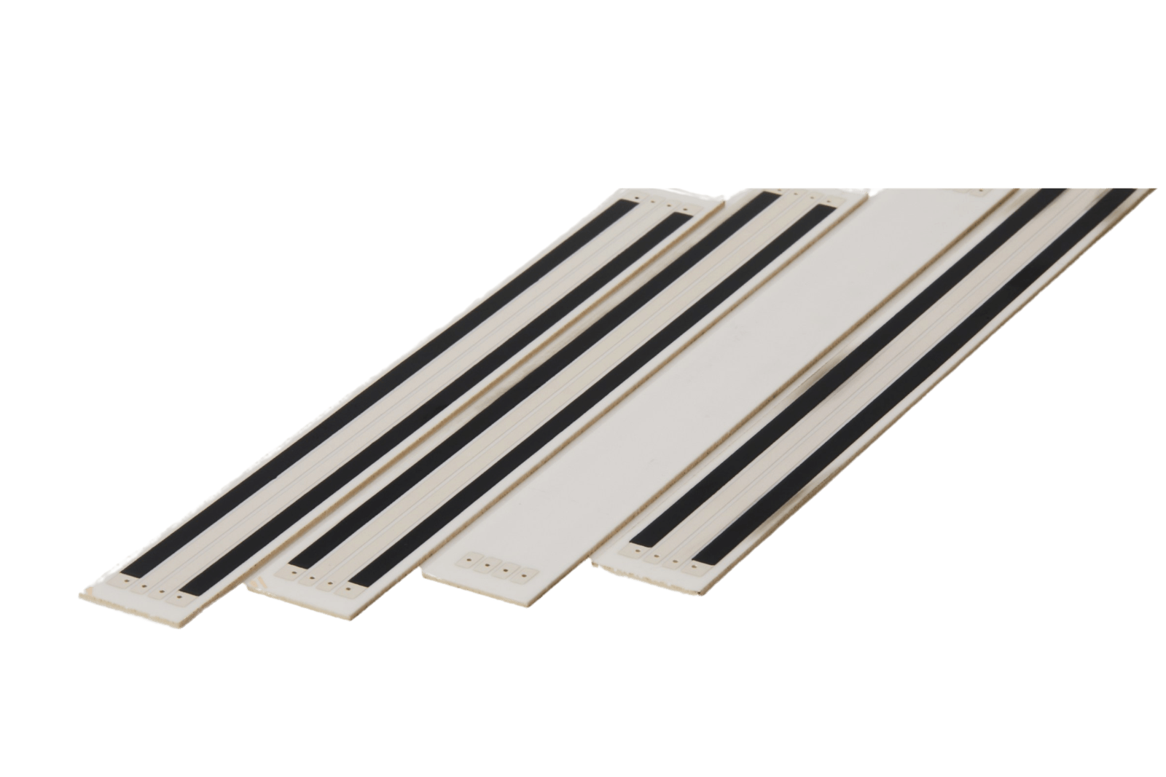
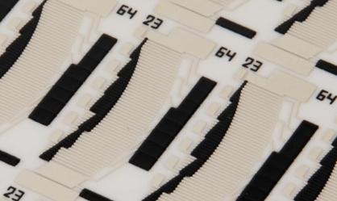
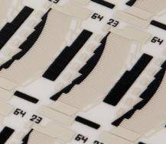
Product : Automotive Components
Product:
Ceramic Potentiometer Elements
Applications:
Fuel Level Sensors
Blower Motor Resistor Arrays
Linear/Rotary Position Sensors
Throttle Position Sensors (TPS)
Mass Air Flow Sensors

Slide 17
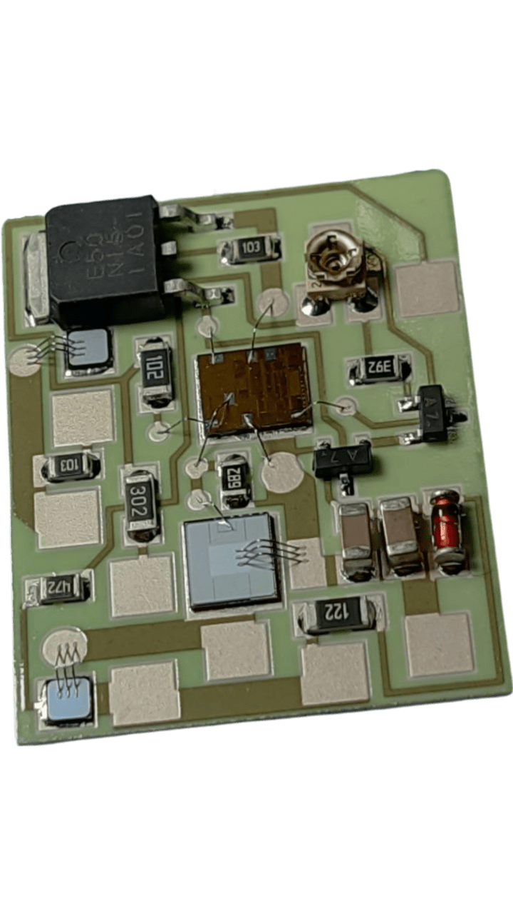
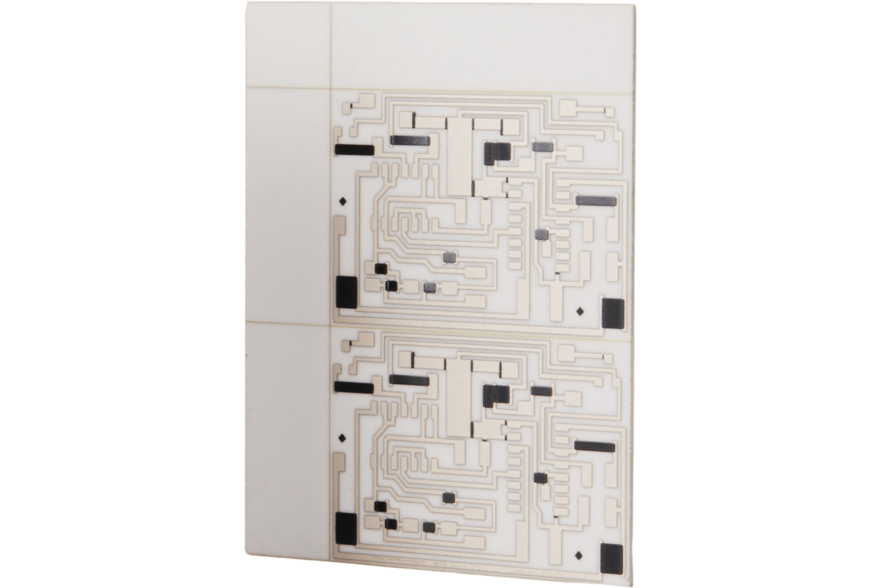
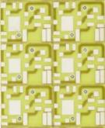
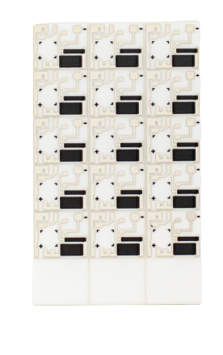
Product : Automotive Components
Product:
Ceramic Hybrid Circuits
Applications:
Ignition Modules
Voltage Regulators
Power Transmitter Modules

Slide 18
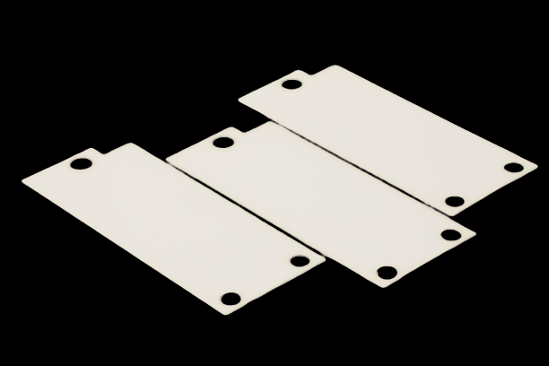
Product : Automotive Components
Product:
Ceramic Insulating Thermal Interfaces
Applications:
Electric Power Steering (EPS)
Engine Compartment Thermal Management

Slide 19
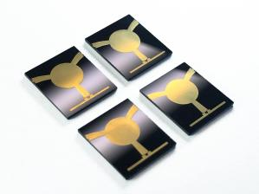
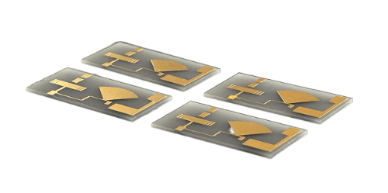
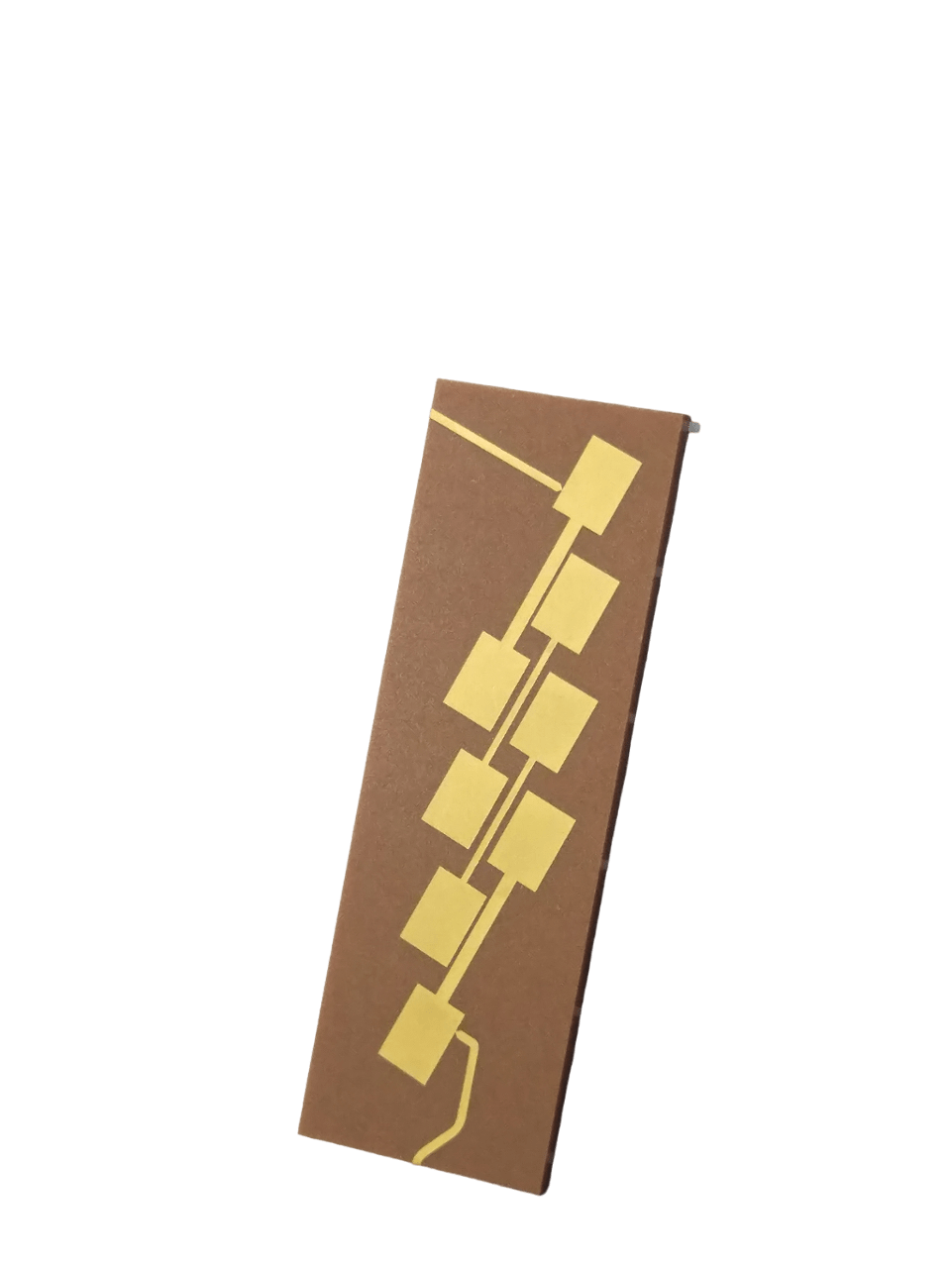
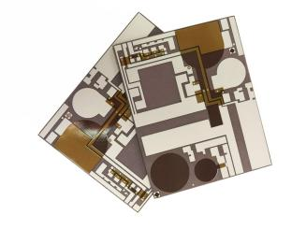
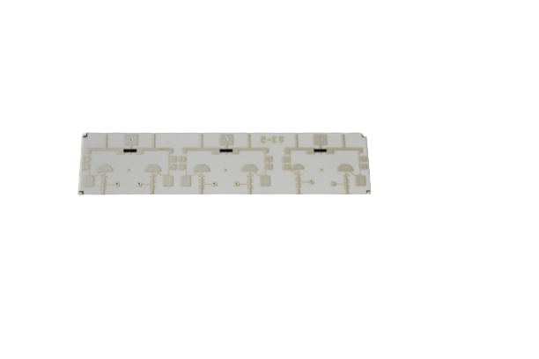
Product : Aerospace & Defence
Product: Microcircuits for Radar, Missile Guidance, Electronic Warfare, Avionics and Satellite Communications

Slide 20
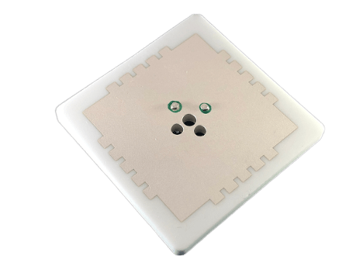
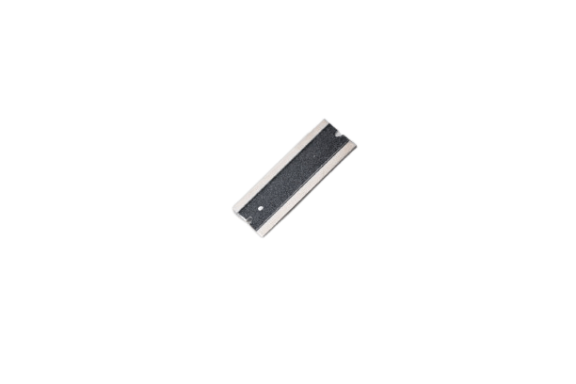
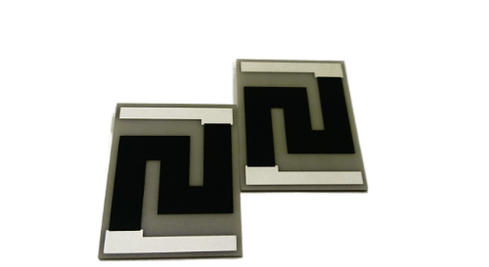
Product : Aerospace & Defence
Ceramic Antennas and Resonators
Custom Power Resistors, RF Termination Resistors for Antenna Arrays
Hi-Rel Ceramic RFID

Slide 21




Product : Optoelectronics and LED
Laser/Photodiode Submounts
LED Substrates
Submounts for Charge-coupled devices

Slide 22





Product : Power Electronics
Full range of substrates for high-power modules, inverters, converters, and other devices

Slide 23




Product : Ceramic Microheaters
Thick Film Ceramic Heaters
Special Heating Elements

Slide 24




Product: Sensors and MEMS
Temperature, acceleration, electrical measurement, gas sensors and more
Biosensors, X-ray, Medical

Slide 25





Product : Ceramic Components
Ceramic Thermal Interfaces
Custom Ceramic Components

Slide 26



Product : Hybrid Assemblies
Custom Hybrid Micromodules
Special Power Assemblies

Slide 27
Thankyou & Contact US
INCERAM Innovations LLP
Address: 500, 5th Floor, ITL Twin Tower, NSP, New Delhi 110034
Phone: +91 9319962859
Email: sales@inceram.in

