Slide 1

WELCOME TO REEYAA CIRCUIT AND ELECTRONICS (OPC) PVT.LTD.
Professional Manufacture of Printed circuit boards
Are You Looking for a PCB Sample in 24 Hours? Kindly Contact Us.
B-65,GIDC,Electronic Estate, Sector-25,
Gandhinagar-382025. Gujarat.INDIA
Sales-Phone:+91-9376666567, 7567833664
Sales-Email:- :- info@reeyaacircuit.com ,
reeyaacircuit.pcb@gmail.com,
sales@reeyaacircuit.com
Website:- http://www.reeyaacircuit.com
Company Profile 2022

Slide 2



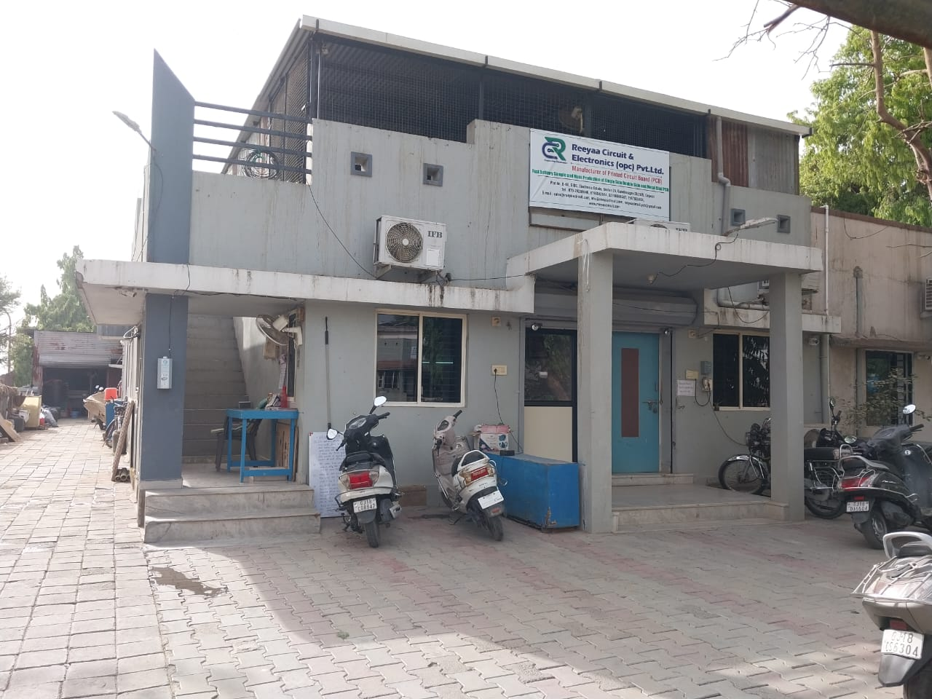
INTRODUCTION
INTRODUCTION
REEYAA Circuit & Electronics (OPC) Pvt. Ltd. (RCEPL) is a professional PCB manufacturing & PCB design company since 2007 having wide industrial experience in PCB design & PCB CAM, PCB manufacturing.
We have a very good exposure to entire electronic
industries i.e. Energy Metering, Power Supply,
Communication, Process Control, Aerospace,
Industrial, Automotive products etc.
WWW.REEYAACIRCUIT.COM
WWW.REEYAACIRCUIT.COM

Slide 3
PLANT SPECIFICATION
Factory Location : Plot No.B-65, GIDC, Electronics Estate,Sector-25 ,
Gandhinagar-382025,Gujarat.
Established : 1-04-2007
Invested Capital : 2 CRORE
Product : PCB FABRICATION UP TO 2 LAYERS
Plant Floor : 500 square meter
Floor Spare : 500 square meter
Employee : 50 +
Annual Capacity : 12000 square meter
Annual Turnover : 4 CRORE
Legal representative : Mr. Jagdish Namera
WWW.REEYAACIRCUIT.COM

Slide 4

REEYAA CIRCUIT [Mfg. Printed Circuit board]
Our vision is to become a global leader in the field of printed circuit board manufacturer and one stop solution for PCB (Design, Fabrication and Assembly).
Our mission is To serve fast delivery and best quality. We concentrate on customer’s satisfaction.
WWW.REEYAACIRCUIT.COM

Slide 5
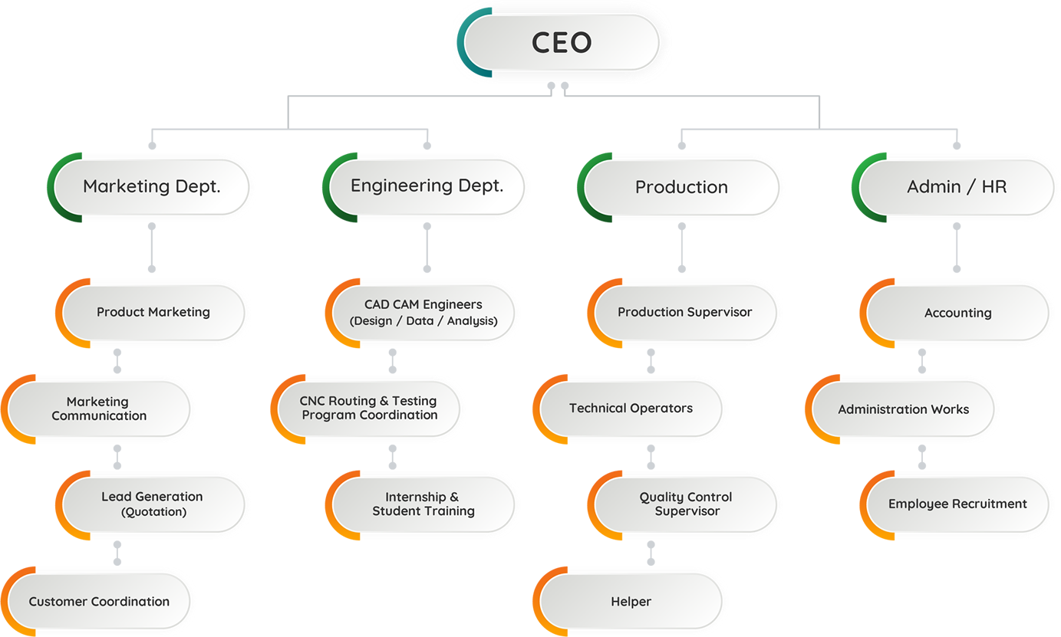
ORGANIZATION CHART
WWW.REEYAACIRCUIT.COM

Slide 6

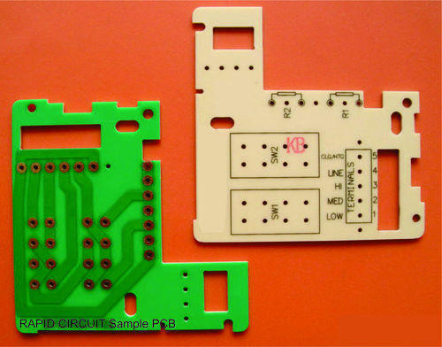
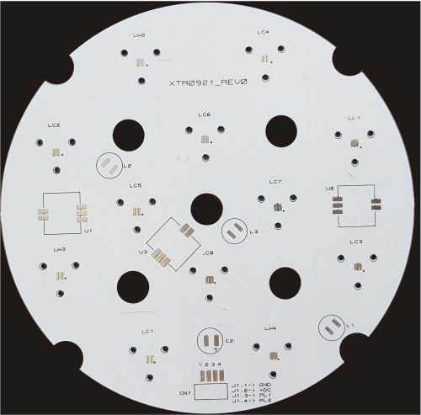
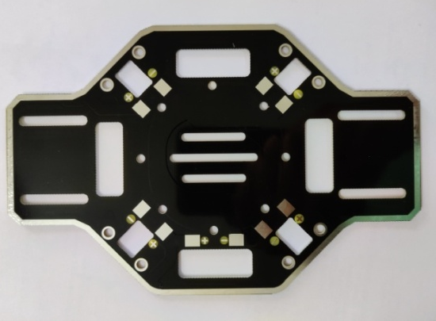
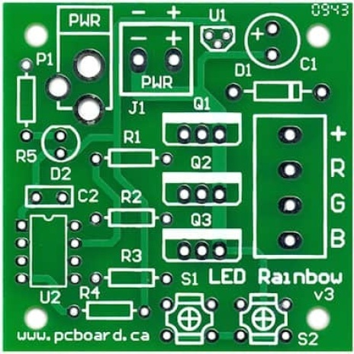
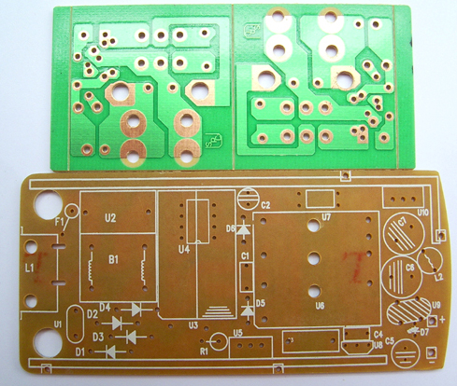
OUR PRODUCTS
Single side PCB
S/S , CEM – 1, GREEN MASKING, BLACK LEGEND
S/S , ALUMINIUM,WHITE MASKING , BLACK LEGEND
S/S , FR 4, BLACK MASKING BOTH SIDE , WHITE LEGEND
S/S ,FR 4, Glass Epoxy, GREEN MASKING, WHITE LEGEND
S/S ,FR 1, Paper Phenolic, GREEN MASKING, WHITE LEGEND
WWW.REEYAACIRCUIT.COM

Slide 7

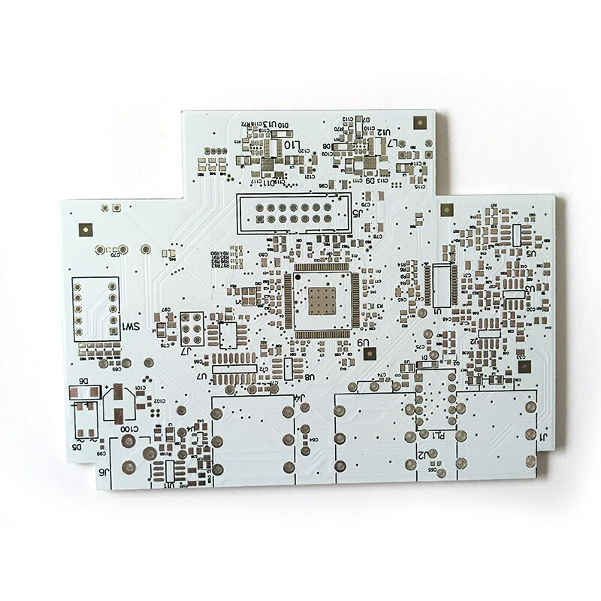
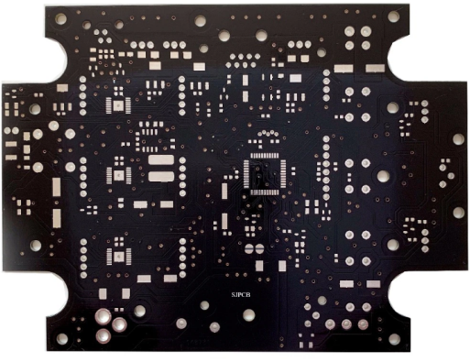
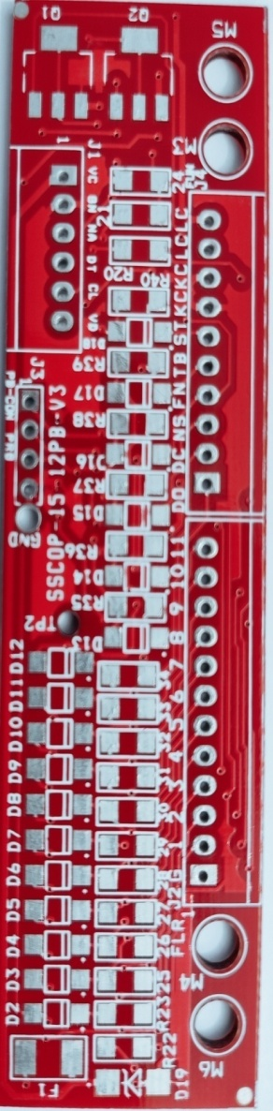
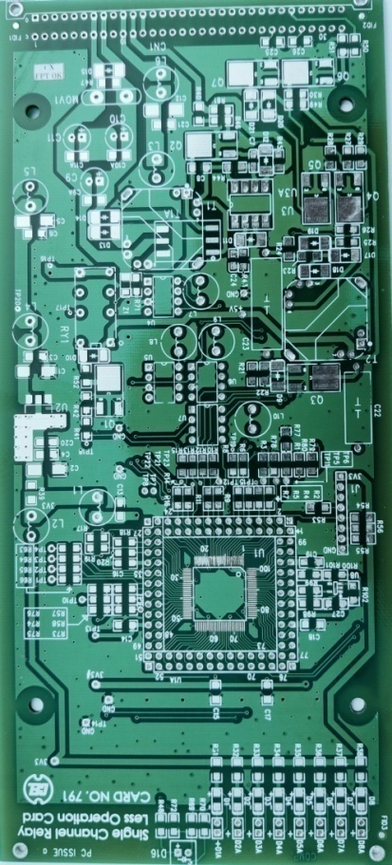
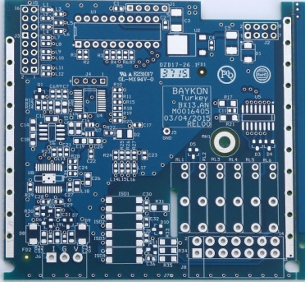
OUR PRODUCTS
Double Side PCB
Double Side, 0.8-3.2 mm,FR4,Glass Epoxy, 35-70-105 µm FINISH Cu thickness, GREEN,WHITE,RED,BLUE
,BLACK MASKING, WHITE / BLACK Legend, BBT/FPT, HAL Finish[SMOB]
WWW.REEYAACIRCUIT.COM

Slide 8

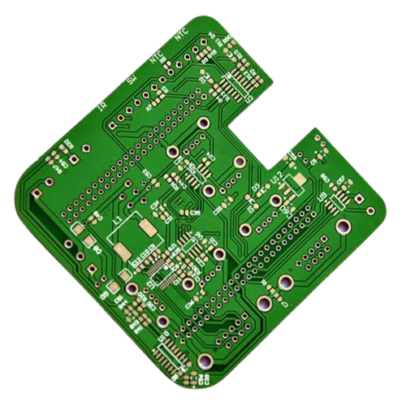
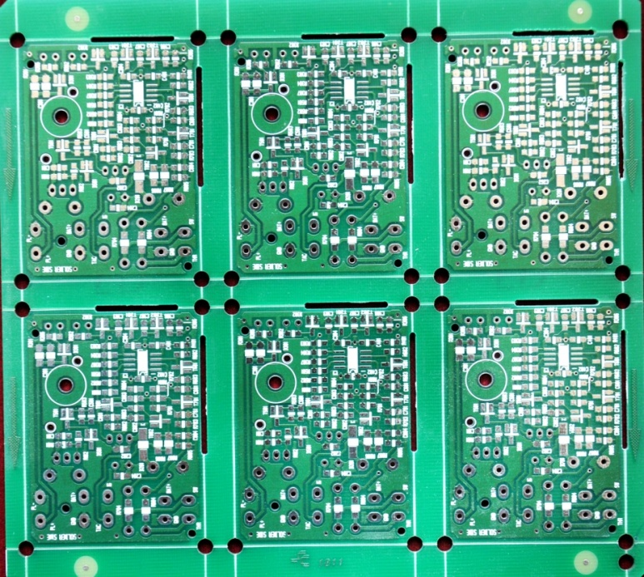
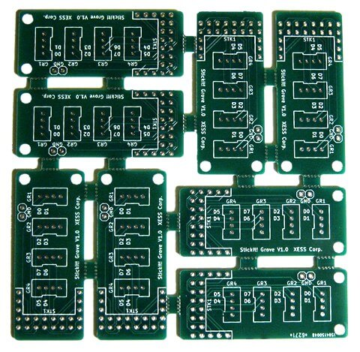
OUR PRODUCTS
Double Side PCB :- PANELIZATION WITH CNC ROUTING
Double Side, 0.8-3.2 mm,FR4,Glass Epoxy, 35-70-105 µm FINISH Cu thickness, GREEN,WHITE,RED,BLUE,BLACK MASKING, WHITE Legend, BBT/FPT, HAL Finish[SMOB]
WWW.REEYAACIRCUIT.COM

Slide 9
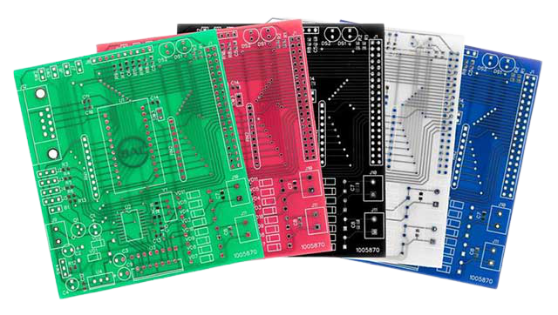
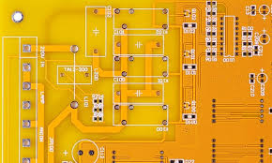
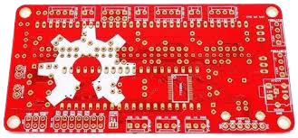
DIFFERENT COLOURS
Black Mask
White Mask
Pink Mask
Blue Mask
Green Mask
Yellow Mask
Red Mask
DIFFERENT COLOURS OF PCB
Are You Looking for a PCB Sample in 24 Hours? Kindly Contact Us.
WWW.REEYAACIRCUIT.COM

Slide 10
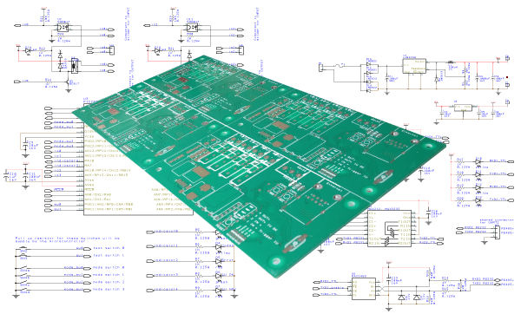
OUR SERVICES
PCB Design
Layout Design From Schematic
WWW.REEYAACIRCUIT.COM

Slide 11
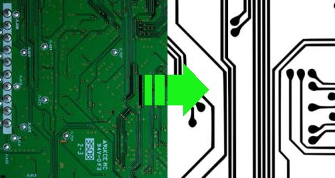
OUR SERVICES
Reverse Engineering
CHOOSE reeyaa circuit and electronics (opc) pvt.ltd.FOR YOUR PCB ENGINEERING SOLUTIONS
WWW.REEYAACIRCUIT.COM

Slide 12
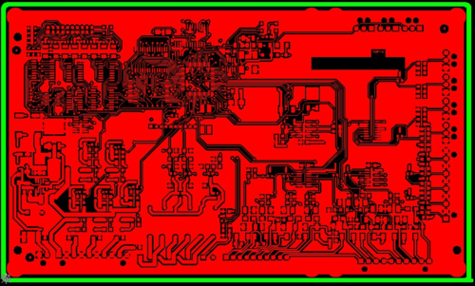
OUR SERVICES
PCB CAM Work
PCB CAM For Pre Production
WWW.REEYAACIRCUIT.COM

Slide 13
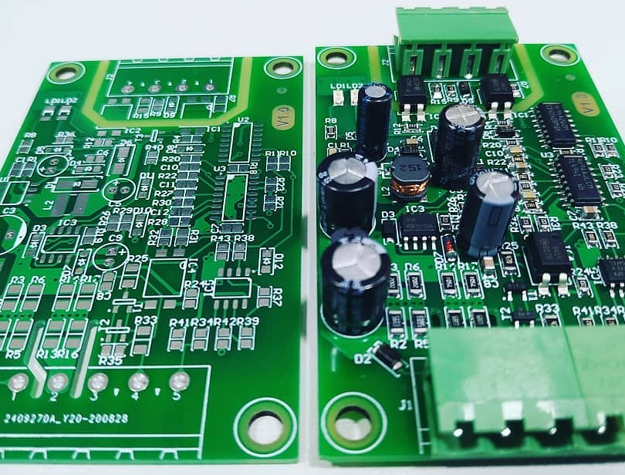
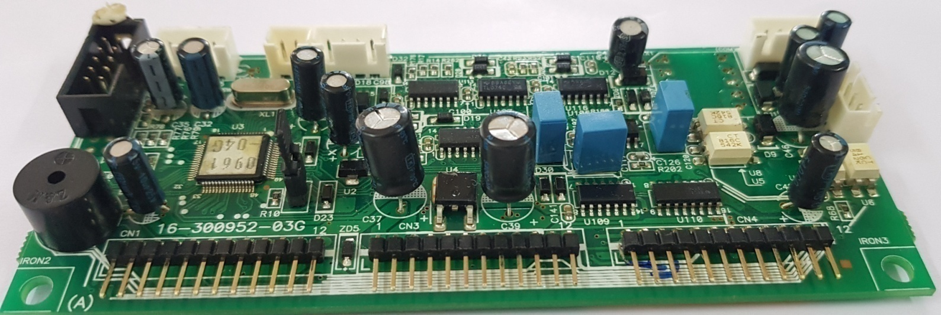
OUR SERVICES
Assembling PCB
Through-Hole Technology (THT) Assembly Process,
Surface Mount Technology (SMT) Assembly Process,
Mixed Technology
WWW.REEYAACIRCUIT.COM

Slide 14
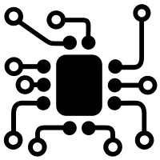

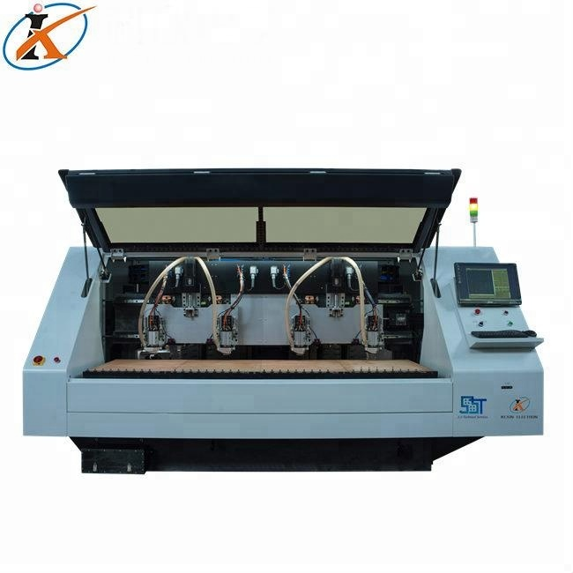
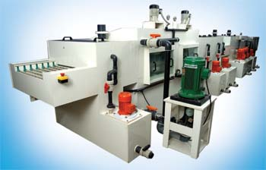
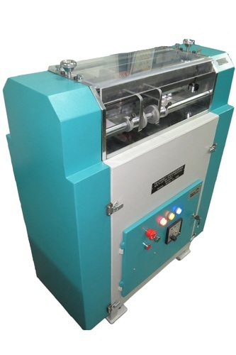
PART OF PRODUCTION MACHINES
Etching Machine
V- Scoring
Drilling
WWW.REEYAACIRCUIT.COM

Slide 15
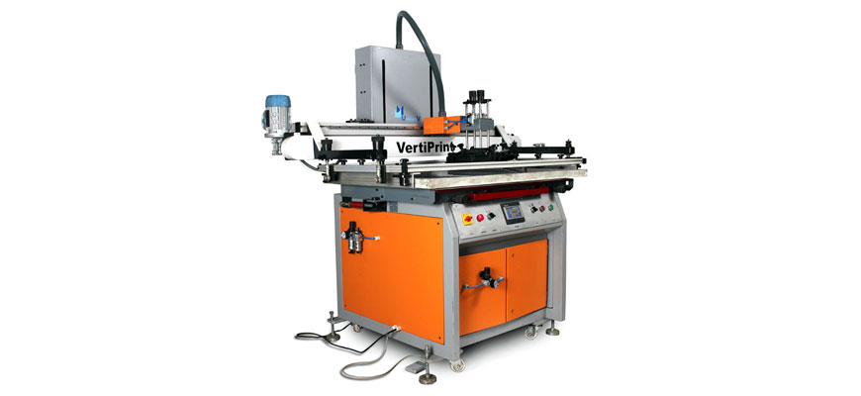
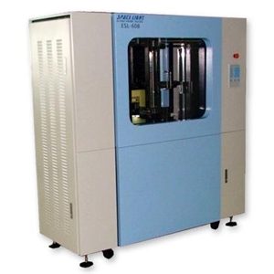
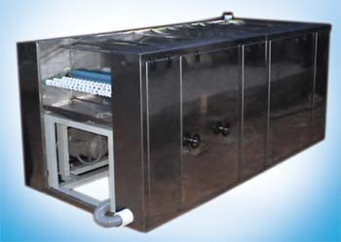
PART OF PRODUCTION MACHINES
Auto Screen Printing
Electrical Testing [FPT/BBT]
Deburring Machine
WWW.REEYAACIRCUIT.COM

Slide 16
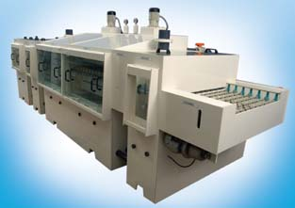
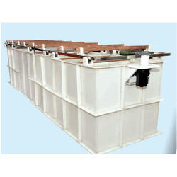
PART OF PRODUCTION MACHINES
Dry film Stripping Machine
Electro Plating line
WWW.REEYAACIRCUIT.COM

Slide 17

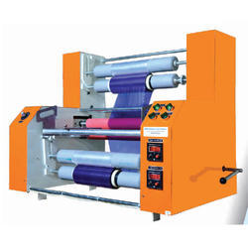
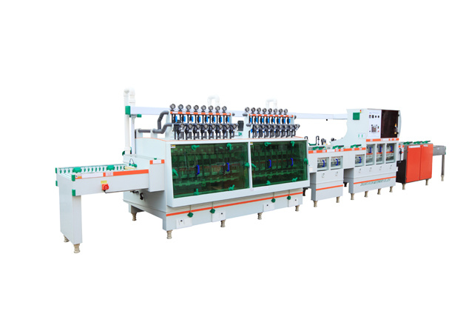
PART OF PRODUCTION MACHINES
DRY FILM LAMINATOR
P.T.H LINE
WWW.REEYAACIRCUIT.COM

Slide 18

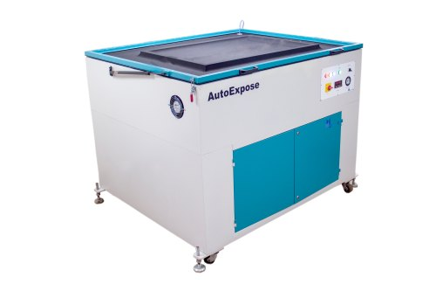
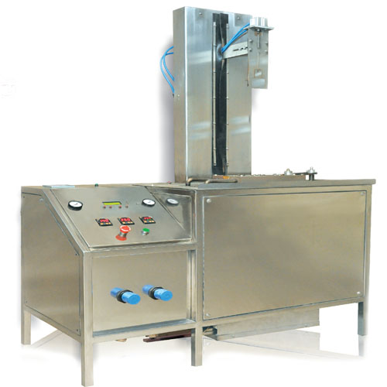
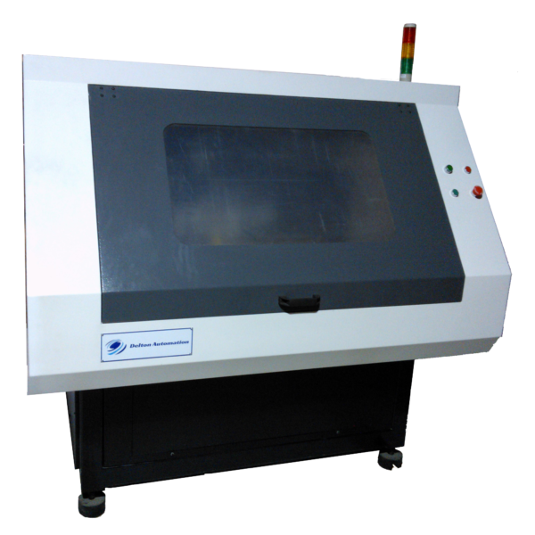
PART OF PRODUCTION MACHINES
UV LED SCREEN EXPOSING
HAL
[ Hot Air Leveling]
CNC ROU
[ Routing / Profiling ]
WWW.REEYAACIRCUIT.COM

Slide 19
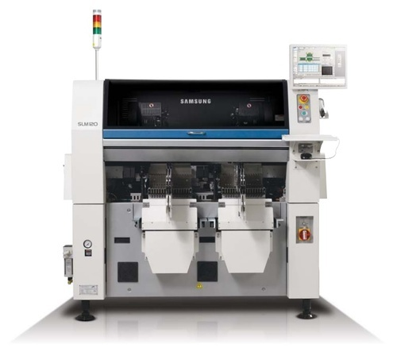
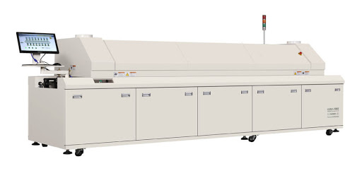
PART OF PRODUCTION MACHINES
SMT PICK AND PLACE MACHINE
REFLOW CURING OVEN
WWW.REEYAACIRCUIT.COM

Slide 20

OUR CAPABILITY
Sr.No | Technical Specification | Single Side | Double Side
1 | Lead time | 24 hour’s, 3 days, 5 days, 7 day’s | 24 hour’s, 3 days, 5 days, 7 day’s, 10, 15 , 21days
2 | Material | FR1,FR4, CEM1, CEM3, Paper Phenolic, Metal Clad(Al) | FR4
3 | PCB Thickness (mm) | 0.4, 0.8, 1.0, 1.2, 1.6, 2.0, 2.4, 3.2 | 0.4, 0.8, 1.0, 1.2, 1.6, 2.0, 2.4, 3.2
4 | Finish Copper Thickness | 1 oz (35 µ), 2 oz (70 µ), 3 oz(105 µ) | 1 oz (35 µ), 2 oz (70 µ), 3 oz(105 µ)
5 | Maximum Board size | 400 X 500 mm | 400 X 500 mm
6 | Minimum Track Width | 4mil(0.1 mm) | 4mil(0.1 mm)
7 | Minimum Finish Hole size | 10mil(0.25mm) | 10mil(0.25mm)
8 | Maximum Finish PTH Hole size | 240 mil(6 mm) | 240 mil(6 mm)
9 | Cutting Option | Routing , V groove , Punching | Routing , V groove , Punching
10 | Electrical Testing | BBT, FPT | BBT, FPT
11 | Mask colour | No mask, Green, Red, White, Black, Blue | No mask, Green, Red, White, Black, Blue
12 | Legend Colour | White, Black, No legend | White, Black, No legend
13 | Surface Finish | HAL, ENIG, OSP, Lacquer, Nickel | HAL, ENIG, OSP, Lacquer, Nickel
14 | Special Requirement | Carbon Printing on Push Button, Selective Gold & Nickel plating on Connecting Tabs
15 | ROHS Compliance | Yes |  | Yes
16 | ISO CERTIFICATE | APPLIED |  | APPLIED
17 | CE CERTIFICATE | APPLIED |  | APPLIED
WWW.REEYAACIRCUIT.COM

Slide 21

MANUFACTURING PROCESS
PROCESS FLOW CHART FOR DOUBLE SIDE PCB:-
Job Launching/ Sheet Cutting
Photo Imaging –Track
Electro Plating
CNC Drilling
P.T.H
Etching
Pre Engineering (CAD-CAM)
Sales /Marketing/ Order Accepts
Tin Stripping
Packing and Dispatch
Quality Control
BBT/F.P.T-Electrical Testing
V scoring/ Routing/ Final Cutting
Masking (PISM) + LP Print
HASL
WWW.REEYAACIRCUIT.COM

Slide 22


SOCIAL MEDIA
LIKE!
SUBSCRIBE!
@reeyaacircuit
@reeyaacircuit
FOLLOW!
FOLLOW!
@Riacircuit3219
@reeyaacircuit
FOLLOW!
CONTACT!!
@reeyaacircuit
+91 8799542514
WWW.REEYAACIRCUIT.COM

Slide 23

REEYAA CIRCUIT [Mfg. Printed Circuit board]
​REEYAA CIRCUIT AND ELECTRONICS (OPC) PVT. LTD. (RCEPL)
(​Manufacturer and Exporter of Printed Circuit Boards)
B-65, GIDC Electronic Estate, Sector-25,
Gandhinagar-382025, Gujarat.
Ph.079-29289049, Mob.:- 8799542514, 7567833664
Mail: sales@reeyaacircuit.com | reeyaacircuit.pcb@gmail.com
Website: www.reeyaacircuit.com
Are You Looking for a PCB Sample in 24 Hours? Kindly Contact Us.

